Slide 1
Faculty Assembly
January 23, 2026

Slide 2
Faculty Assembly (FA)
The Faculty Assembly is the elected body of representatives of the faculty of the campuses of the University of North Carolina. The chair of the FA is Wade Maki.
The Assembly gathers and exchanges information on behalf of the faculties of the campuses of the University of North Carolina, advises the Board of Governors, the General Assembly, and other governmental agencies, and communicates with the President.
Charlotte is allocated five delegates to the Faculty Assembly.

Slide 3
UNC Charlotte Faculty Assembly Delegates
Unit/Title | Representative | Dept. | College | Alternate | Alternate | Dept. | College | Term Start & End | Term Start & End
Faculty Assembly Delegates [three-year term]
Member | Karen Flint | HIST | CHESS | n/a |  |  |  | 8/11/25 |  | 5/15/28
Member | Lisa Walker | SOCY | CHESS | n/a |  |  |  | 8/11/25 |  | 5/15/28
Member | David Dalton | LANG | CHESS | n/a |  |  |  | 8/14/23 |  | 5/11/26
Member | Elizabeth Sullivan | MUSC | COAA | n/a |  |  |  | 8/14/23 |  | 5/11/26
Member (Past President or designee) | Xiaoxia Newton | EDLD | COED | n/a |  |  |  | 8/11/25 |  | 5/11/26
Alternate | Craig Allan | EEGS | CHESS | n/a |  |  |  | 8/11/25 |  | 5/11/26
Alternate | Ella Fratantuono | HIST | CHESS | n/a |  |  |  | 8/11/25 |  | 5/11/26

Slide 4
Our work
We have partnered with the UNC System and other campus reps on these items:
Faculty Realignment Incentive Program (FRIP)
Post-Tenure Review
Workload, Rewards & Recognition
Measurement of Teaching Effectiveness
Academic Program Review
Liberal Arts as Career Readiness
Professional Track Faculty

Slide 5
2025-2026 Initiatives
Artificial Intelligence Policy
Accreditation
Academic Freedom
Faculty Morale and Welfare
Liberal Arts
Efficiency survey results from last spring
Rapid response to UNC System such as syllabus policy.

Slide 6
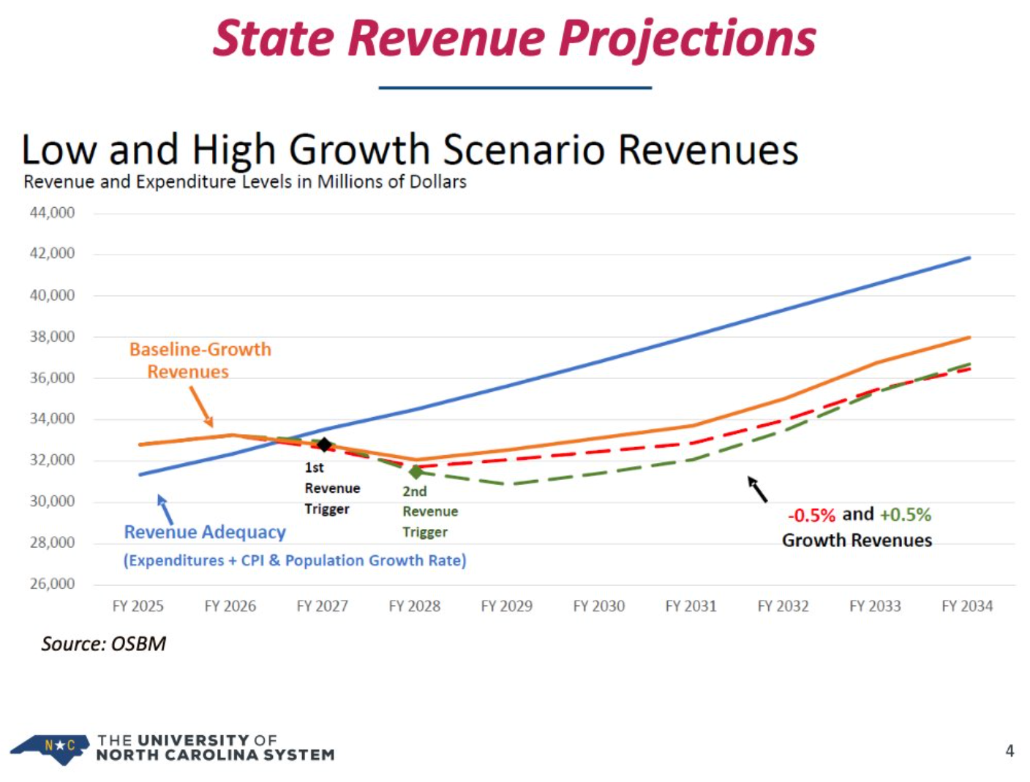
Notes January 23, 2026 FA Meeting
State Budget
General Assembly (House) and State Senate leadership remain deadlocked.
Mini-budget has allowed for continuing operations and allotments for NC Promise, building reserves, offset benefit rate increases, repairs and renovations, building reserves, but not salary increases besides promotions or for enrollment growth ($40 million we should have received as a System this cycle; ~$90 million for next cycle).

Slide 7
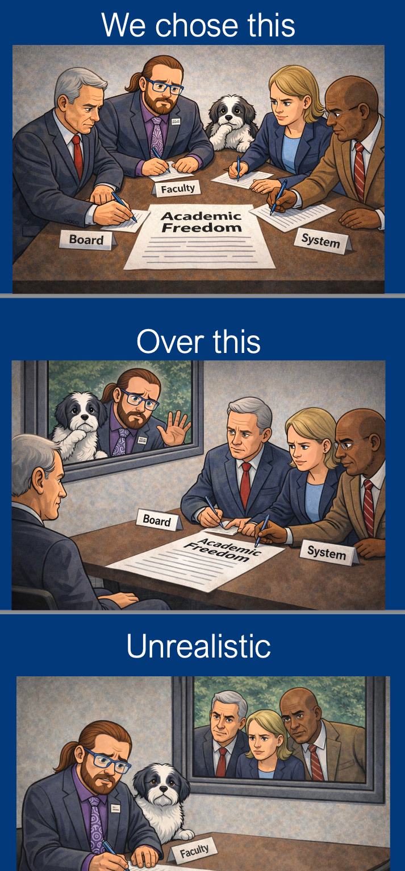
Notes from January 23, 2026 FA Meeting
Academic Freedom
Faculty Assembly’s definition of Academic Freedom
was presented by Chair Wade Maki at the November Board of Governors meeting.
In December, campuses received a draft Academic Freedom code modification (highest possible level of change, requires two-thirds majority on Board of Governors) from UNC System Office for a month of campus review and feedback.
FA feedback focused on getting System proposal (esp. 601.A.1-3) aligned with what we passed.
Draft that is going to the Board of Governors will be in Board of Governors (BoG) January meeting materials.
FA is working on one more round of feedback.

Slide 8
Academic Freedom Continued
Also, the BOG materials have posted. Here is a direct link to the Governance Committee where Academic Freedom will first be discussed (Item A-4): https://www.northcarolina.edu/apps/bog/doc.php?id=68628&code=bog
Faculty are encouraged to watch that committee live on Wednesday (it is not recorded)
Schedule of meetings: https://www.northcarolina.edu/apps/bog/doc.php?id=68624&code=bog
Livestream location: https://www.pbsnc.org/watch/unc-board-of-governors-meetings/
Korie Dean with The Assembly has published on Academic Freedom today: UNC System Could Set 'Parameters' for Academic Freedom

Slide 9
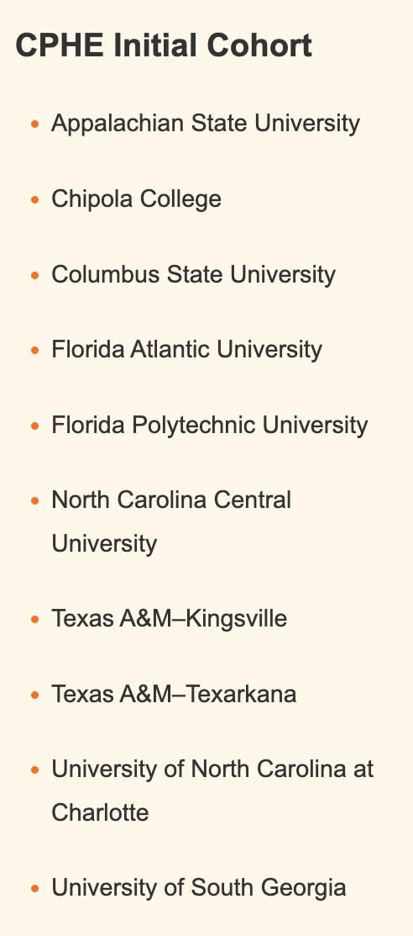
Notes from January 23, 2026 FA meeting
Accreditation
Commission on Public Higher Education
Initial pilot cohort of 10 schools announced.
Draft evidentiary guidance (“how to meet standards”) has been been provided to FREA for a “first look.” (FREA = a seven-state faculty working group. Wade Maki and Rob Taber are the UNC System reps.)
Draft evidentiary guidance will be sent out the first week of February for four weeks of public comment, including by the FA – please engage!
NOTE: Visit CPHE.org to get information on applying to be a peer reviewer.

Slide 10
Notes from January 23, 2026 FA meeting
Syllabi
December regulation came because of questions on whether syllabi are public documents (campuses disagreed), likelihood of legislative action.
Syllabi:
Faculty name & contact information is not required.
Full listing of every reading/video/podcast or other content is not required (only what is required for purchase which is already publicly available on websites).
The posting date is no later than one (1) week prior to the first day of classes for the applicable semester. It is important for you to review your campus syllabus policy (if you have one) to ensure alignment

Slide 11
Syllabi (contd.)
Next steps for Charlotte campus conversations:
Faculty Academic Policy and Standards Committee (FAPSC) – Review/ align campus syllabus requirements
Determining collection/posting processes; moving course schedules behind logins.
Distributing other info in Canvas? (Only one “syllabus”)
What to do if a public records request is received

Slide 12
FAPSC Members
Faculty Academic Policy and Standards Committee (FAPSC) [two-year term]
Chair | Mira Frisch | MUSC | COAA | n/a |  |  | 8/12/24 | 5/11/26
Arts + Architecture | Meredith Magoun | THEA | COAA | Hali Hutchison-Houk | PAS | COAA | 8/11/25 | 5/10/27
Business | Faith Neale | FINN | COB | Jack Cathey | ACCT | COB | 8/15/22 | 5/11/26
Computing & Informatics | Sunshine Niu | SIS | CCI | Meera Sridhar | SIS | CCI | 8/11/25 | 5/10/27
Education | Luke Reinke | REEL | COED | Lisa Merriweather | EDLD | COED | 8/11/25 | 5/10/27
Engineering | Kimberly Warren | CEE | COE | Arindam Mukherjee | ECE | COE | 8/12/24 | 5/11/26
Health & Human Services | Susan Lynch | NURS | CHHS | Susan McCarter | SOWK | CHHS | 8/12/24 | 5/11/26
Humanities & Earth and Social Sci. | Olga Padilla-Falto | LANG | CHESS | vacant |  |  | 8/11/25 | 5/10/27
Humanities & Earth and Social Sci. | Ralf Thiede | ENGL | CHESS | vacant |  |  | 8/12/24 | 5/11/26
Science | Alan Dow | MATH | COS | Brian Cooper | CHEM | COS | 8/12/24 | 5/11/26
Library | Ryan Harris | LIB | LIB | Doug Short | LIB | LIB | 8/11/25 | 5/10/27
Undergrad. Student (selected by SGA) | Ryan Zimmerman | SGA | SGA | n/a |  |  | 8/11/25 | 5/11/26
Grad. Student (selected by GSA) | Corwin Keys | GSA | GSA | n/a |  |  | 8/11/25 | 5/11/26

Slide 13
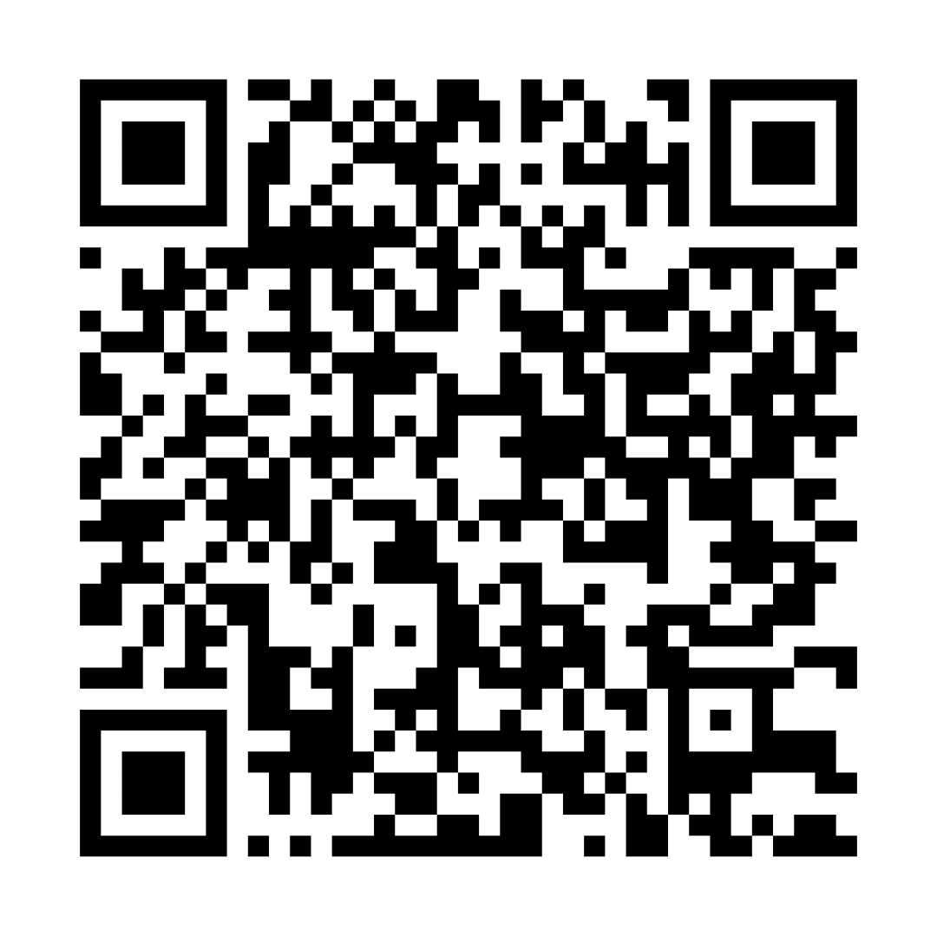
Notes from January 23, 2026 FA Meeting
Faculty Safety
Guidance and reminders from the UNC System Office:
There’s a Cyber Hygiene resource document that also links to campus-level resources. (QR code on this slide.)
If you receive emails that are unusual or threatening, alert campus IT.
Campus public safety chiefs are also available to do trainings.

Slide 14
Notes from January 23, 2026 FA Meeting
Public Scrutiny and Free Inquiry
UNC System concerned about the way technology and culture have combined to fuel surveillance culture, reduced student willingness to engage in classroom conversation, increased student/faculty fear.
If targeted by an online harassment campaign, get offline. Don’t feed the trolls. Campuses have procedures for monitoring threats—let IT/Security know so they can provide support.
Often, it’s better if university administrators don’t make public statements, as these can fan the flames and have the harassment campaign last longer.

