Slide 1
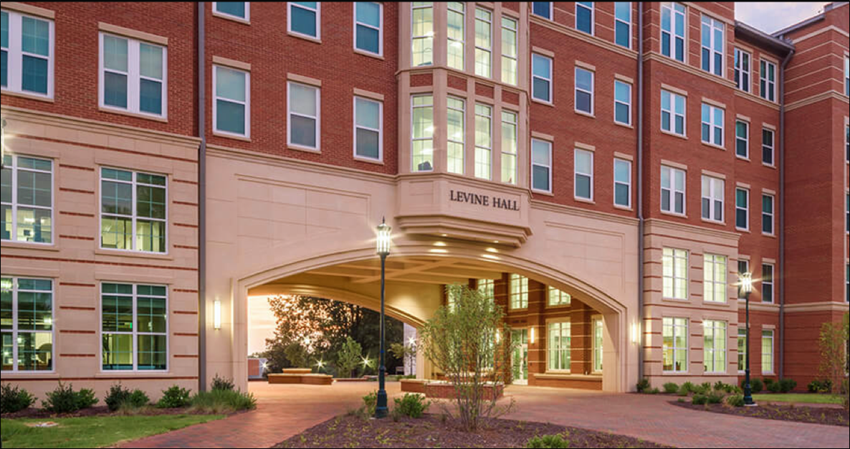
Honors Council Report
2024-2025

Slide 2
Honors Council Members
 | Representative | Alternate
COAA | Dylan Savage | Ann Dils
COB | Jackie Robinson | Theresa Mannah-Blankson
CCI | Jake Lee | Heather Lipford
COED | Adriana Medina | Drew Polly
COE | Meg Harkins | HaiTao Zhang
CHHS | *Laura Magennis | Amy Peters
CHESS | Victoria Rankin | Jennifer Webb
CHESS | Vaughn Schmutz | John Szmer
COS | Susan Trammell | Andrew Goff
PHS/At-Large | Pilar Zuber | Jackie Chattopadhyay
LIBRARY/At-Large UHP | *Abby Moore | Kaus Sarkar
SPED/ At-Large UHP | Erin FitzPatrick | Rebecca Shore
Student Representative | MaKenna Jordan | Madi Adams
Ex-officio non-voting members:
Malin Pereira (Dean, Honors College)
Cindy Gilson (Associate Dean, Honors College)
Colette Chenault (Administrative Support Associate)
* Honors Council Co-Chair

Slide 3
2024-2025 Highlights:
Regular Business:
Honors Faculty Review Committee
55 applications; 51 appropriate for review.
27 new apps, 28 renewals
48 approved
Honors College Evaluation Committee (Evaluation Reports for Dean and Associate Dean)
Honors Curriculum Committee
15 course proposals
5 program revisions

Slide 4
Governing document for The Structure and Election Process for the Honors Council updated on the Honors College Honors Council website (Office of the Provost). 3rd bullet of FAQ corrected to include changes were made in previous academic year regarding committee structure.
Governing document for The UNC Charlotte Academic Policy: Honors Program updated on the Honors College Honors Council website to include changes that had been approved in the previous academic year. (e.g., 13 members rather than 11; and Associate Dean to serve as Faculty Advisor).

Slide 5
2023-2024 Highlights:
Pillar questions for course evaluation questions were analyzed; four pillar questions selected and open-ended questions added.
Documents were endorsed for workload, evaluation, reappointment, and promotion of faculty lines at the Honors College. Will be submitted to the Associate Provost for Faculty Affairs for final adoption.
MaKena Jordan - Student Survey
126 respondents
64% rated their satisfaction with the Honors program as satisfied or extremely satisfied; 28% rated as somewhat satisfied.
81% listed “priority registration” as one of the most valuable benefits of honors. “Access to scholarships” and “being in a community of academically motivated peers” were also frequently selected benefits.

Slide 6
Thank you!
Questions?
Laura Magennis (Laura.magennis@charlotte.edu )
Abby Moore
(amoor164@charlotte.edu )

