Slide 1
Faculty Athletics Representative Report
Michael J. Turner, PhD
Applied Physiology, Health, and Clinical Sciences

Slide 2
What is a Faculty Athletic Representative?
University’s Faculty Representative to NCAA and AAC
Liaison between Faculty/Administration and Student-Athletes/Athletic Department
Understand current key issues within Collegiate Athletics
Name, Image, and Likeness (NIL) and Transfer Portal
Work with the Student-Athlete Advisory Committee (SAAC)

Slide 3
Charlotte Athletic Performance
Last Academic Year – Teams won 5 championships (19) in the American Athletic Conference (AAC)
Men’s Tennis
Softball
Men’s Soccer
Women’s Indoor and Outdoor Track & Field

Slide 4
Last 12 Month Coaching Changes
Volleyball – Benavia Jenkins (was coaching at Michigan)
Women’s Basketball – Tomekia Reed (Jackson St. Univ.)
Softball – Courtney Breault (Clemson)
Women’s Soccer– Sinead Byrne (Interim, Savannah A&D)
Football – Tim Albin (Ohio Univ.)

Slide 5
Charlotte Academic Performance
 | Spring 24 | Fall 24
Semester GPA | 3.21 (3.13) | 3.20 (3.11)
Cumulative GPA | 3.29 (3.20) | 3.24 (3.18)
Student-Athletes 3.00+ GPA | 63.2% | 68.0%
Student-Athletes 4.00 GPA | 19.5% | 17.7%
(University Mean)

Slide 6
Charlotte Academic Performance
Spring 2024, top Semester GPAs were Women’s Tennis (3.84) and Men’s Tennis (3.43)
Fall 2024, top Semester GPAs were Volleyball (3.71), Softball (3.67), and Women’s Soccer (3.66)
3 other teams above 3.5 (Men’s and Women’s Tennis, Women’s Golf)

Slide 7
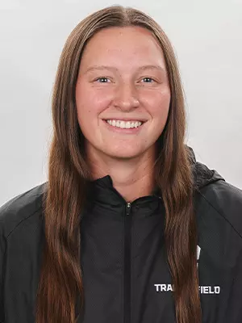
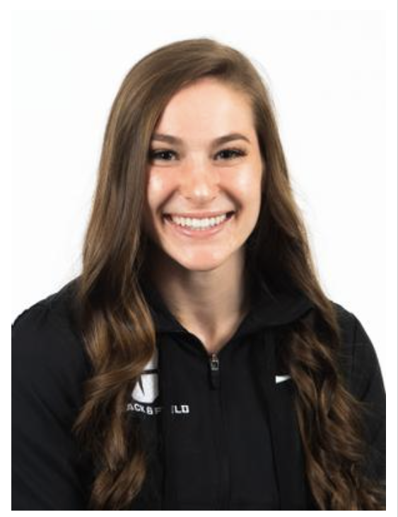
Charlotte Academic Performance
Elizabeth (Lizzy) Bailey (Javelin)
2024 Olympic Trials
Majoring in Meteorology (3.92 GPA)
Riley Felts (Pole Vault)
AAC Scholar-Athlete of 2024
NCAA Woman of the Year (Finalist)
NCAA Today’s Top 10
Completed Master’s in Civil Engineering

Slide 8
Charlotte Athletic Academic Issues
Second Half Semester Courses
Undergraduate Non-Degree Seeking Program
1 Year Master’s Degree/Certificate Programs
When S-As are Added to Courses during Drop/Add Period
Mandatory Attendance Opportunities
Previous Assignment Opportunities

