Slide 1
Understanding and supporting mental health needs of UNC Charlotte students
Faculty Council 2014

Slide 2
Some findings
Mental health related to:
Retention and graduation rates
Academic functioning
Graduation rates

Slide 3
UNC Charlotte students
Within the last 12 months:
Felt things were hopeless – 44.7%
Felt so depressed it was difficult to function – 30%
Felt overwhelming anxiety – 47.7%
Source: National College Health Assessment, spring 2013, n=1,171
Notes:
Extrapolating to a population of 24,700 students: over 7000 students who felt so depressed it was difficult to function and almost 12,000 with overwhelming anxiety.

Slide 4
UNC Charlotte students
Factors affecting academic performance (incomplete, dropped course, poor grade):
Stress 27.5%
Sleep difficulties 18.8%
Anxiety 18.6%
Depression 11.9%
Concern for troubled friend or family member 10.4%
Source: National College Health Assessment, spring 2013, n = 1,171
Notes:
Extrapolating to a population of 24700 students: over 5, 000 students that had so much anxiety that it lead to poor academic performance

Slide 5
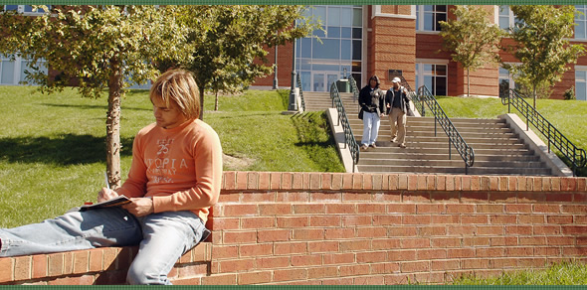
Students who use the Counseling Center
Either prior to college, after starting college, or both, students report that they have:
Had prior counseling 49%
Taken medication for mental health 39%
Considered attempting suicide 30%
Used self-injury (e.g., cutting) 17%
Made a suicide attempt 10%
Been hospitalized for mental health 8%
Had alcohol or drug abuse treatment 4%
Source: UNC Charlotte Standardized Data Set, 2012-2013

Slide 6
Presenting concerns
Anxiety (generalized, social)
Depression (recurrent, moderate)
Relationship issues (with partners, parents)
Post-traumatic stress

Slide 7
Outcome
Percentage of clients rating problems as “major” or “significant”:
Problem | Start of counseling | After counseling
Depressed mood | 61% | 16%
Anxiety | 64 | 20
Hopelessness | 45 | 9
Sleep problems | 44 | 15
Concentration | 48 | 19
Relationships | 59 | 17
Eating issues | 11 | 5
Academic performance | 29 | 12

Slide 8
Outcome: 2012-13
85% of all clients agreed or strongly agreed: “I feel more hopeful about my future as a result of the counseling I received.”
Over 21% of clients: “I was thinking of leaving UNC Charlotte before starting counseling.”
75% of those agreed or strongly agreed: “Counseling helped me stay in school.”
Over 30% of clients: “I was having significant academic problems before I started counseling.”
73% of those agreed or strongly agreed” “Counseling helped me improve my academic performance.”

Slide 9
How faculty can help
Identify and approach students who may be experiencing psychological distress
Consult with counseling staff when you have questions
Refer students who may be in psychological distress

Slide 10
Resources for faculty
http://counselingcenter.uncc.edu/home/concerned-about-a-student
Signs and symptoms of distress
Guidelines for responding
Consultation
Referral guidelines

Slide 11
Resources for faculty
Consultation services
One-on-one consultation with a counselor about how to respond to students of concern
In person or by phone
Counselor on call each business day
Presentations and discussion at department faculty meetings or with other groups

Slide 12
Resources for faculty
Response to traumatic events
Counselors available to do classroom presentations on trauma response and counseling services
Individual consultations
Online mental health resources

Slide 13
Gatekeeper Training
Resources for faculty
Fast, convenient, engaging
Completed in 45-minutes--in one or more sittings
Access online, 24/7
Simulation format: Learn through virtual role-play
Practice having conversations with up to 5 virtual students
Notes:
After thorough research of Gatekeeper training options, we have selected and invested in an innovative online training course called At-Risk. Understanding the time crunch that all faculty share, we have chosen this training because it is fast, convenient and engaging - it can be executed in multiple sessions and can be revisited as needed (while license is valid). The At Risk training is delivered in the form of a simulation, where you take on the role of a … yes, university professor who has concerns about several of his students.

Slide 14
Questions?
704-687-0311
http://counselingcenter.uncc.edu

