Slide 1
Innovation & Entrepreneurship at UNC Charlotte
Faculty Council 11/17/2016
Paul Wetenhall | paul.wetenhall@ventureprise.org

Slide 2
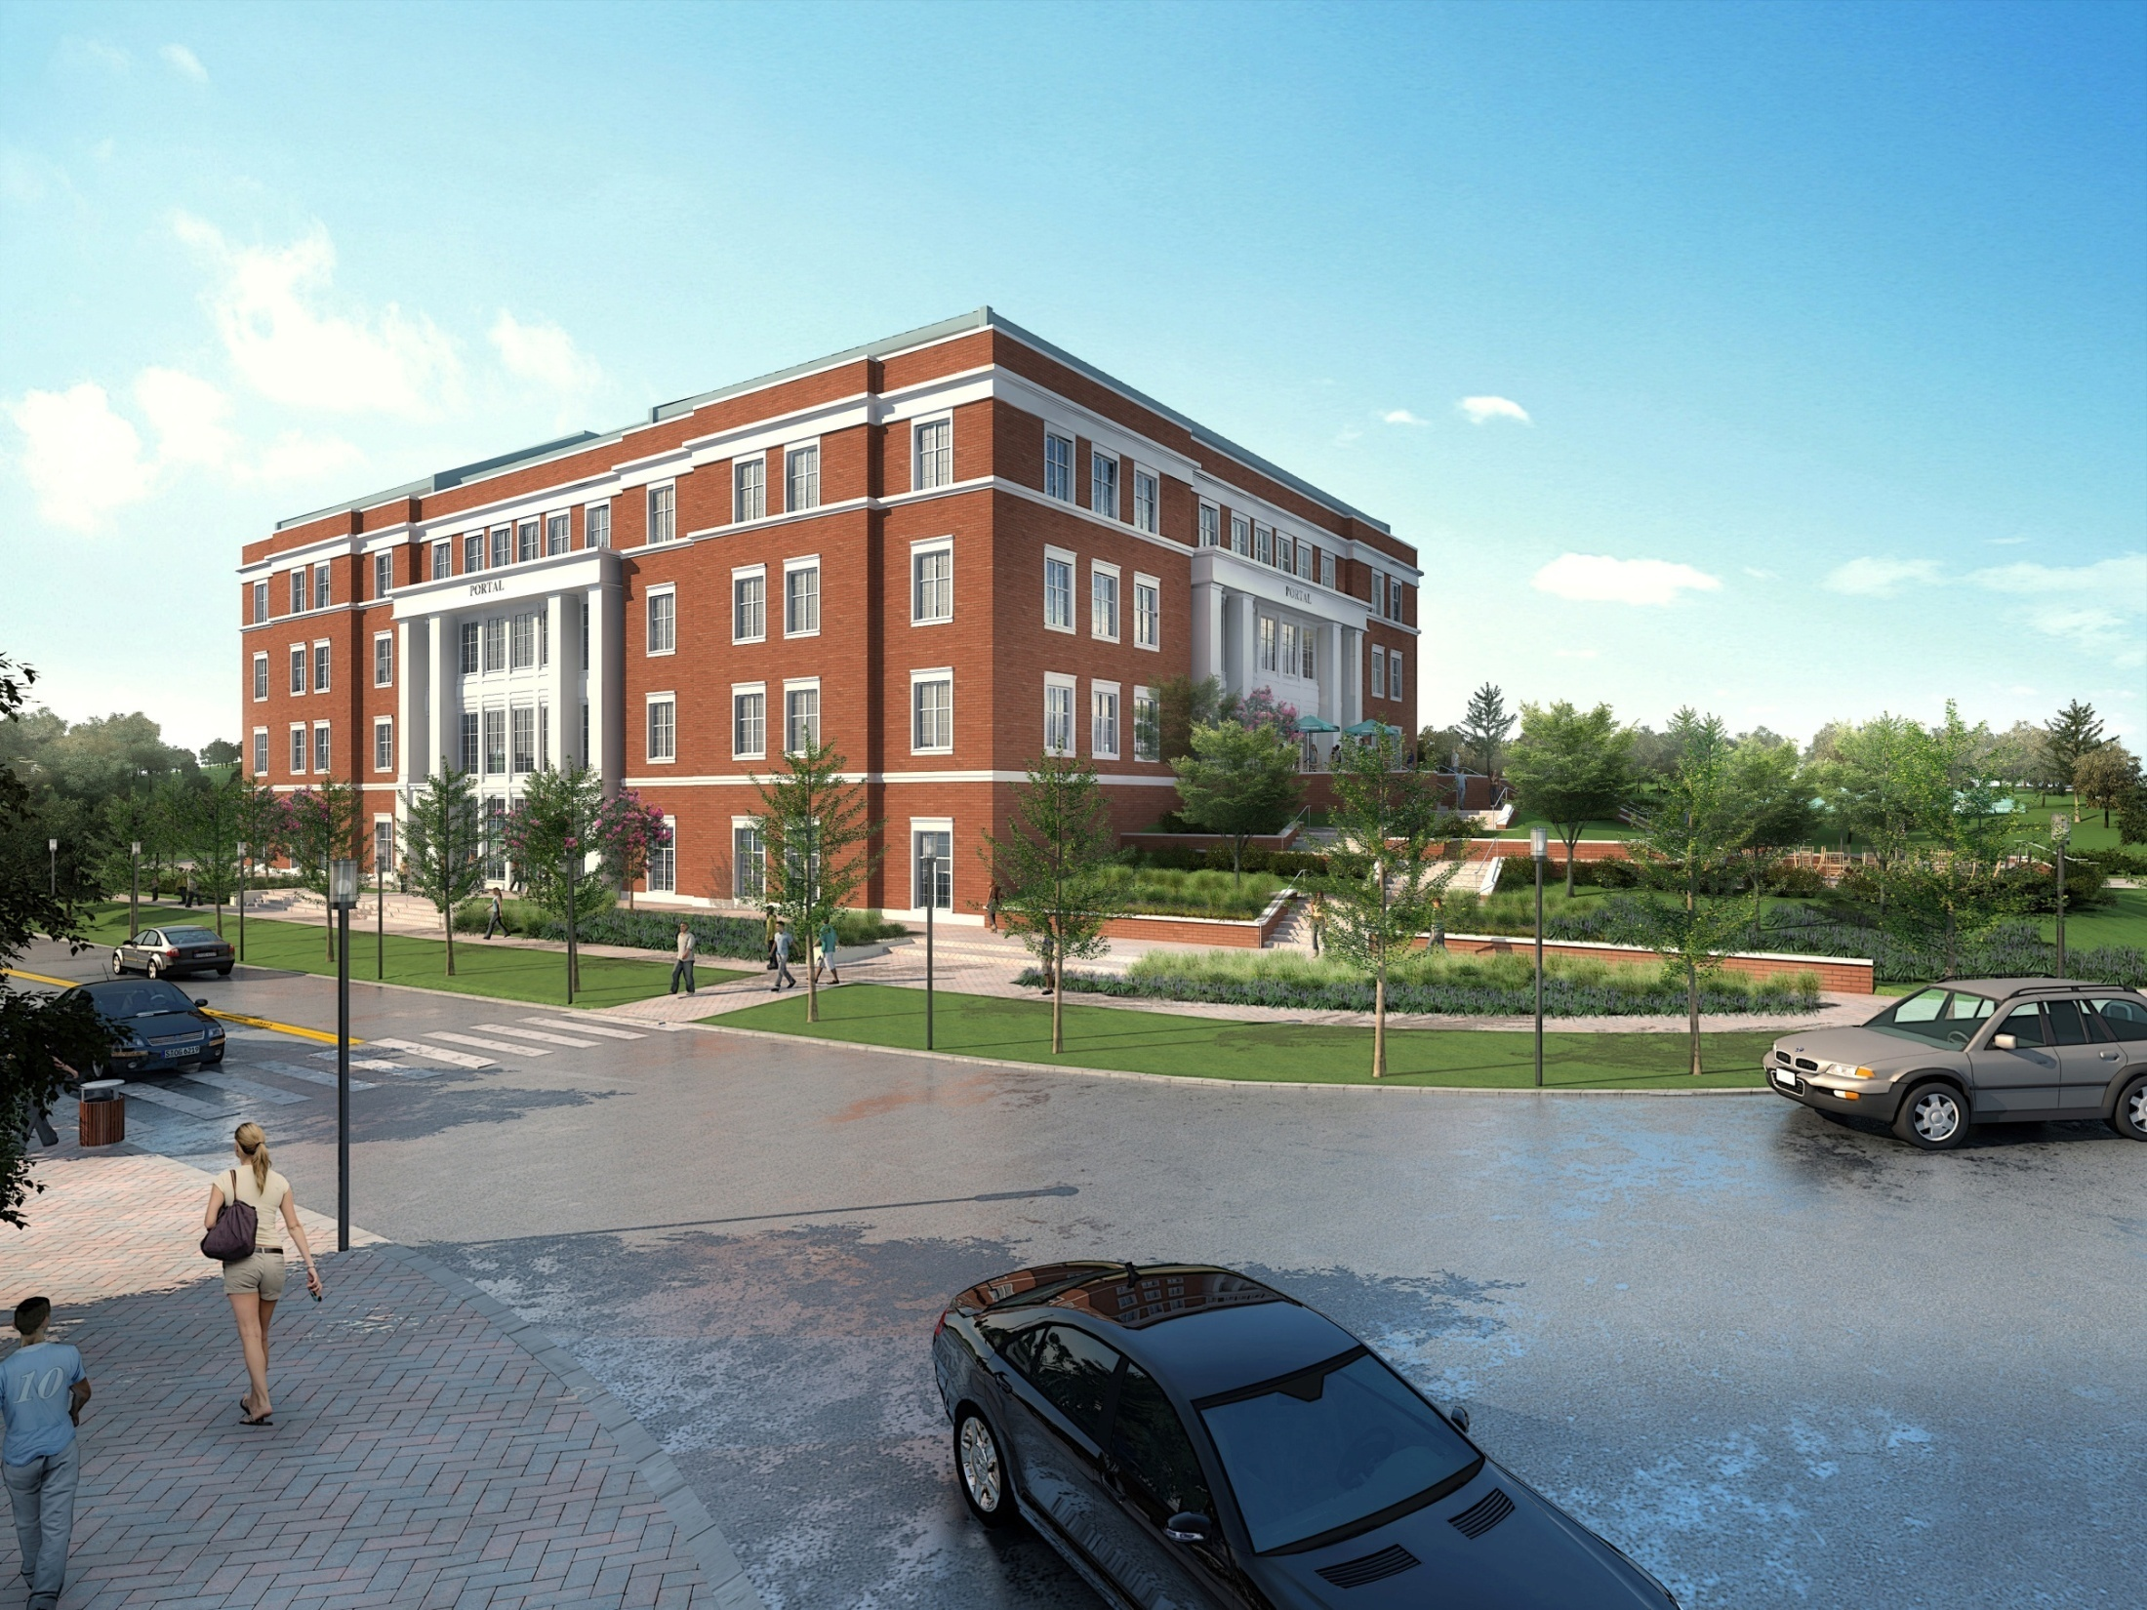
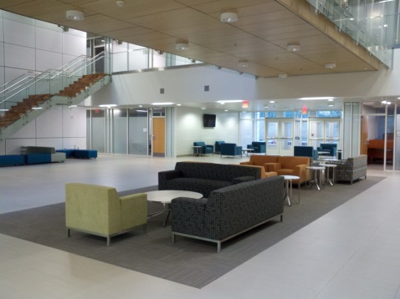
Ventureprise
Venture Development Organization
UNCC Research & Economic Development
Non-profit with community & university board
Focus on university innovation and entrepreneurship
Transformative entrepreneurship will change student lives and support accelerated UNCC research growth
Strong UNCC entrepreneurship will support Charlotte community economic opportunity
Experiential & inter-disciplinary
Resources
PORTAL university-industry collaboration
NSF National Innovation Network
Paul Wetenhall, Devin Collins, Carolyn Smith (PORTAL #252, X70900)

Slide 3
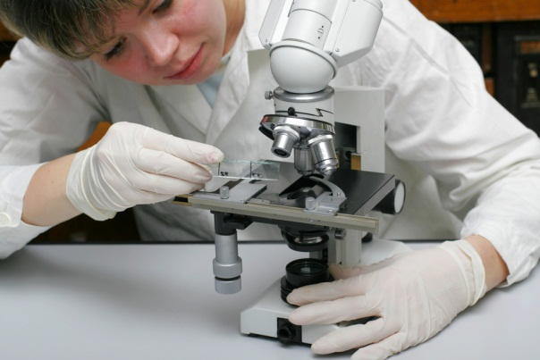
Faculty & Researchers
Ventureprise can help
Expand access to funding
Improve opportunity to commercialize research
Support innovation-driven startups
NSF I-Corps Site
UNC Charlotte only Site in NC or SC
National Innovation Network of 51 universities
Purpose: accelerate commercialization
Evidence-based entrepreneurship
30 teams (student, faculty, mentor) annually
3 cohorts of 8-week customer discovery programs
Up to $3000 funding and NSF lineage for faculty and students
Positive outcomes lead to funding
I-Corps National $50K, NSF AIR-TT $200K, SBIR/STTR $500K+
Example: Video Collaboratory team of computing and dance

Slide 4
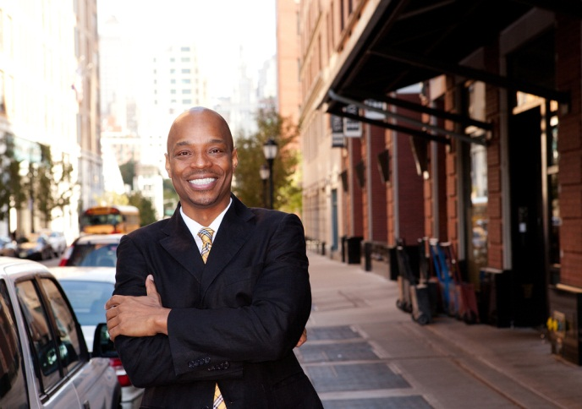
Students
Experiential entrepreneurship opportunities
I-Corps team participation
Typically, graduate student
Communication undergrad pilot program
UNC system social entrepreneurship competition
Spring semester
Student business incubator in PORTAL
Pursue business idea

Slide 5
Regional Engagement
Ventureprise Launch
Data & Policy Support
Charlotte Entrepreneur Growth Report
For Students
Core Expertise
For Faculty & Researchers
Experiential Programs to be defined
49 Innovators
[Innovation pipeline]
I-Corps Entrepreneur Lead [Fall, Spring, Summer]
I-Corps cohorts & funding [Fall, Spring, Summer]
UNC Social Entrepreneur Conf. & other events
49er Launchpad [Post I-Corps]
50 Universities
National Innovation Network
Commercialization
New Venture Creation
PORTAL office rental
ongoing incubation
Mentor Council
Community & UNCC Alumni support I-Corps, 49er Foundry, Fast Start
Collaboration

Slide 6
Topic | Contact
NSF I-Corps 49er Foundry Charlotte Venture Challenge | Devin Collins devin.collins@uncc.edu X78058
Ventureprise | Paul Wetenhall paul.wetenhall@ventureprise.org X78057

