Slide 1
Graduate Student Funding As-Is: Definitions and Concepts
Julie Goodliffe, Manuel Perez Quinones
Committee for Graduate Student Funding

Slide 2
Tuition & Fees Bill Per Semester
 | 0-2 cr hr | 3-5 cr hr | 6-8 cr hr | 9+ cr hr
North Carolina Resident Tuition | $542.25 | $1,084.25 | $1,626.50 | $2,168.50
Non-Resident Tuition | $2,221.50 | $4,442.75 | $6,664.25 | $8,885.50
Total Fees* | $770.15 | $770.15 | $1,167.25 | $1,642.00
Health Insurance | $1,313.50 | $1,313.50 | $1,313.50 | $1,313.50
Many Programs’ Tuition Increment (e.g. CCI) | $500.00 | $1,000.00 | $1,500.00 | $2,000.00
Total Resident | $2,625.90 | $3,167.90 | $4,107.25 | $5,124.00
Total Non-Resident | $4,305.15 | $6,526.40 | $9,145.00 | $11,841.00
Cost Per Credit (3, 6, or 9 cr) |  | $1,055.97 | $684.54 | $569.33
 |  | More expensive as part-time
* Fees include Ed & Tech, Safety and Security, University, 49er Card Access Misc. Service Charge, UNC System Assoc., Food Service Facilities Misc. Service Charge, Transportation Misc. Service Charge, and Health Services

Slide 3
The cost to complete a program is more expensive for part-time students
 |  | Total Cost for Degree
Typical Degree (program hours) | Residency | 6 credits per semester | 9 credits per semester
MS (~50 hours) | NC | $23,250 | $21,150
 | Nonresident | $65,250 | $58,500
Doctoral (~72 hours) | NC | $33,480 | $30,456
 | Nonresident | $93,960 | $84,240

Slide 4


Tuition, fees and increments are actual money spent; there is no “waiver”
Tuition, fees, health insurance, & tuition increment

Slide 5
Funding: UNC Charlotte provides money to help students fund their education
Tuition support: GASP and more
Graduate Assistantships: stipend salaries
GA Position Definitions
Student loans

Slide 6
For eligible doctoral students, GASP pays full tuition and the health insurance premium
Tuition & health insurance paid to student’s account
Tuition, fees, health insurance, & tuition increment

Slide 7
We also provide tuition money for eligible master’s students
Graduate School Grant: $2,000
Master’s Merit: $4,000 or $8,000
Tuition, fees, health insurance, & tuition increment

Slide 8


We fund 1,119 students with a program that was set up to pay for 282 students
282
Money for 282 students
837
1,119
Master’s and Doc
Tuition, fees, health insurance, & tuition increment

Slide 9
Funding: UNC Charlotte provides money to help students fund their education
Tuition support: GASP and more
Graduate Assistantships: stipend salaries
GA Position Definitions
Student loans

Slide 10

Graduate Assistantships pay salaries to students for work
Average doc: $15,728
Average master’s: $7,452
Tuition and health insurance paid to student’s account
Tuition, fees, health insurance, & tuition increment

Slide 11
Graduate Assistantships pay salaries to students for work
Average doc: $15,728 - $3,284 = $12,444 taxable income
Average master’s: $7,452 - $3,284 = $4,168 taxable income
Tuition and health insurance paid to student’s account
Tuition, fees, health insurance, & tuition increment

Slide 12
Funding: UNC Charlotte provides money to help students fund their education
Tuition support: GASP and more
Graduate Assistantships: stipend salaries
GA Position Definitions
Student loans

Slide 13
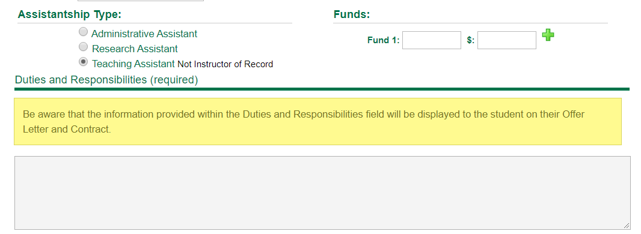
What is the work? eGA asks for a Type and Duties and Responsibilities that appear in the student’s contract
Anything can be written here… there are no rules about the number of supervisors, number of contact hours (for TA), nature of the work, etc.

Slide 14
Where does the TA/RA money come from?
Average doc: $15,728
Average master’s: $7,452
$13 million from the University for 826 TAs, 593 RAs, 98 AAs (1,517)
$5.0 million from grants/contracts for 510 RAs

Slide 15
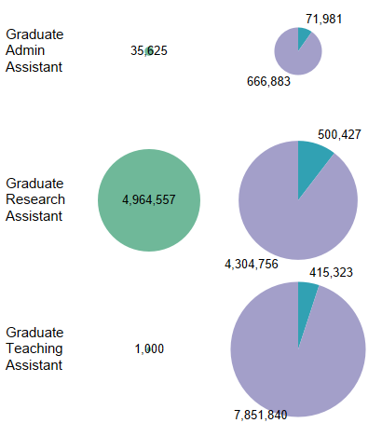
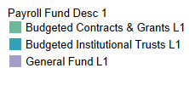
Grant funds pay RAs, Institutional funds pay TAs, AAs, AND RAs
Grant Funds
Institutional Funds
*Pie size is determined by distinct count of TA, RA or AA appointment

Slide 16
RAs funded by the University – what is the mission? What are the rules?
Human Resources insists on federal minimum wage
GASP eligibility requires $7,000/year stipend
No other rules exist, except for the 205 TA/RA “Positions” managed by the Graduate School:
  20-hours
  One supervisor
  Full academic year
  $18,500 stipend for doctoral students
  $14,000 stipend for master’s students

Slide 17
Graduate Assistantships pay salaries to students for work – but it’s not a living wage
Average doc: $15,728 - $3,284 = $12,444 taxable income
Average master’s: $7,452 - $3,284 = $4,168 taxable income
Tuition and health insurance paid to student’s account
Tuition, fees, health insurance, & tuition increment

Slide 18
Funding: UNC Charlotte provides money to help students fund their education
Tuition support: GASP and more
Graduate Assistantships: stipend salaries
GA Position Definitions
Student loans

Slide 19
Students can borrow up to the Cost of Attendance minus EFC
 | NC Resident | Nonresident | International
Cost of Attendance | $24,700 | $38,982 | $38,982
GASP tuition and HI | $6,964 | $20,398 | $20,398
Stipend or EFC | On FAFSA? | On FAFSA? | $15,000
Remaining to show or borrow | $17,736 | $18,584 | $3,584

Slide 20
Students can borrow up to the Cost of Attendance minus EFC
 | NC Resident | Nonresident | International
Cost of Attendance | $24,700 | $38,982 | $38,982
GASP tuition and HI | $6,964 | $20,398 | $20,398
Stipend or EFC | On FAFSA? | On FAFSA? | $15,000
Remaining to show or borrow | $17,736 | $18,584 | $3,584
International students must show this much (depending on stipend) for just ONE year

Slide 21
Our agenda: find ways to implement the Funding Task Force recommendations
Subcommittee meets regularly to formulate implementation plans from recommendations
  Collect feedback from GPDs via meetings & online discussion forums
  Provide regular update to Associate Dean’s Council and Graduate Council
  Bring recommendations to Graduate Council for discussion/consideration
Discussion cycle:
  Proposal available for discussion for several weeks
  Subcommittee crafts formal proposal and presents to Grad Council
  GC discussion followed by possible vote for adoption

