Slide 1
Last DaTE of Attendance
September 26, 2019

Slide 2
New Requirements for F and U Grades
Beginning in Spring 2020, all instructors will be required to enter the last date of attendance/participation for all students with failing (F) or unsatisfactory (U) grades.
The Last Attend Date is required to comply with federal student financial aid reporting requirements. This is because a student cannot receive financial aid for a course he or she did not attend.
Students who received an F or U may have to pay back their financial aid funds depending on their last date of attendance.
Notes:
Faculty, staff, and teaching assistants listed as an instructor and entering grades

Slide 3
Why is this required for all students?
The US Dept of Education requires the Office of Financial Aid to determine if a student who receives financial aid and fails to earn a passing grade in a course has actually attended and/or completed the course.
75% of our student population receives some form of financial aid. A student could become a financial aid applicant at any point during the academic year, therefore this information must be collected for all students. Plus, financial aid status is private information and is not identified to faculty members.
A student cannot receive financial aid for a course he or she did not attend. For students who received an F or U, we use the last date of attendance to determine:
  ​if they attended the class for the entire semester and "earned" those grades, or
  if they attended all or part of the semester, to determine how much financial aid the student will have to pay back.
Notes:
Significant financial repercussions of not complying with § 34 CRF 668.21
University of Tennessee: $2M finding
George Stone Area Vocational Technical Center: $500K finding
Hillsborough Community College (HCC): $90K finding
Southern University at New Orleans: $37K finding

Slide 4
Participation Examples
The date should be the last date on record that the student attended or participated in your class.
Options include:
  physically attending/participating in a class activity
  electronic attendance (ex: Poll Everywhere, attendance module in Canvas, Connect class attendance feature)
  participating in an online discussion or activity about academic matters
  attending a study group assigned by the instructor
  submitting an assignment/project/test/tutorial/quiz
  initiating contact with instructor to ask a question about the course or course content
Note: Even if your class is an online or distance education course, the student simply logging into an online course or viewing a page does NOT count.

Slide 5
Attendance Scenarios
Scenario | Self-Service Banner Guideline | Canvas Guideline
No academic-related activity in course. Don’t know if student attended | Enter the first day of class in Last Attend Date and enter a zero (0) in Attend Hours. | Check the ‘Did not attend’ box. This will auto-populate the day prior to the first day of classes.
Academic-related activity recorded, however did not complete course | Enter date of last academic-related activity | Enter date of last academic-related activity
Attended course and completed final exam | Enter last date of semester | Enter last date of semester
Notes:
Same guidelines for undergrad and grad.

Slide 6
Resources
Webpages & Reminders

Slide 7
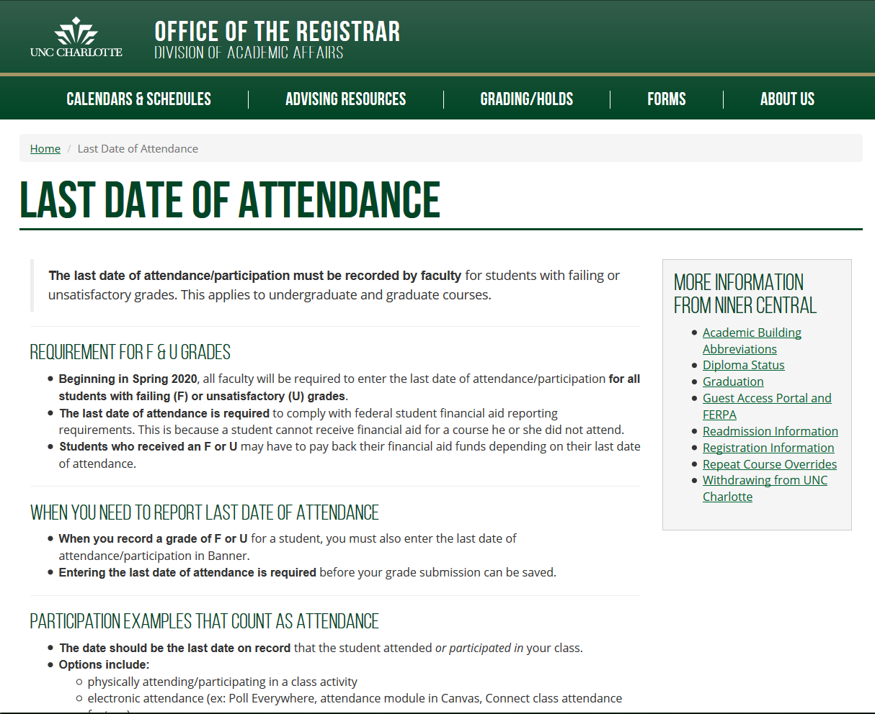
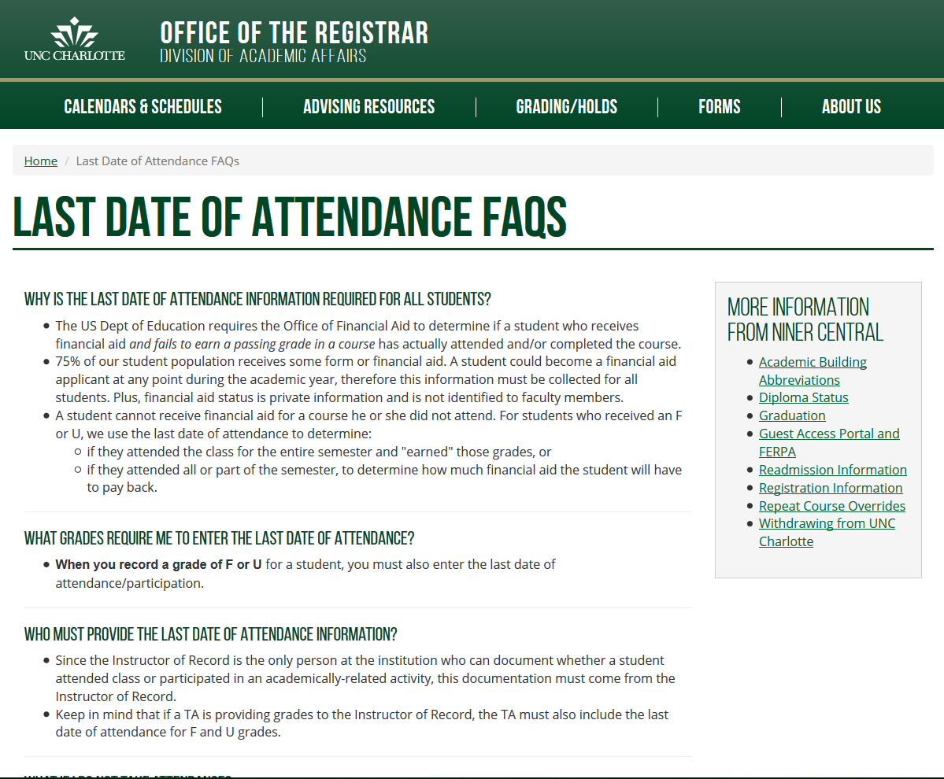
Last Day of Attendance Webpage & FAQ
https://registrar.uncc.edu/gradingholds/last-date-attendance
https://registrar.uncc.edu/gradingholds/last-date-attendance-faqs

Slide 8
Reminders
October
  Provost Email to Faculty
  Registrar Newsletter
  Inside UNC Charlotte
  AA eNews Digest
  CTL Bi-Weekly Messages
  My UNC Charlotte (Faculty)
December
  Instructors assigning F/U grades
January
  Start of Term Email
February
  Part A Term – Grading Open
March
  Full Term & Part B Term – Grading Open
May
  Non-Reported Grades

Slide 9
Outreach
Sept 10 – Associate Deans
Sept 20 – Department Chairs/Directors
Sept 26 – Faculty Council
Sept 25-26 – Registrar Forums
General Info Sessions (no RSVP - Drop In)
October 10 – 2pm DUKE 208
November 20 – 10am CHHS 122
January 14 – 3pm COED 102
January (TBD) – CCB

Slide 10
Appendix
What will this look like?

Slide 11
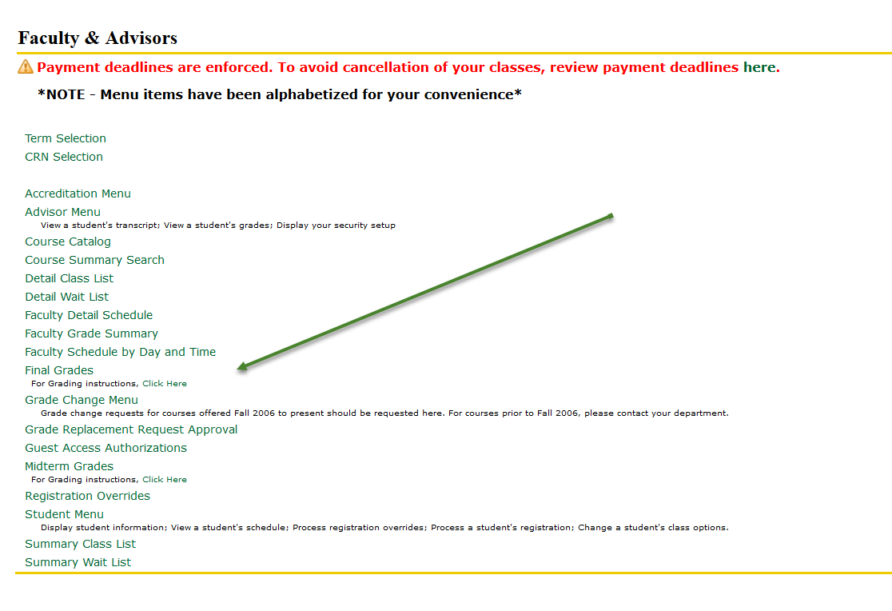
Self-Service Banner Screen Shots
Notes:
Functionality already exists, need to turn on for required for grades F/U. Sample screen shot.

Slide 12
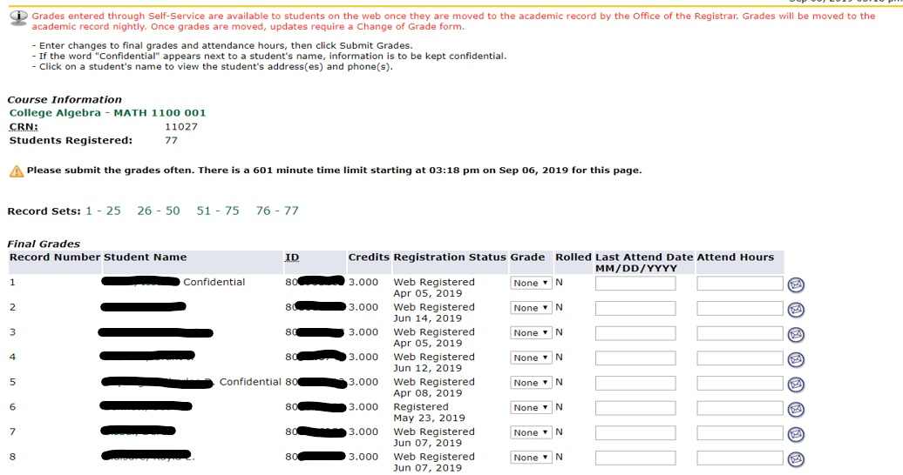
Self-Service Banner Screen Shots
Notes:
Functionality already exists, need to turn on for required for grades F/U. Sample screen shot.

Slide 13
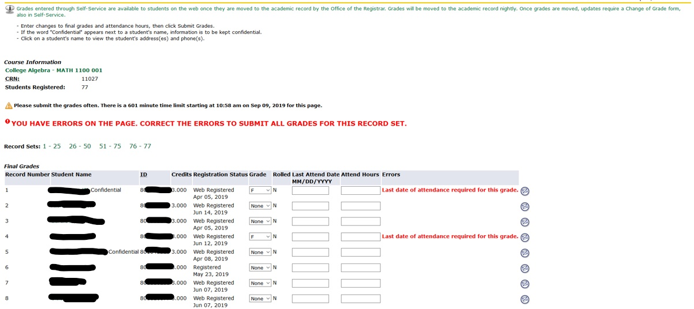
Self-Service Banner Screen Shots
Notes:
Functionality already exists, need to turn on for required for grades F/U. Sample screen shot.

Slide 14
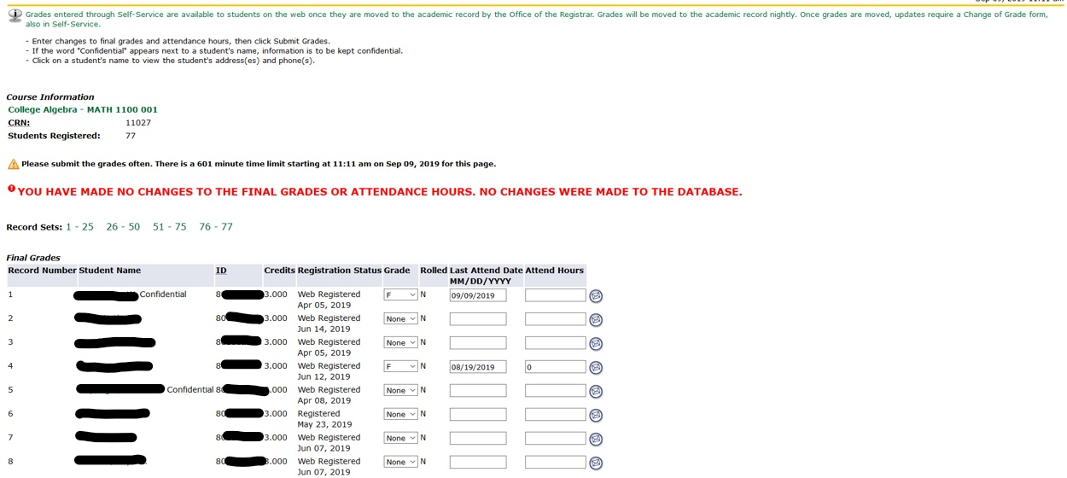
Self-Service Banner Screen Shots
Notes:
Functionality already exists, need to turn on for required for grades F/U. Sample screen shot.

Slide 15
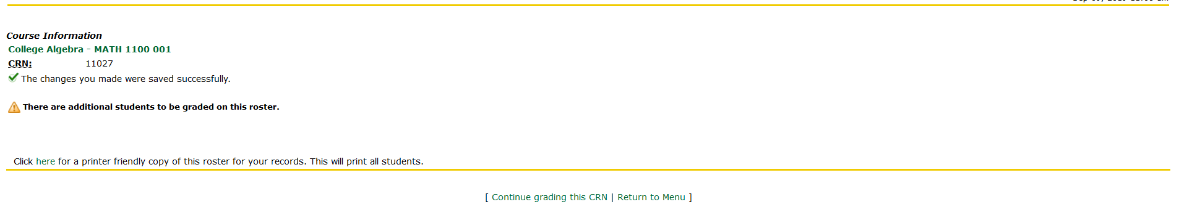
Self-Service Banner Screen Shots
Notes:
Functionality already exists, need to turn on for required for grades F/U. Sample screen shot.

Slide 16
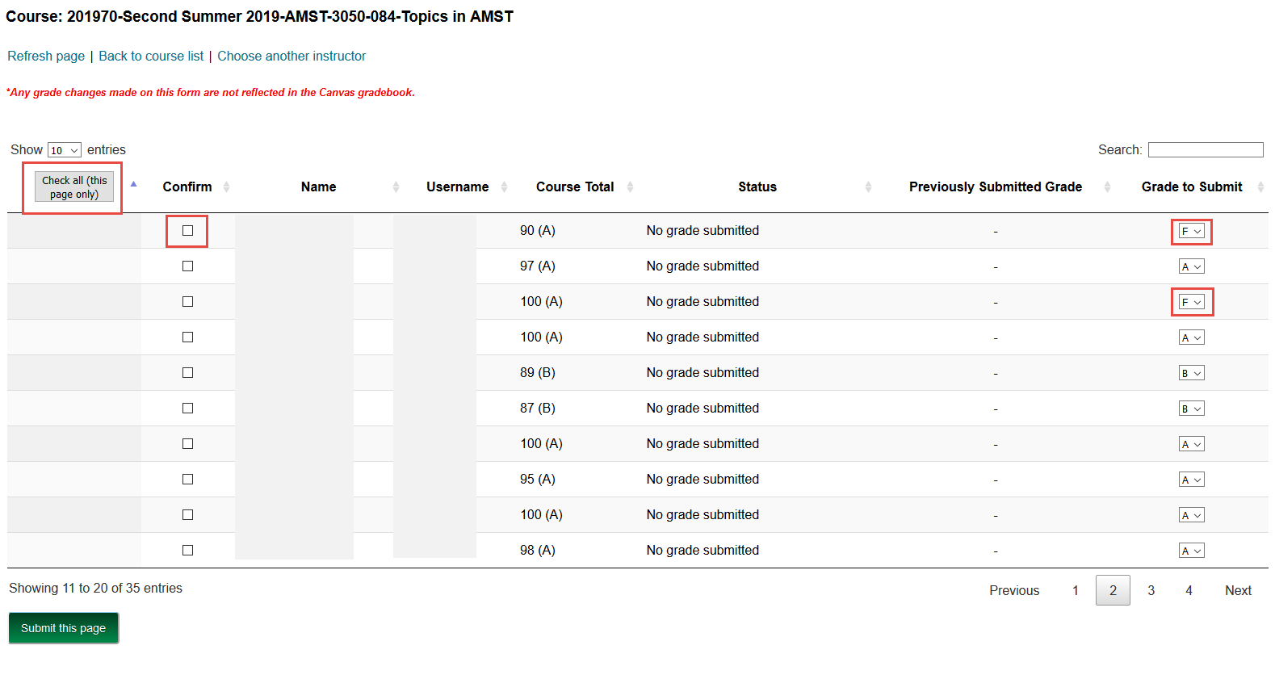
Canvas Screen Shots
Instructors enter grades in a form. The form shows the grade from the Canvas gradebook in the Course Total column, but the instructor can choose a different grade from the drop-down in the Grade to Submit column. To submit grades, the instructor either needs to check the individual check boxes or click the Check all... box at the top of the form and then click the Submit this page button.
Notes:
Functionality does not currently exist in production, but will be available when launch last date of attendance. Sample screen shot.

Slide 17
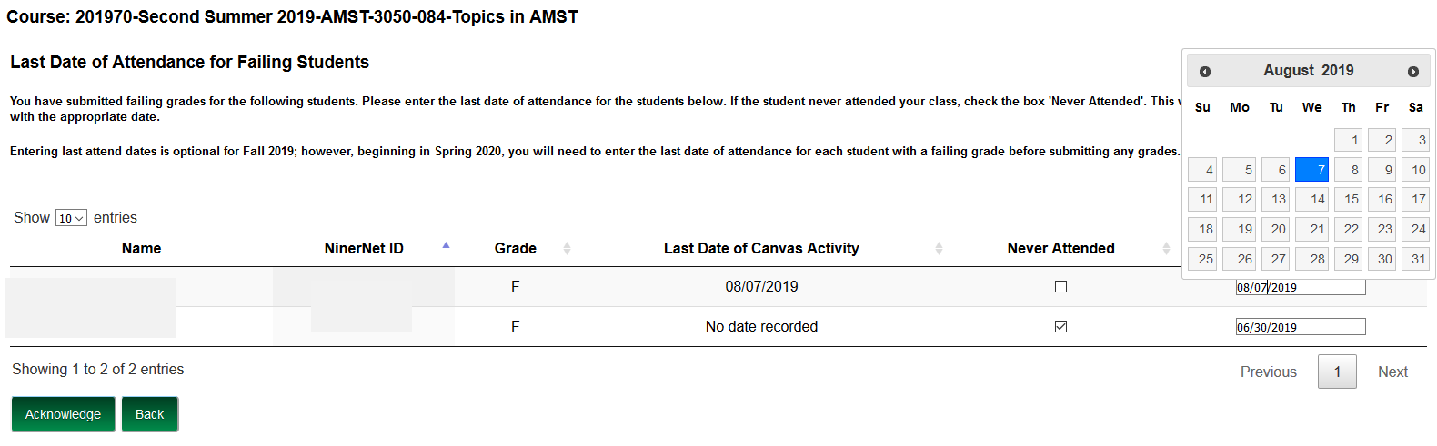
Canvas Screen Shots
As the Last Attend Date is a required field, if submitted without entering dates, the empty boxes turn red, and the instructor cannot advance to the next page. If the student never attended, checking the Never Attended check box will auto-populate the Last Attend Date box with the correct date. A calendar pops up when the instructor clicks within a box in the Last Attend Date column. After entering the dates, the instructor clicks Acknowledge.
Notes:
Functionality does not currently exist in production, but will be available when launch last date of attendance. Sample screen shot.

Slide 18
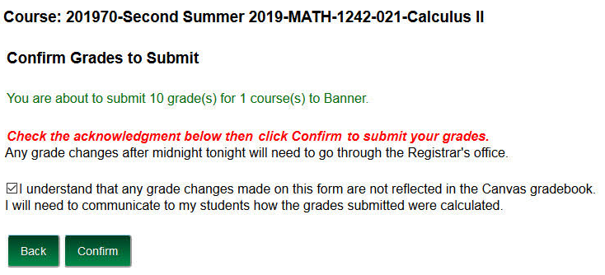
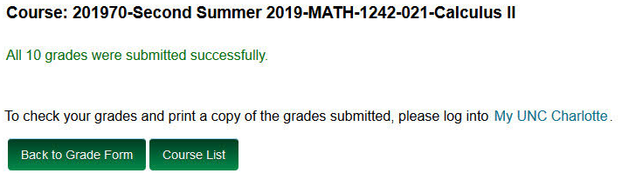
Canvas Screen Shots
The instructor must check the box, agreeing to the submission terms and Confirm that any grade changes on the form will not be reflected in the Canvas gradebook. Grades are then submitted.
Notes:
Functionality does not currently exist in production, but will be available when launch last date of attendance. Sample screen shot.

Slide 19
Questions

