Slide 1
IPASS: Integrated Planning and Advising for Student Success
IPASS – National Best Practice Grant
Gates Foundation through EDUCAUSE
~ 30 Institutions Nationwide, mix of 2- and 4-year schools
3 years
IPASS – Randomized Controlled Trial (RCT)
Gates Foundation through CCRC / MDRC
3 Institutions:
UNC Charlotte
Fresno State
Montgomery CC (Philadelphia)

Slide 2
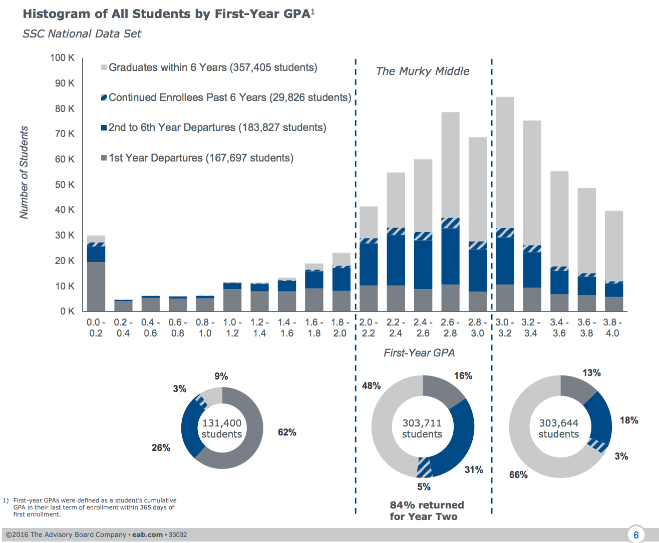
The Murky Middle
Source: EAB: “The Murky Middle Project”

Slide 3
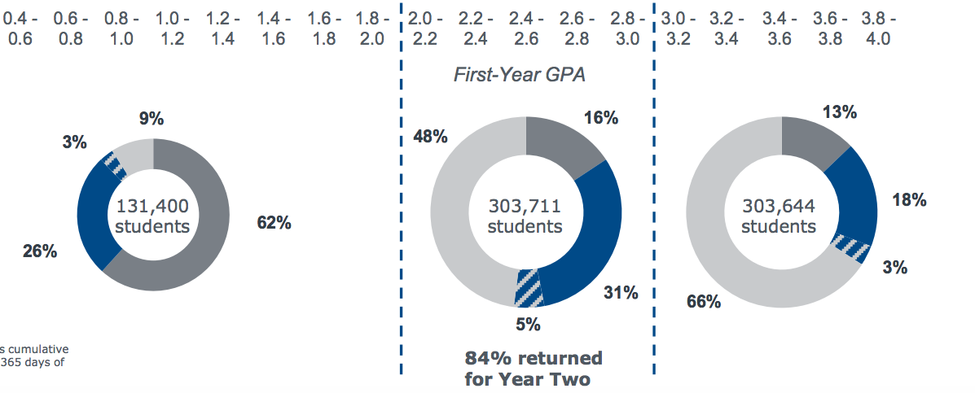
1. Attrition
Attrition by First Year GPA: SSC National Data Set of UNC Charlotte
1st Year GPA | < 2.0 | 2.0 - 2.99 | < 3.0
SSC National Data Set | 88% | 47% | 31%
UNC Charlotte FTFTFR, 2005-2010 (N=18,165) | 87% | 46% | 29%

Slide 4
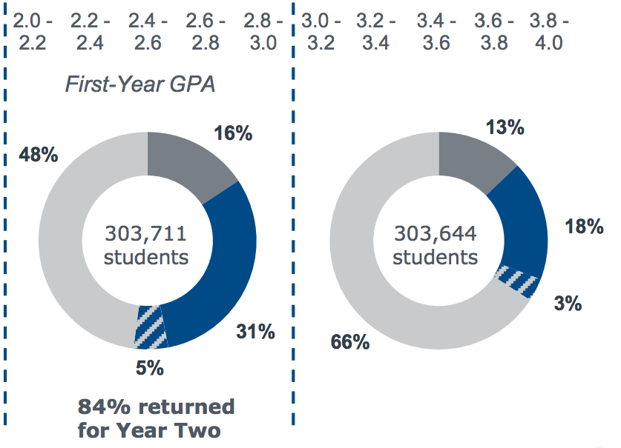
Finding the Right Major
6 YR
6 YR
4 YR
4 YR
Notes:
Fit to Major is a critical problem for Transfer students
Graduation of Transfer students w/in 4 years of achieving Junior standing lags 10-15% behind comparable rates for native Freshmen who achieve Junior standing

Slide 5
IPASS: WHY?
To increase degree completion – TIMELY completion
We need to help students …
Murky Middle students
Transfer students
…find the ‘Right Fit’ major…
…faster

Slide 6
IPASS: HOW?
Advising Touch Points … Problematic
Less structured advising after freshman year.
Most advising is during pre-registration (limits leverage)
Developing culture of intrusive advising
Advisor capacity
Students’ expectations

Slide 7
IPASS: WHAT
Leveraging (new) data
SSC Graduation Risk
SSC Success Markers
Early Alerts*
Mid-Term Grades*
Responsiveness
Engaging Students
Early
Expecting action
Developing skills

Slide 8
IPASS: WHAT
Week 0 – 52% Grad Probability, 1 Success Marker
-- Homework to set goals
Week 2 -- Flag progression courses, link to success services
Week 4 -- EA in Progression course(s)
-- Push success services for EA courses (again)
Week 6 -- Warning if student not taking action
Week 8 -- MT D in progression course
-- Parallel Plan assignment
Week 9 + -- Required Risk Advising
Next Term -- Pre-term outreach

Slide 9
IPASS: Adaptable
Presented
Freshmen and Sophomores
Emerging Academic Risk
Focus on ‘Right Fit’ major
Options
Time to degree – Juniors and Seniors (esp w/ Degree Works)
Sub-groups (gender, underrepresented)
High achievers

Slide 10
IPASS: Randomized Controlled Trial
Cohort 1 -- Spring 17 → Fall 18
Continuing FR and SO (both native freshmen and transfers)
Colleges
COB
CCI
CLAS (PBIO, PCJU, PCOM, PSYC, POLS)
UCOL
Randomized Treatment and Control (total N of 2500)
Cohort 2 ?

Slide 11
Early Alerts and Mid-Term D/F Grades TOP 40 / PROGRESSION COURSES, FALL 2016
REPORTING --
994 SECTIONS designated as Top 40 or Progression Courses
EARLY ALERT -- 54% of sections
MT GRADES -- 60% of sections
BOTH EA and MT -- 32% of sections
NEITHER EA or MT -- 26% of sections
Notes:
29% MT grades only
13% EA only

Slide 12
Early Alerts and Mid-Term D/F Grades TOP 40 / PROGRESSION COURSES, FALL 2016
RELIABILITY – MT Grades (instructors in same color)
Course | Sections Reporting | % D or F | % D or F | % D or F | % D or F | % D or F | % D or F | % D or F | % D or F
LBST 1105 | 4 | 4% | 12% | 21% | 29%
BIOL 1110 | 4 | 6% | 10% | 28% | 45%
CHEM 1200 | 4 | 17% | 21% | 31% | 43%
CHEM 1251 | 9 | 42% | 43% | 47% | 47% | 50% | 51% | 51% | 52%
MATH 1100 | 25 | 5 < 10% |  | 10% < 11 <20% |  | 20% < 7 <30% |  | 40% < 2
ACCT 2121 | 9 | 5 | 6 (2) | 8 | 8 | 3 | 15 | 19 | 23
ITCS 1212 | 3 | 8 | 8 | 45
Notes:
33% of students in a section reporting MT grades only
13% of students in a section reporting EA only

