Slide 1
Offsite Storage Plan
Faculty Council Collection Review
Task Force
Notes:
Faculty from across campus and library faculty have worked together over the past year to prepare a plan for the library to move large percentage of the print colleciton to a offsite storage facility.

Slide 2
Why the move is needed
Collection is not currently browsable
About half the collection has not been checked out since 1999
Seating is not currently adequate for student size and need
Tower elevators and floors are not currently ADA Compliant
Number of checkouts | Number of books
0 checkouts | 349,197
1 checkout | 122,881
2+ checkouts | 233,633
Total | 705,711
Notes:
There are several reasons this move would be important to making the library space more useable and accessible for students and faculty. The library ran out of space for new collections in 2012 and even with some aggressive deselection work, the collection remains disjointed and not browsable due to half the collection being on the ground floor and the other half in the tower. We rely on overflow shelving to incorporate new materials into the collection but this also hinders browsing.
Half of the collection has not been checked out since 1999. This does not include in house use but the library started tracking this use in January.
The student population has grown exponentially since the last building renovation of Atkins library and we not longer meet the needs of our population size, particularly related to seating within the library. In addition, the library elevators and tower floors are not ADA compliant which hinder many students from browsing the materials on this floor.

Slide 3
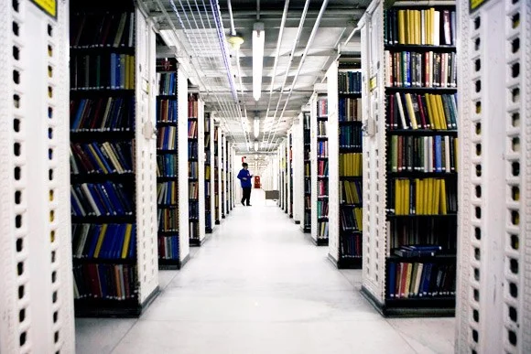
To accomodate the need for more seats, more print collection, and ADA compliance we need to move at least 70% of the collection to an offsite location.
Notes:
Will all of this in mind, the most ideal situation would be to move at least 70% of the collection to an offsite location. We do not know at this time if this is the space that will be allocated, but this is our ultimate goal.

Slide 4
Faculty Council Collection Review Task Force Goals
Create a plan for how to select materials to be stored in an off-site location.
Provide guidance on space planning for (arrangement of) print materials remaining in Atkins Library.
Suggest policies regarding retrieval and use of print materials stored in offsite storage.
Notes:
At the direction of the Faculty Senate Executive Board, a Task Force was formed of faculty members from various academic departments on campus and library employees to address issues related to the print collection. We wanted to ensure we received feedback and assistance on developing a plan for the transition, execution and maintenance of an offsite storage facility.
The Task Force had three main goals. This presentation will outline the plan to meet each of these goals.

Slide 5
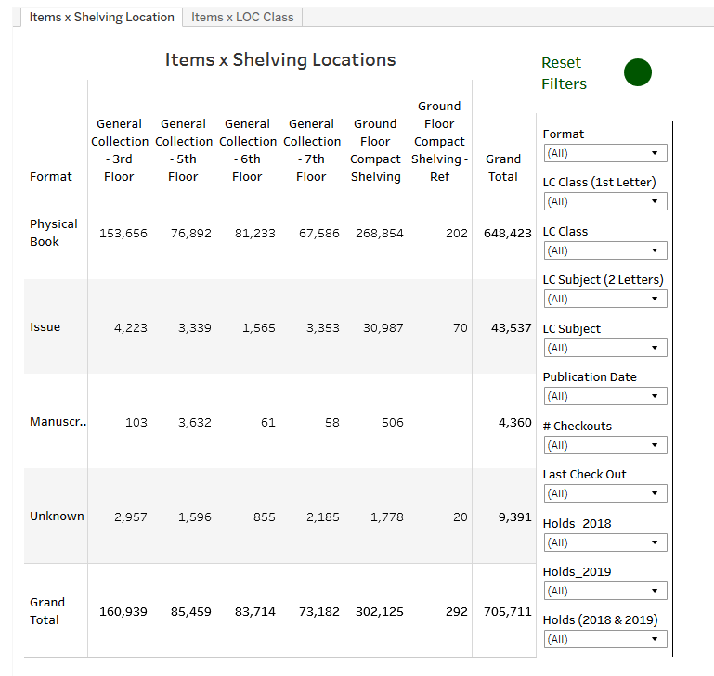
Plan for selecting materials
Selection would be equitable among all subject areas.
Creation of tool review titles which does not include Government Documents, Serials, CIMC materials, and multimedia materials.
Criteria to review - LC Classification (subject areas), usage data, and publication date.
Notes:
In order to be able to analyze the colleciton as a whole, our Head of Assessment, Becky Croxton, created a tool for the team to use to review the numbers based on LC Classification, checkout data, and publication data. This information helped give the task force information about the makeup of the collection and how it was being utilized to help formulate a plan on how to use these numbers to identify titles. Ideally the titles selected would be equitable among the subject areas and rely on mostly use data and publication date.

Slide 6
Model design
Calculate the percentage of collection being used based on LC Classification.
Use this percentage to pinpoint a number of titles to keep in the building
Identify the specific titles that would meet that number based on usage and publication date.
Ex: Prior to 1960 - 1999 with 1+ use after 2013, 2000-2009 1+ uses, 2010-present.
Provide room for tailoring collection based on need.
Leave room for new titles
Leave room for titles checked out from remote storage to stay in the library
Keep multi-volume collections together
Model Calculations
Notes:
Once the task force got a feel for the data, model calculations were devised based on the percentage of the collection used in each two letter LC Classification. This percentage is then used to pinpoint the number of titles that would be kept in the building per classification. To identify the actual titles that get to this number a criteria would be created and applied.
The model calculations we are currently working with is based on 33% of the colleciton staying the building. We can modify the model based the amount of the collection we want to stay in the building depending on the size of the offsite storage. For example, if we can only move 30% of the colleciton out of the building we can recalculate the model to pinpoint new numbers and create new models.

Slide 7
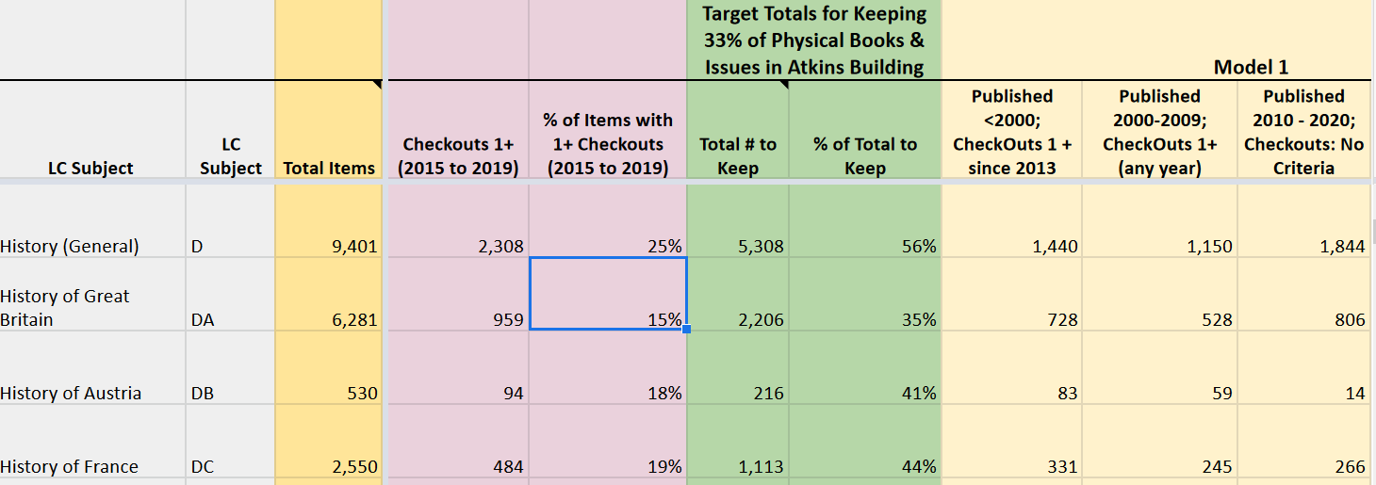
Model Example
Notes:
This is a screen shot of the calculations we created using the model, keeping 33% of the collection in the building. As you can see we use the total number of books and divide it by the total number of checkouts to get the percentage of total checkouts. We then multiply the total number of books by % of check out items, and the multiply again by 2.3 to get the 33% to find the total number of books we will keep in the library.
The next step is to try different models of selection to get as close to that number as we can, which is reflected in the first model displayed.

Slide 8
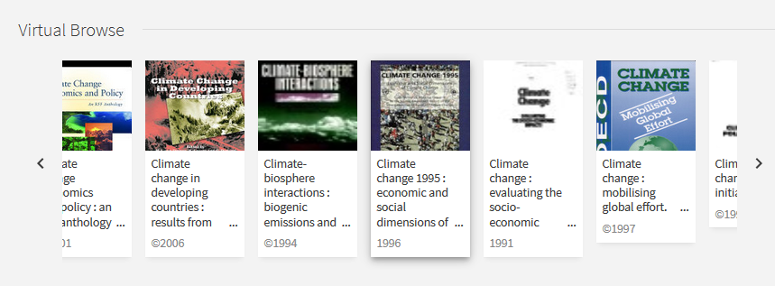
Space Planning
The print collection remaining in the library will stay in LC Classification order for optimal browsing.
Try to theme floors and integrate other materials such as media throughout the collection to create awareness for the print collection.
Continue enhancement of virtual browsing
Make room for new materials and review the collection each year to make adjustments.
Notes:
Once the Task Force figure out how to identify the titles that would remain the building, we then set to creating a plan for how the books would be arranged. For optimal browsing, we decided to keep the books in LC Classification. When possible we would try theme floors based on subject area and incorporate other materials to help promote the ever expanding print collection. With much of the colleciton off-site we would continue to enhance our virtual browsing option in our catalog, to replicate physical browsing on the shelves. Finally, the materials would be reviewed every year to make adjustments including:
Adding new materials and moving older material off site.
Review off-site collection for deselection.
Keep materials that have been requested in the building for future use.

Slide 9
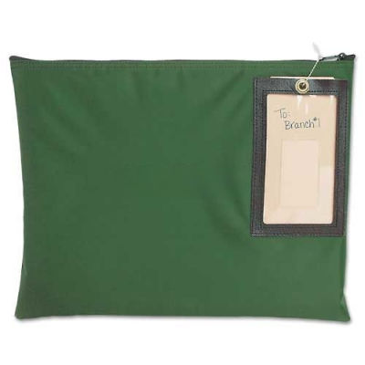
Policies Regarding Retrieval
The library will strive to retrieve materials within 24 hours of request during regular business hours.
The library will maintain service of delivering books directly to faculty.
Notes:
One of the biggest fears that students and faculty might have is the time it will take to obtain items requested from remote storage. The library will strive to retrieve materials within 24 hours of request during regular business hours. We recently tested the process, when the tower was closed for building maintenance, and we did not receive any negative feedback related to the time it took to retrieve materials.
The library will also continue it service of mailing materials to faculty as requested.

Slide 10
Next Steps
We have been provided with an off-site storage facility for 70% of the print colleciton and most of our print journals to provide adequate space for social distancing in the library during the pandemic. The move is scheduled for early November.
Currently the remaining 30% of the collection will be moved compact shelving but the library plans to use the recommendations to eventually integrate the colleciton back throughout the building.
We have prepared the materials lists based on the model in the recommendations.

Slide 11
Questions?
Notes:
If you have any questions or concerns about anything discussed in this presentation please contact the Associate Dean for Colleciton Services, Liz Siler.

