Slide 1
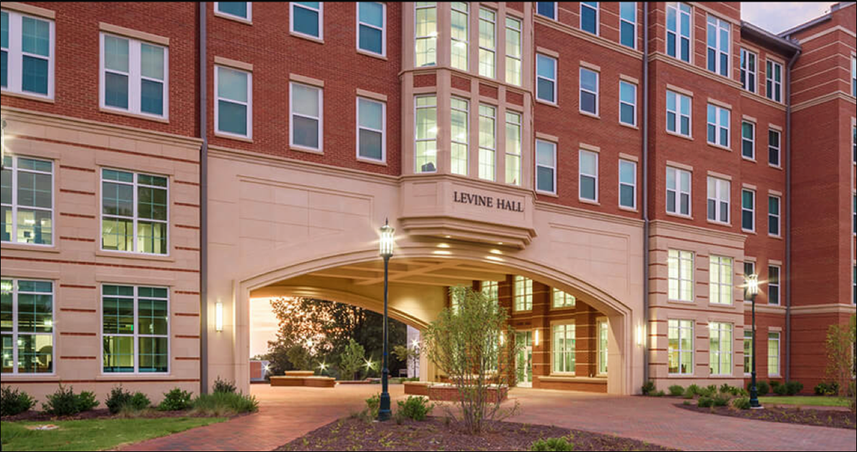
Honors Council Report
2023-2024

Slide 2
Honors College Organizational and Governance Structure
Academic Affairs
Faculty Council
Colleges of Arts + Architecture, Business, Computing and Informatics, Education, Engineering, Humanities & Earth and Social Sciences, Science
Honors
College
Administration,
Honors Faculty,
and Staff
Honors
Council
University Honors Program
Levine Scholars Program
Merit Scholars Programs:
Albert
Martin
Johnson
Freeman
Arts + Architecture Honors
Dept of Art History Honors
Nationally Competitive Scholarship Advising
Business Honors
The Honors College administration and staff collaborates with, and provides advisory and administrative
support to, all honors programming, curricula,
advising, and student support services.
CCI Honors
The Honors Council provides faculty governance and curricular oversight for all honors programs and the Honors College.
Education Honors
Engineering Honors
CHESS Departmental Honors
CHHS Departmental Honors
COS Departmental Honors

Slide 3
Honors Council Members
 | Representative | Alternate
COAA | Dylan Savage | Ann Dils
COB | Carol Stivender | Karen Ford-Eickhoff
CCI | Jake Lee | Heather Lipford
COED | Cindy Gilson | Adriana Medina
COE | Cathy Blat | Andrew Willis
CHHS | Deborah Beete | Kelly Powers
CHESS | Sandra Clinton | Sara Levens
CHESS | Ashli Stokes | Vaughn Schmutz
COS | Susan Trammell | Andrew Goff
PHS/At-Large | Pilar Zuber | Jill Massino
LIBRARY/At-Large | Abigail Moore | Susan Arthur
Alex Toback (Student Representative)
Malin Pereira (Dean, Honors College)
Jeffrey Leak (Interim Associate Dean, Honors College)
Colette Chenault (Administrative Support Associate)

Slide 4
2023-2024 Highlights:
Regular Business:
Honors Faculty Review Committee (58 applications [38 new apps, 15 renewals, 5 auto-adds])
Honors College Evaluation Committee (Evaluation Reports for Dean and Associate Dean)
Honors Curriculum Committee (15 course proposals, 4 program revisions)
Updated Bylaws (e.g., 11 → 13 members)
Held a special election for the College of Science (COS)
Updated Structure and Election Process for Honors Council - equitable opportunities; bios added to ballots.
Updated the Honors Faculty Definition and Criteria
Updated the Honors Faculty Application Form to streamline the process

Slide 5
2023-2024 Highlights:
Improved communication process with Honors Faculty, Program Directors, and Department Chairs about elections for Honors Council versus nominations for Honors Faculty
Developed onboarding/welcome emails to new members
Equity Sub-Committee
Analyzing data at the college or disciplinary level is challenging; UHP graduation rate is higher than the average undergraduate graduation rate
Alex Tobak - Student Survey
110 respondents (compared to 13 last year)
70-75% gave their honors program 4 or 5 stars!
102 students listed priority registration as one of the most valuable benefits of honors. Graduating with distinction, being in a community of academically motivated peers, co-curricular opportunities, and study abroad were also noted frequently.

Slide 6
Thank you!
Questions?
cgilson@charlotte.edu

