Slide 1

Update on Graduate School Funding
and Student Support on Grants
In collaboration with Academic Affairs and Division of Research
March 1, 2024
Notes:
UNC Charlotte is prioritizing graduate education as a key component of its mission to advance research and innovation. Investing in recruiting and educating top-tier graduate students is crucial for the university to establish itself as a leading research institution. By fostering strong graduate education programs, UNC Charlotte will continue to attract talented individuals who will contribute to groundbreaking research and ultimately propel the university forward. Continued investment in resources and support for graduate students is essential for sustaining this momentum and achieving the university's long-term goals.

Slide 2

Graduate education remains a key component of our mission to advance research, innovation, and entrepreneurship.
Increase in Stipend for GAs from Fall 2024
$1500 per PhD
$250 per masters
Notes:
UNC Charlotte is prioritizing graduate education as a key component of its mission to advance research and innovation. Investing in recruiting and educating top-tier graduate students is crucial for the university to establish itself as a leading research institution. By fostering strong graduate education programs, UNC Charlotte will continue to attract talented individuals who will contribute to groundbreaking research and ultimately propel the university forward. Continued investment in resources and support for graduate students is essential for sustaining this momentum and achieving the university's long-term goals.

Slide 3
Overview
Investments in Graduate Funding | Growth in Grant-Funded Ph.D. Students and Eligible MTART Students | Funding Challenge | Solution and Planning for the Future

Slide 4



Investments in Graduate Funding
2005
2022-23
2022-23
Graduate Assistant Support Plan (GASP) GASP covers $7,252 for resident and $21,821 for non-resident students. | Funding Increases Academic Affairs provided $1,500,000 in recurring funding stipends and $475,000 per year in one-time funding for Master’s TA resident tuition (MTART). | $1,000 Scholarships The Graduate School provided all Ph.D. students scholarships to cover E&T and health fees.
Notes:
Graduate Assistant Support Plan (GASP) - Started in 2005
Currently, GASP covers $7,252 for in-state and $21,821 for out-of-state students
Since the GASP began in 2005, it has grown more than 50%, thus providing a significant boost to both the instructional and research missions at Charlotte. Even more significant, the percentage of full-time enrolled doctoral research students now comprises over 73% of the total (the highest percentage ever).
Recent Increases in Funding - 2022 and 2023
Academic Affairs provided $1,500,000 in recurring funding stipends to colleges and units bring college funded TAs in line with the compensation policy and new lines to support General Education Programs
Master’s TA Resident Tuition (MTART) 2022 and 2023 - $475,000 per year in one-time funding to cover Masters TA resident tuition.
$1,000 Scholarships
2022-2023 - Graduate School provided all Ph.D. students $1,000 scholarship to cover E&T and health fees
In Spring 2024, over 131,000 billable hours were taught by TAs. Demonstrates that we need to continue this investment.
(note: these are hours attributed to a full-time faculty member in excess of 4 sections for one semester, assuming TAs were teaching the many sections of a course, non-asynchronous courses either F2F or hybrid)

Slide 5
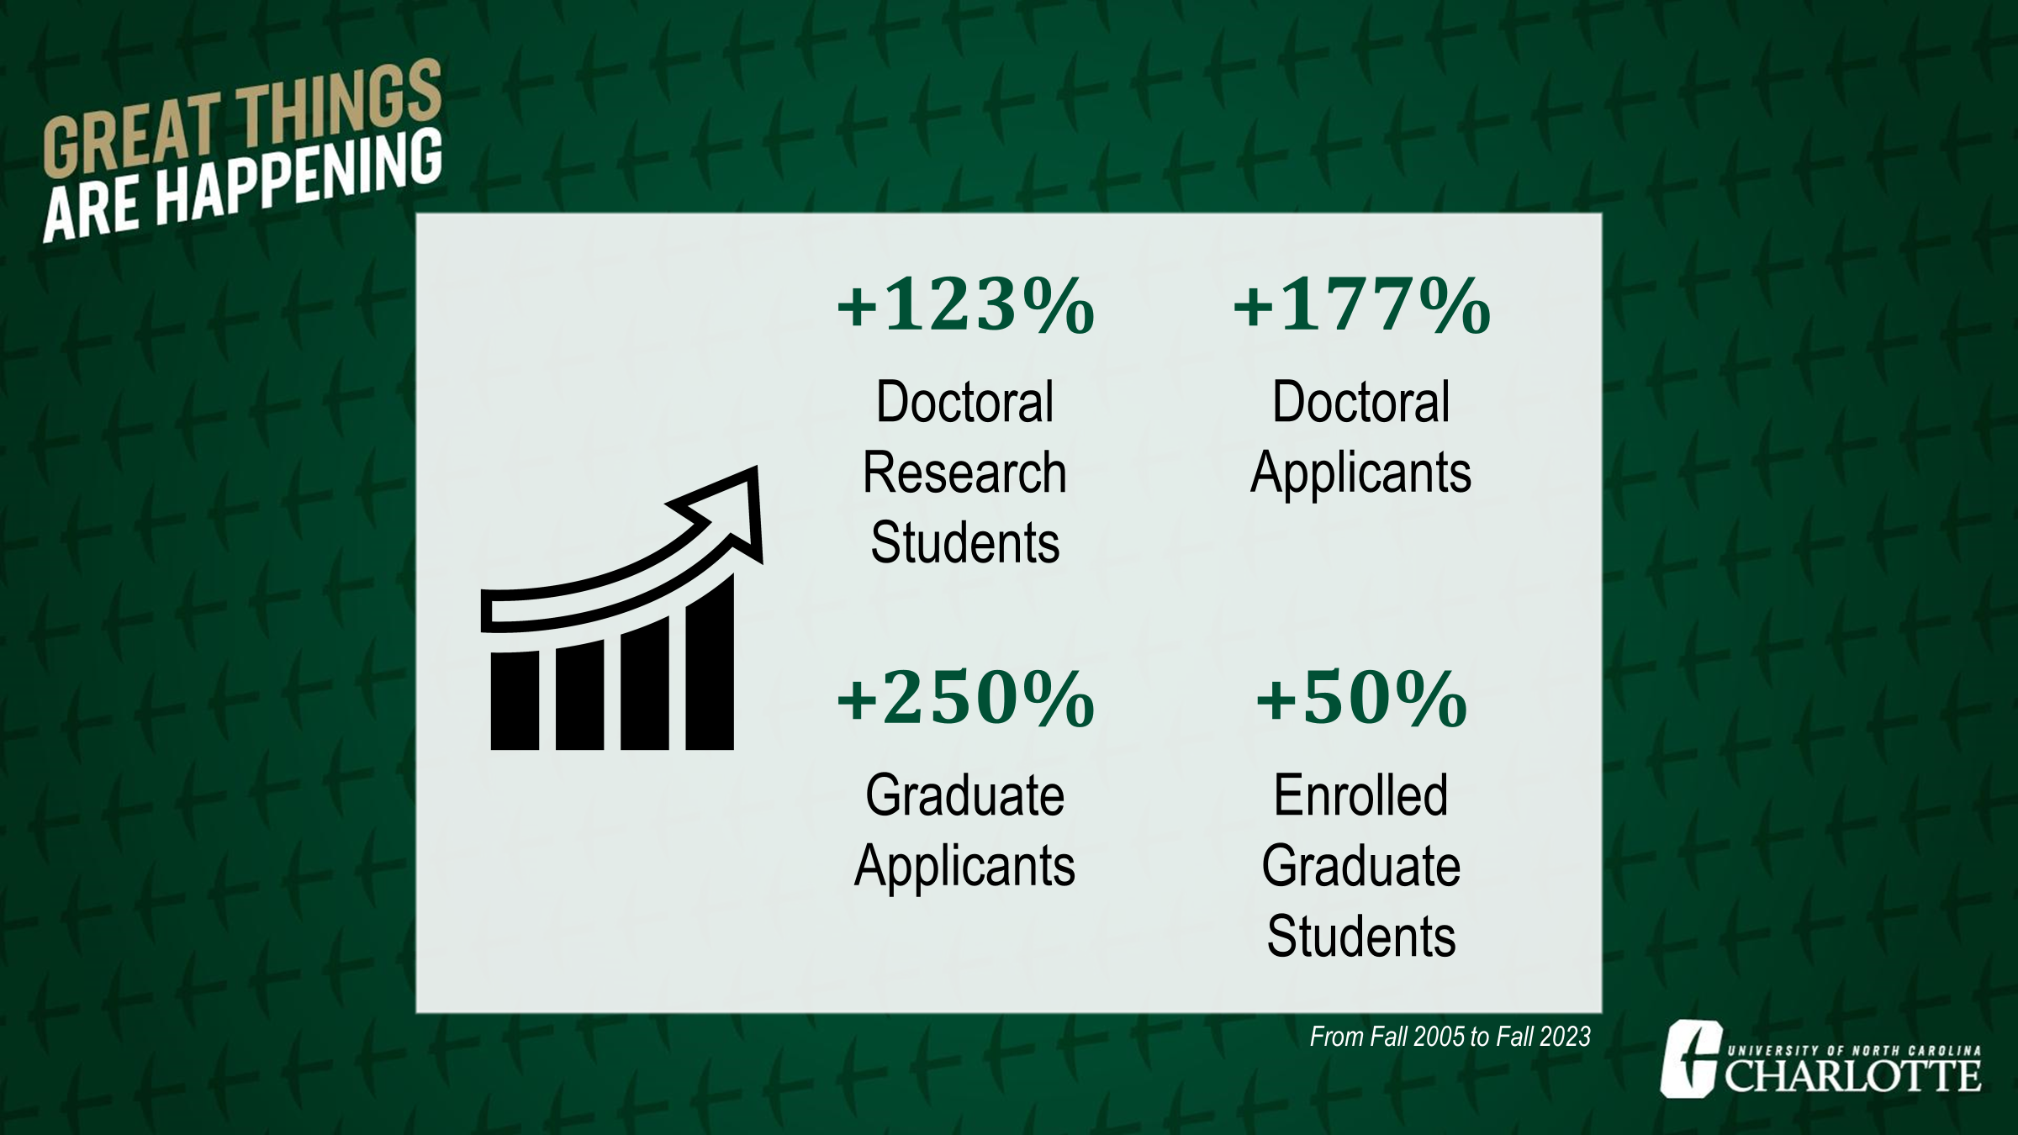
$29-32 million per semester in Revenue

Slide 6
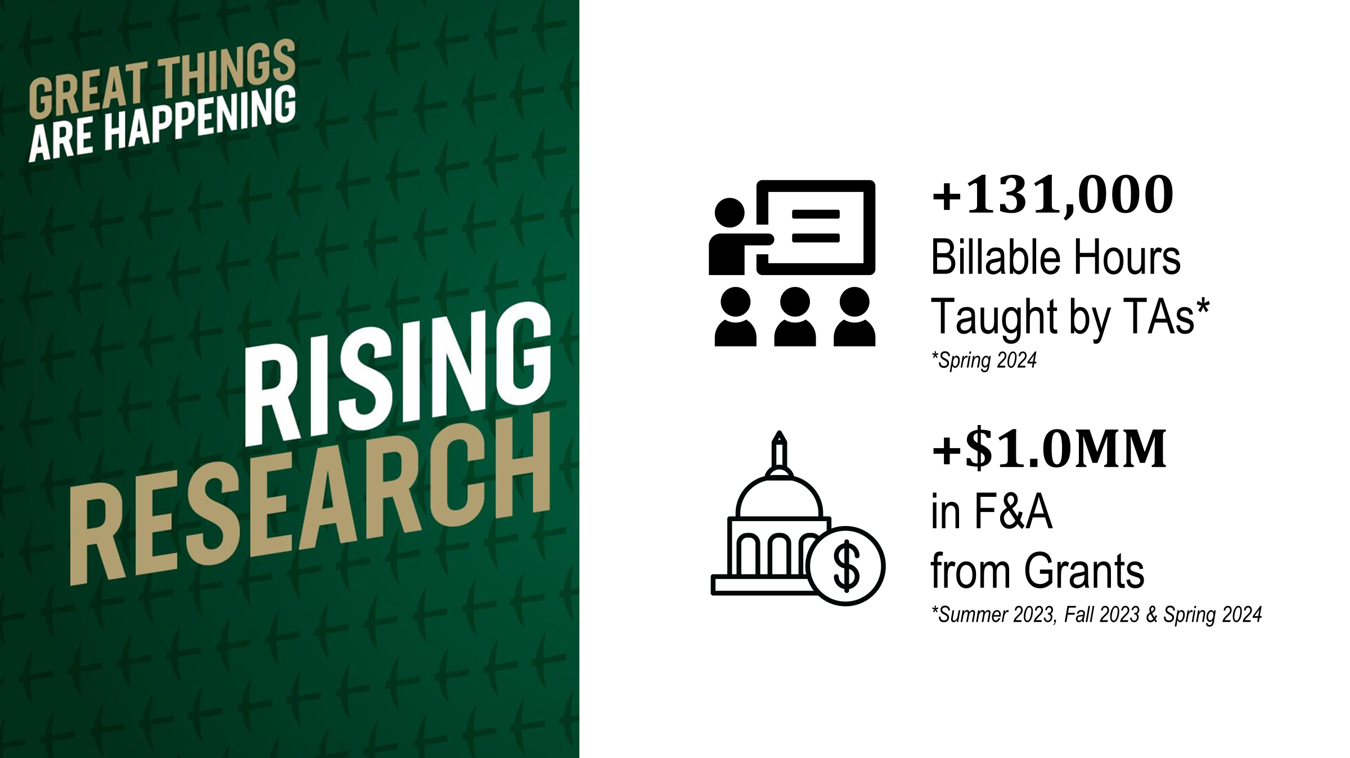

Slide 7
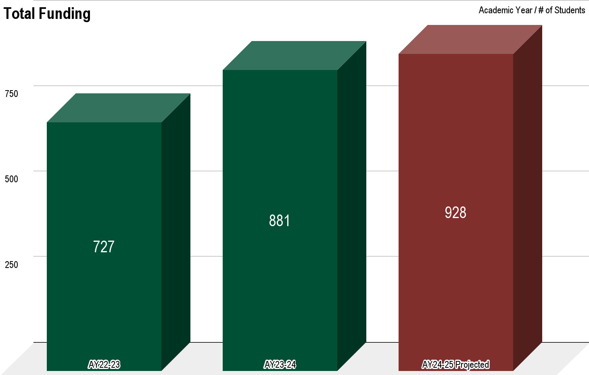
Graduate School Funding
Notes:
Growth in Grant-Funded Ph.D. Students and Eligible MTART Students
There was a significant increase in grant-funded Ph.D. research assistants (RAs), from 38 in Academic Year (AY) 18-19 to 320 in AY 23-24. This growth, albeit exciting, has contributed to a dramatic increase in GASP expenditures by the Graduate School. During the same timeframe, institutionally-funded Ph.D. RAs decreased from 253 to 207, and Ph.D. TAs declined from 342 to 330.
An increase in master’s students eligible for MTART (171 in AY 22-23 to 262 in AY 23-24), also contributed to an increase in expenditures. Before MTART, we funded approximately 50 students with master’s merit awards. We expect that this level of MTART funding for 262 students will continue in AY 24-25 and beyond.
In total, the Graduate School funded 727 students in AY 22-23, 881 students in AY 23-24, and projects a need to fund 928 students in AY 24-25 with GASP/MTART if we enroll 152 new GASP-eligible Ph.D. students.

Slide 8
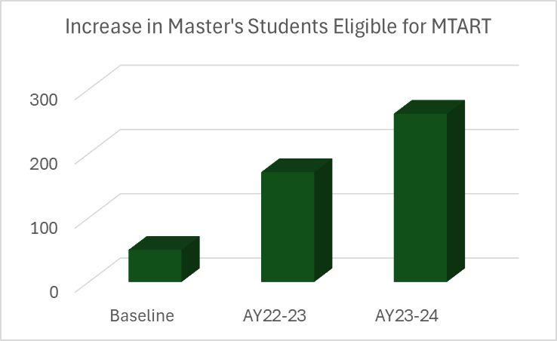
Growth in Eligible MTART Students
$1.25MM for 262 students
Notes:
Growth in Grant-Funded Ph.D. Students and Eligible MTART Students
There was a significant increase in grant-funded Ph.D. research assistants (RAs), from 38 in Academic Year (AY) 18-19 to 320 in AY 23-24. This growth, albeit exciting, has contributed to a dramatic increase in GASP expenditures by the Graduate School. During the same timeframe, institutionally-funded Ph.D. RAs decreased from 253 to 207, and Ph.D. TAs declined from 342 to 330.
An increase in master’s students eligible for MTART (171 in AY 22-23 to 262 in AY 23-24), also contributed to an increase in expenditures. Before MTART, we funded approximately 50 students with master’s merit awards. We expect that this level of MTART funding for 262 students will continue in AY 24-25 and beyond.
In total, the Graduate School funded 727 students in AY 23-24, 881 students in AY 23-24, and projects a need to fund 928 students in AY 24-25 with GASP/MTART if we enroll 152 new GASP-eligible Ph.D. students.

Slide 9
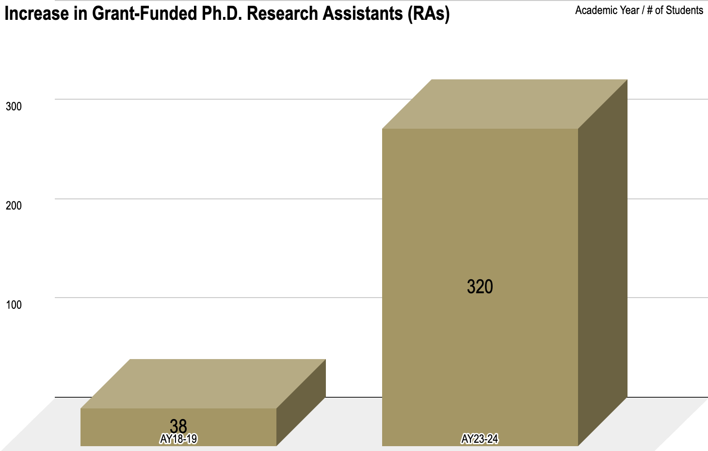
Growth in Grant-Funded Ph.D. Students
Grants paid in-state tuition
$3MM for 256 out-of-state students
Institutional PhD GAs fell by 58
Notes:
Growth in Grant-Funded Ph.D. Students and Eligible MTART Students
There was a significant increase in grant-funded Ph.D. research assistants (RAs), from 38 in Academic Year (AY) 18-19 to 320 in AY 23-24. This growth, albeit exciting, has contributed to a dramatic increase in GASP expenditures by the Graduate School. During the same timeframe, institutionally-funded Ph.D. RAs decreased from 253 to 207, and Ph.D. TAs declined from 342 to 330.
An increase in master’s students eligible for MTART (171 in AY 22-23 to 262 in AY 23-24), also contributed to an increase in expenditures. Before MTART, we funded approximately 50 students with master’s merit awards. We expect that this level of MTART funding for 262 students will continue in AY 24-25 and beyond.
In total, the Graduate School funded 727 students in AY 23-24, 881 students in AY 23-24, and projects a need to fund 928 students in AY 24-25 with GASP/MTART if we enroll 152 new GASP-eligible Ph.D. students.

Slide 10

Educational Expenses on Grants
  Prior to July 1, 2022-Policy required investigators to budget in-state tuition for graduate students funded on grants
  Intended for additional tuition revenue from grants to free up GASP dollars to fully fund MTART and additional GASP-eligible Ph.D. students
Ph.D. Students
July 1, 2022 $6,000 PI REQUEST MINIMUM | July 1, 2023 $8,000 REQUIRED MINIMUM FOR NEW GRANT SUBMISSIONS
Master’s Students
July 1, 2022 Grants Must Include Resident Tuition
Notes:
Investments in Graduate Funding
Graduate Assistant Support Plan (GASP): In 2005, the institution implemented the Graduate Assistant Support Plan (GASP). Under GASP, UNC Charlotte committed funds to cover expenses for many full-time enrolled doctoral students and Master of Architecture students with 20-hour assistantships. GASP covers full tuition and health insurance, regardless of residency status and the stipend source. The funding for GASP has increased incrementally over time. Currently, GASP covers $7,252 for in-state and $21,821 for out-of-state.
FY23 and FY24 Increases in Funding: In FY23 and FY24, Academic Affairs provided $1,500,000 in recurring funding to colleges to bring college-funded assistantships in line with the compensation policy for graduate students and to support the implementation of the 2023 general education programs by adding new TA lines. In addition, Academic Affairs provided a total of $475,000 per year in one-time funding.
Master’s TA Resident Tuition (MTART): In approximately 2005, stipends for master’s teaching assistants (TAs) were provided by Academic Affairs to select new programs, but there was no tuition benefit provided. As and if funds were available, the Graduate School provided master’s merit awards at $2,000 per student per semester to about 50 students who were nominated by their program director. In May 2022, under the new policy on graduate student compensation, the Graduate School provided master’s TAs receiving a two-year assistantship of at least $14,000 per year with resident tuition.
Requirements for Educational Expenses on Grants: The policy required investigators to budget for educational expenses for graduate students on grants. For Ph.D. students, PIs were required to request a minimum of $6,000 per academic year starting on July 1, 2022. Starting on July 1, 2023, $8,000 per academic year was the required minimum for new grant submissions to cover educational expenses for Ph.D. students. For master’s students, it was required that grants must include current resident tuition as of July 1, 2022. The intent was for the additional tuition revenue from grants to free up GASP dollars to fully fund MTART and additional GASP-eligible Ph.D. students.

Slide 11
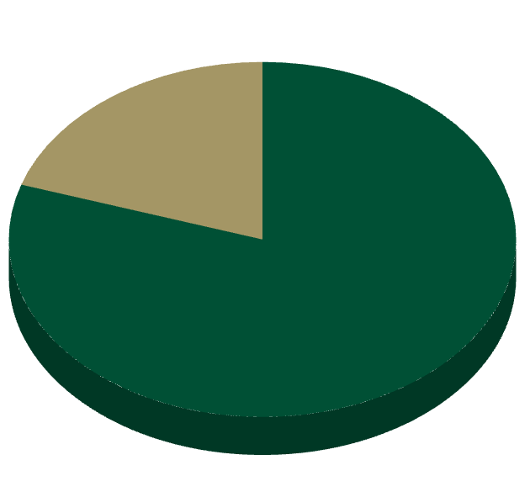
Funding Challenge
Dramatic growth in Ph.D. students funded on grants created a larger than anticipated deficit
  $8,000 budgeted on grants for educational expenses
  Graduate School pays at least $11,036 in tuition for every out-of-state or international Ph.D. student funded on grants
~80%
$2.8MM for 256 out-of-state students
of all grant-funded RAs on GASP are out-of-state or international students
Just 23% of grants paid the full $8,000 towards nonresident tuition
Notes:
Funding Challenge
With the $8,000 budgeted on grants for educational expenses, under the current GASP program, the Graduate School pays at least $11,036 in tuition ($19,036 minus $8,000) for every out-of-state or international Ph.D. student funded on grants. This is significant as approximately 80% of all grant-funded RAs on GASP are out-of-state or international students, and, currently, just 23% of grants pay the full $8,000 towards nonresident tuition. The plan projected that the savings from grant-funded tuition of $8,000 per non-resident student would be sufficient to fund the budget. However, the dramatic growth in Ph.D. students funded on grants created a larger than anticipated deficit.
For AY 24-25, the Graduate School is projected to run a deficit of approximately $750,000. To cover the projected GASP/MTART deficit for AY 24-25, the Divisions of Academic Affairs, Research and Business Affairs will provide additional funding. However, managing the growing funding gap with the current policy is unsustainable.
A committee of budget officials and leadership from Academic Affairs, Business Affairs, Research and the Graduate School reviewed data on planned enrollment growth and GASP/MTART funding requirements and concluded that the Graduate School award funds will not be able to cover the deficit beyond AY 24-25.

Slide 12
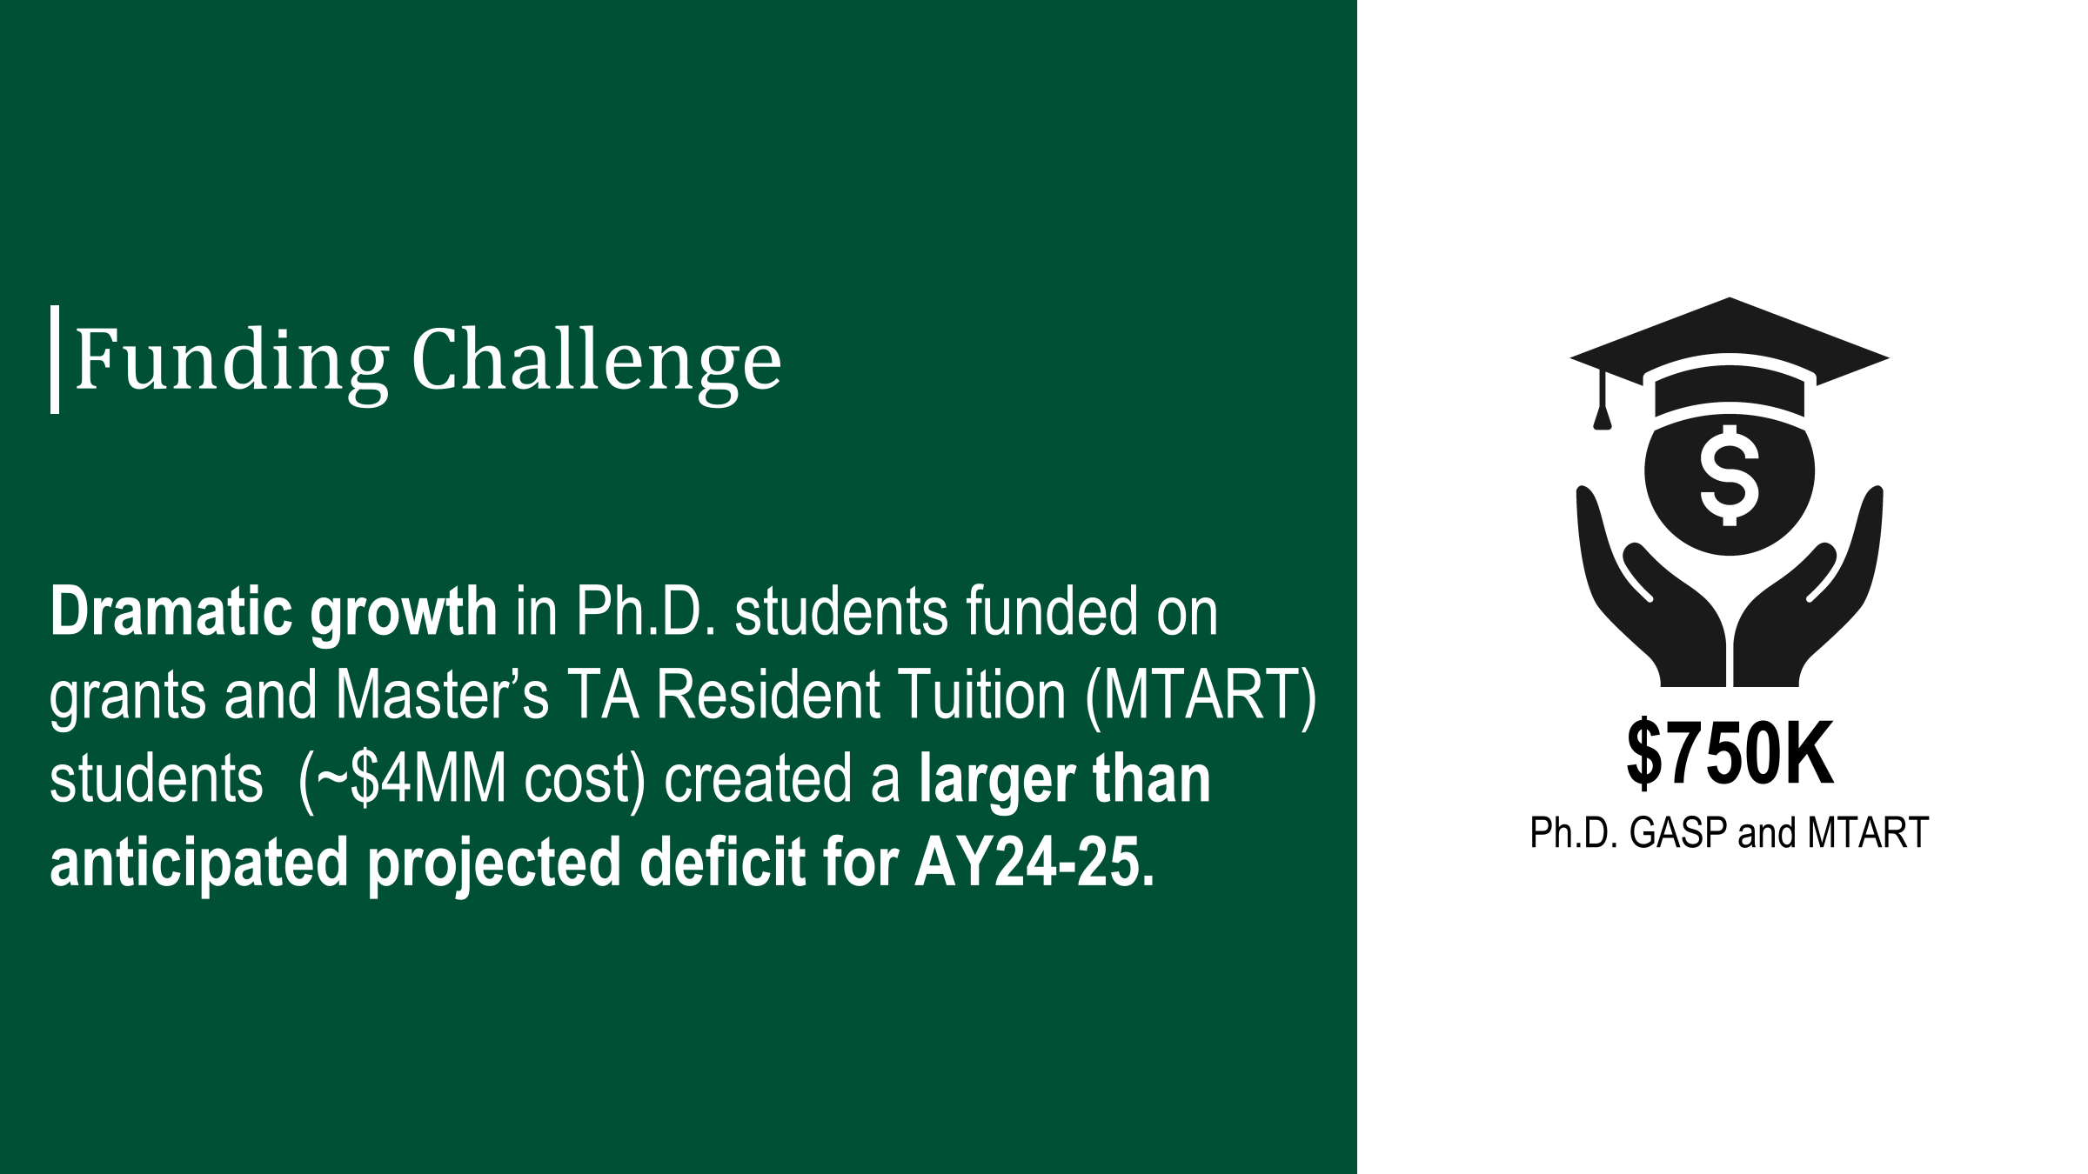
Notes:
Funding Challenge
With the $8,000 budgeted on grants for educational expenses, under the current GASP program, the Graduate School pays at least $11,036 in tuition ($19,036 minus $8,000) for every out-of-state or international Ph.D. student funded on grants. This is significant as approximately 80% of all grant-funded RAs on GASP are out-of-state or international students, and, currently, just 23% of grants pay the full $8,000 towards nonresident tuition. The plan projected that the savings from grant-funded tuition of $8,000 per non-resident student would be sufficient to fund the budget. However, the dramatic growth in Ph.D. students funded on grants created a larger than anticipated deficit.
For AY 24-25, the Graduate School is projected to run a deficit of approximately $750,000. To cover the projected GASP/MTART deficit for AY 24-25, the Divisions of Academic Affairs, Research and Business Affairs will provide additional funding. However, managing the growing funding gap with the current policy is unsustainable.
A committee of budget officials and leadership from Academic Affairs, Business Affairs, Research and the Graduate School reviewed data on planned enrollment growth and GASP/MTART funding requirements and concluded that the Graduate School award funds will not be able to cover the deficit beyond AY 24-25.

Slide 13
Solution and Planning for the Future
The Graduate School:
  Has provided each graduate program with a fixed budget for GASP/MTART funding. Program Directors have been encouraged to allocate the funding in a way that maximizes the number of students funded.
  For all new institutionally-funded RA and TA lines, the college/department will budget full GASP/MTART when hiring additional full-time GAs from their college/departmental funds
Notes:
Solution and Planning for the Future
On the road to an R1 designation, funding full-time Ph.D. and master’s TAs encourages enrollment and student success. We must find a solution that covers the budget shortfall in the Graduate School.
The Graduate School has provided each graduate program with a fixed budget for GASP/MTART funding. Program Directors have been encouraged to allocate the funding in a way that maximizes the number of students funded.
The Graduate School will discontinue the $1,000 scholarship that was provided to all Graduate Assistants to offset the cost associated with E&T and health fees.
The Graduate School will reduce summer research fellowships for Ph.D. students and master’s student graduate school grants if funding is not available.
For all grant-funded RAs, the grant budget must include the full non-resident tuition, where the funding agency allows, starting July 1, 2024. Grants written before July 1, 2024, will not be subject to the higher tuition. If the PI hires a student who has North Carolina residency, the PI can reallocate the difference between non-resident and resident tuition to other budget categories.
For all new institutionally-funded RA and TA lines, the college/department will budget full GASP/MTART when hiring additional (in excess of the current Graduate School allocation) full-time GAs from their college/departmental funds. As funding becomes available, priority will be given to providing GASP/MTART to these additional institutional-funded TAs and RAs.
In the long run, the GASP savings from the actions outlined above will enable the Graduate School to expand other high priority areas, such as supporting PIs who are funded by entities that do not allow for tuition support for students, sustaining MTART funding, growing the pool of TAs, and increasing graduate student stipends.

Slide 14
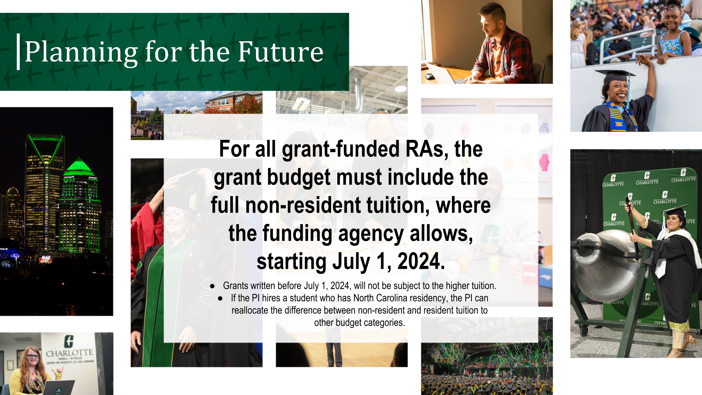
Notes:
Solution and Planning for the Future
On the road to an R1 designation, funding full-time Ph.D. and master’s TAs encourages enrollment and student success. We must find a solution that covers the budget shortfall in the Graduate School.
The Graduate School has provided each graduate program with a fixed budget for GASP/MTART funding. Program Directors have been encouraged to allocate the funding in a way that maximizes the number of students funded.
The Graduate School will discontinue the $1,000 scholarship that was provided to all Graduate Assistants to offset the cost associated with E&T and health fees.
The Graduate School will reduce summer research fellowships for Ph.D. students and master’s student graduate school grants if funding is not available.
For all grant-funded RAs, the grant budget must include the full non-resident tuition, where the funding agency allows, starting July 1, 2024. Grants written before July 1, 2024, will not be subject to the higher tuition. If the PI hires a student who has North Carolina residency, the PI can reallocate the difference between non-resident and resident tuition to other budget categories.
For all new institutionally-funded RA and TA lines, the college/department will budget full GASP/MTART when hiring additional (in excess of the current Graduate School allocation) full-time GAs from their college/departmental funds. As funding becomes available, priority will be given to providing GASP/MTART to these additional institutional-funded TAs and RAs.
In the long run, the GASP savings from the actions outlined above will enable the Graduate School to expand other high priority areas, such as supporting PIs who are funded by entities that do not allow for tuition support for students, sustaining MTART funding, growing the pool of TAs, and increasing graduate student stipends.

Slide 15
Solution and Planning for the Future
In the long run, GASP savings from these actions enables the Graduate School to expand other high priority areas, such as:
  Sustaining MTART funding
  Increasing graduate student stipends and research fellowships
  Supporting PIs who are funded by agencies that do not allow for tuition support for students
  Growing the pool of institutional TAs and RAs
Notes:
Solution and Planning for the Future
On the road to an R1 designation, funding full-time Ph.D. and master’s TAs encourages enrollment and student success. We must find a solution that covers the budget shortfall in the Graduate School.
The Graduate School has provided each graduate program with a fixed budget for GASP/MTART funding. Program Directors have been encouraged to allocate the funding in a way that maximizes the number of students funded.
The Graduate School will discontinue the $1,000 scholarship that was provided to all Graduate Assistants to offset the cost associated with E&T and health fees.
The Graduate School will reduce summer research fellowships for Ph.D. students and master’s student graduate school grants if funding is not available.
For all grant-funded RAs, the grant budget must include the full non-resident tuition, where the funding agency allows, starting July 1, 2024. Grants written before July 1, 2024, will not be subject to the higher tuition. If the PI hires a student who has North Carolina residency, the PI can reallocate the difference between non-resident and resident tuition to other budget categories.
For all new institutionally-funded RA and TA lines, the college/department will budget full GASP/MTART when hiring additional (in excess of the current Graduate School allocation) full-time GAs from their college/departmental funds. As funding becomes available, priority will be given to providing GASP/MTART to these additional institutional-funded TAs and RAs.
In the long run, the GASP savings from the actions outlined above will enable the Graduate School to expand other high priority areas, such as supporting PIs who are funded by entities that do not allow for tuition support for students, sustaining MTART funding, growing the pool of TAs, and increasing graduate student stipends.

Slide 16

Thank you for your time.
Notes:
UNC Charlotte is prioritizing graduate education as a key component of its mission to advance research and innovation.
Investing in recruiting and educating top-tier graduate students is crucial for the university to establish itself as a leading research institution.
By fostering strong graduate education programs, UNC Charlotte will continue to attract talented individuals who will contribute to groundbreaking research and ultimately propel the university forward.
Continued investment in resources and support for graduate students is essential for sustaining this momentum and achieving the university's long-term goals.

