Slide 1
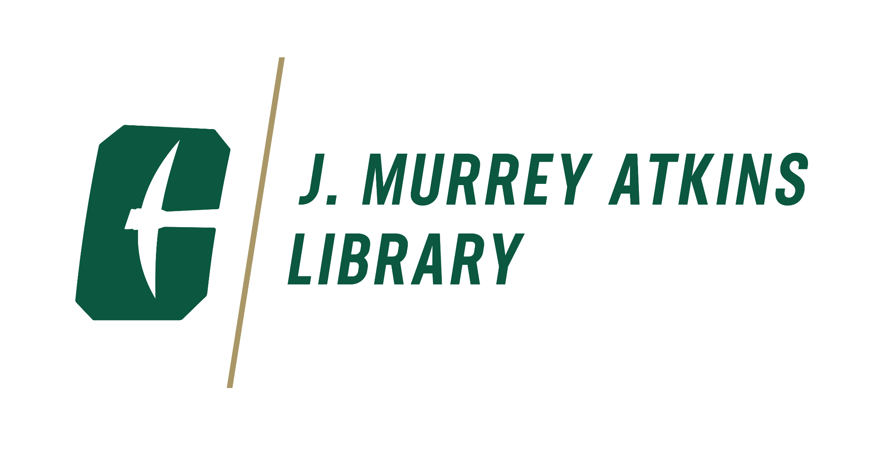
Open Access Policy
at UNC Charlotte
Liz Siler, Associate Dean for Collection Services
Jeff McAdams, Engineering and Open Education Librarian
Savannah Lake, Digital Scholarship Librarian

Slide 2
Open access policy
An open access policy:
Requires depositing a version of your work in your institution's repository
Allows you to opt out of this if required by your publisher
Aligns with UNC Charlotte’s copyright policy, under which faculty grant the University a non-exclusive license to use their work for non-commercial educational and research uses

Slide 3
Open access policy
Please see our draft policy:
Adapted from Harvard’s open access policy
Drafted in consultation with and approved by the Office of Legal Affairs
Recommended implementation date: Fall 2025

Slide 4
Why do we need this?
Makes our research more globally accessible
Provides one location for the university’s research output
Supports commitment on our campus to open research

Slide 5
Top-tier research institutions already have open access policies
Florida Gulf Coast
Rutgers
Boston University
Harvard
Bucknell
Florida State
Penn State
2010
UC System
2020
2005
2015
2022
MIT
UNT
Amherst College
UNC Chapel Hill
Duke
Northeastern Illinois University
California State, Northridge
Looking ahead, UNC Charlotte will become a top-tier research university, and we would benefit from having a Open Access Policy in place.
Notes:
Source: https://roarmap.eprints.org/
pulled the data here https://docs.google.com/spreadsheets/d/1liWN73tsBc6Ihn8yg8ifc2wVKUVNLDYy-mjjgmENTho/edit?usp=sharing

Slide 6
Will this limit where I can publish?
No. An open access policy supports green open access, which opens up access to your work without needing to pay open access fees or publish in an open access journal.
A copy of the work is deposited in an open access repository, typically the “accepted manuscript.”
Enables researchers to both publish in journals that publish behind a paywall and make their work open, without having to pay an article processing charge.

Slide 7
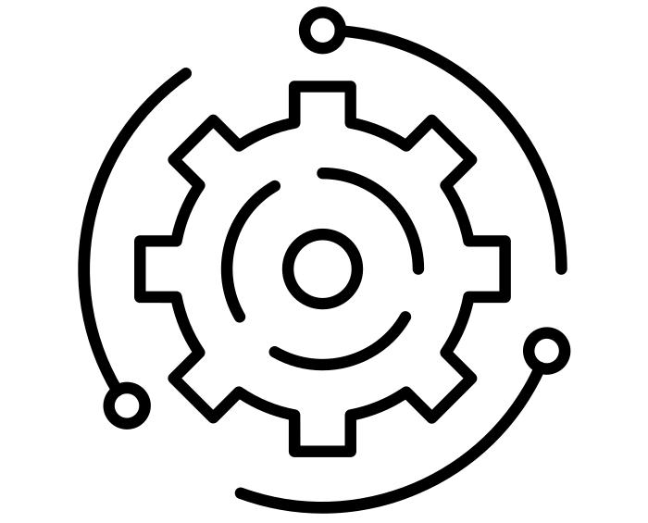
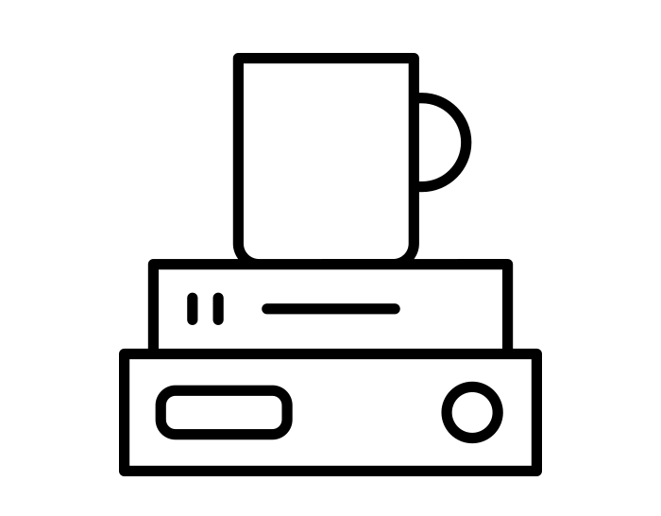
How will this work?
We recently selected a new system for Niner Commons and have done extensive research on how other universities have implemented open access policies. Guiding principles would be:
Automate the process of identifying and ingesting works, to streamline the workflow.
Do not add to faculty workloads, with the Library supporting the ingest of works.

