Slide 1
Faculty Athletics Representative Report
Michael J. Turner, PhD
Applied Physiology, Health, and Clinical Sciences

Slide 2
What is a Faculty Athletic Representative?
University’s Faculty Representative to NCAA and AAC
Liaison between Faculty/Administration and Student-Athletes/Athletic Department
Understand current key issues within Collegiate Athletics
Name, Image, and Likeness (NIL) and Transfer Portal
Work with the Student-Athlete Advisory Committee (SAAC)

Slide 3
Charlotte Athletic Performance
Last Academic Year – Teams won 8 championships (16)
Men’s Golf – 3rd straight NCAA Tournament
Women’s Tennis – 1st time to NCAA Tournament
Baseball won C-USA Tourney - lost in NCAA Reg Finals
Softball won C-USA Season and lost in Regional Finals
Men’s Soccer won AAC.
Men’s and Women’s XC finish 2nd in AAC
Indoor T&F – Women 1st and Men 2nd in AAC.

Slide 4
Charlotte Academic Performance
 | Spring 23 | Fall 23
Semester GPA | 3.145 (3.087) | 3.175 (3.107)
Cumulative GPA | 3.287 (3.206) | 3.251 (3.188)
Student-Athletes > 3.00 GPA | 62.7% | 68%
Student-Athletes at 4.00 GPA | 19.4% | 22%

Slide 5
Charlotte Academic Performance
Spring 2023, top Semester GPAs were Women’s Tennis (3.856) and Men’s Tennis (3.500).
Fall 2023, top Semester GPAs were Women’s Soccer (3.842), Women’s Basketball (3.624), and Baseball (3.468)
NCAA FAR Academic Excellence Awards
27 UNC Charlotte Awardees
Most in AAC (24 – Rice)

Slide 6
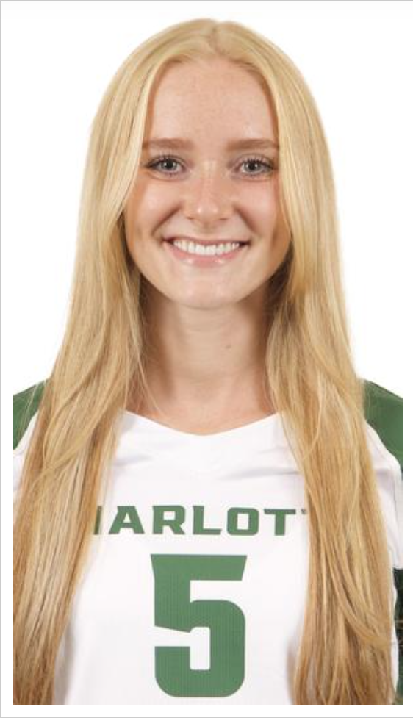
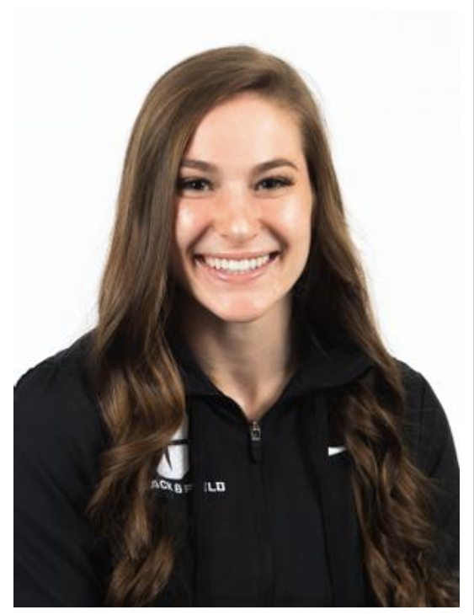
Charlotte Academic Performance
Mckenna Zelna (V-ball) - Goldwater Scholarship Nominee
Majoring in Earth and Environmental Sciences
Riley Felts (Pole Vault) - 2nd Place Indoor NCAAs
Completing Master’s in Civil Engineering

Slide 7
Charlotte Athletic Performance
 | 2003 | 2023 | Change
Enrollment | 17,959 | 30,298 | + 69%
Baccalaureates | 82 | 90 | + 10%
Athletic Teams | 12 | 19 | + 58%
Student-Athletes | 237 | 450 | + 90%

Slide 8
Charlotte Athletic Academic Issues
Second Half Semester Courses
Undergraduate Non-Degree Seeking Program
1 Year Master’s Degree Programs
Have Student-Athletes desiring B.S. And M.S. Programs
Prerequisite requirements
Limited Offerings (days, times, sections)

