Slide 1
BUILDING ON COMMON GROUND THE INCLUSIVE EXCELLENCE STRATEGIC PLAN, 2023-2033

Slide 2
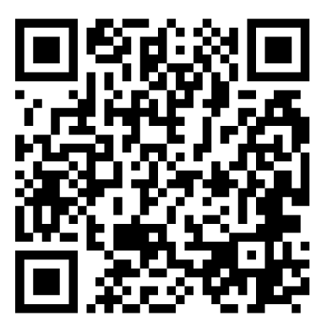
TODAY’S OBJECTIVES
Strategic Planning Process
Strategic Plan Overview
Inclusive Excellence Action Plan
Important Dates
Questions and Answers
https://diversity.charlotte.edu/common-ground
Scan the QR code to see the plan
Notes:
WE HAVE TWO MAIN OBJECTIVES FOR TODAY'S PRESENTATION

Slide 3
STRATEGIC PLANNING PROCESS
Nov 2021-Oct 2022 Dr. Wolfe joined UNC Charlotte analyzed 2 years of data collection, priority and objective development for detailed operational build out and sought plan feedback through public online and in-person survey (546 responses) to improve the framework
Present Efforts were made to align metrics with existing dashboards for Shaping What's Next and items relating to DEI in existing division and college strategic plans. Timelines were added. The final IESP draft has been approved and is now available for public viewing.
May 2021 Dr. Cheryl Waites Spellman, Interim Special Assistant to the Chancellor for Diversity and Inclusion, appointed a Diversity, Equity, and Inclusion Council and they began working on the inclusive excellence plan
Jan 2023 Steering committee and external consultant met to further evolve the plan with input from 60+ senior leader and mid-level managers
Notes:
What are the five salient areas that we need to address to drive DEI

Slide 4
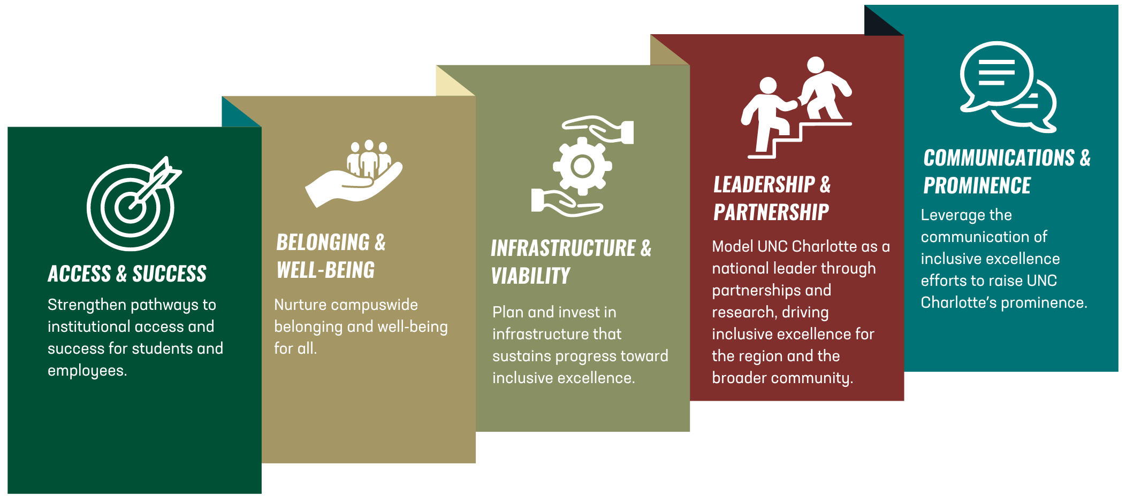
UNC CHARLOTTE’S MODEL FOR INCLUSIVE EXCELLENCE
UNC Charlotte’s Model for Inclusive Excellence
represents our customized approach for how we synergize and support our collective diversity, equity, inclusion and belonging efforts.
Notes:
What is it like here and how

Slide 5
BUILDING ON COMMON GROUND
BUILDING ON COMMON GROUND: INCLUSIVE EXCELLENCE STRATEGIC PLAN
10-year plan with a 5-year refresh period
Carefully crafted in a manner that is consistent with state policies
Functions as a guiding framework consisting of priorities, objectives, and metrics
Composed of four parts: Intro, Priorities and Objectives, Dashboards, and Timeline
STANDARDIZES DIVERSITY, EQUITY AND INCLUSION ACROSS CAMPUS
Shared language and understanding
Building upon existing efforts
Opportunities to reimagine growth
Shared responsibility, collaboration, capacity building, measured actions and ongoing improvement
DESIGNED TO INTEGRATE INTO EXISTING WORK
You are already doing the work
Opportunity to “tell your story”
CREATES SPACE FOR UNIT-LEVEL CUSTOMIZATION
We provide priorities and objectives
Your plan adds the actions
Notes:
How are we advancing inclusive excellence in our area?

Slide 6
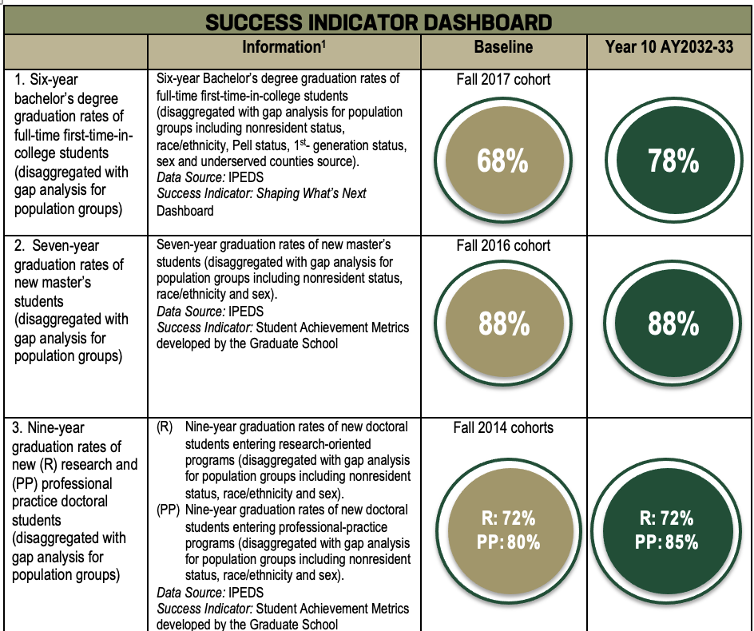
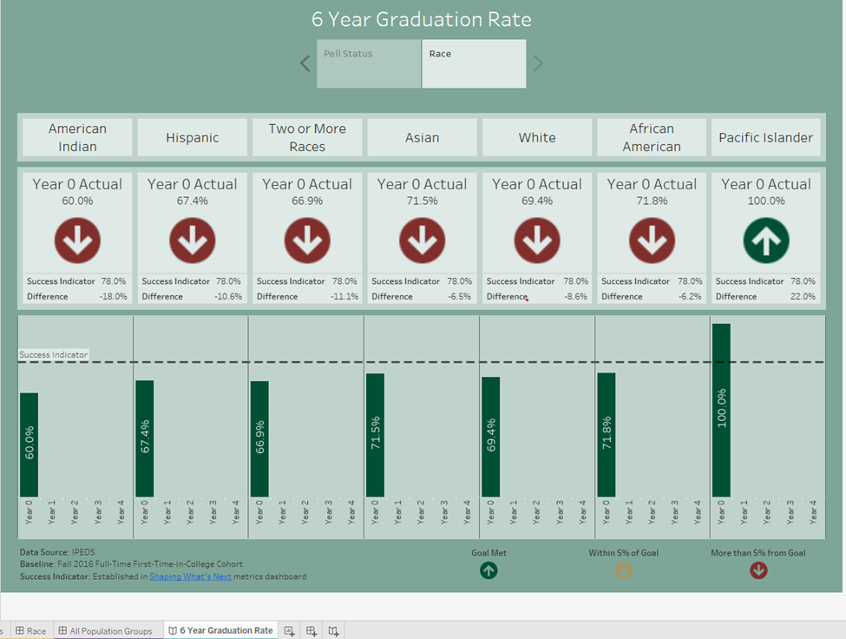
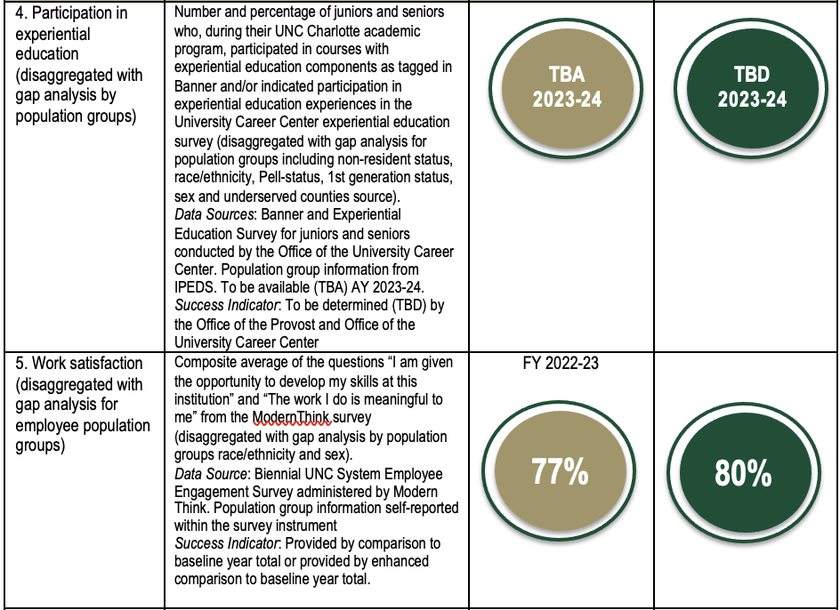
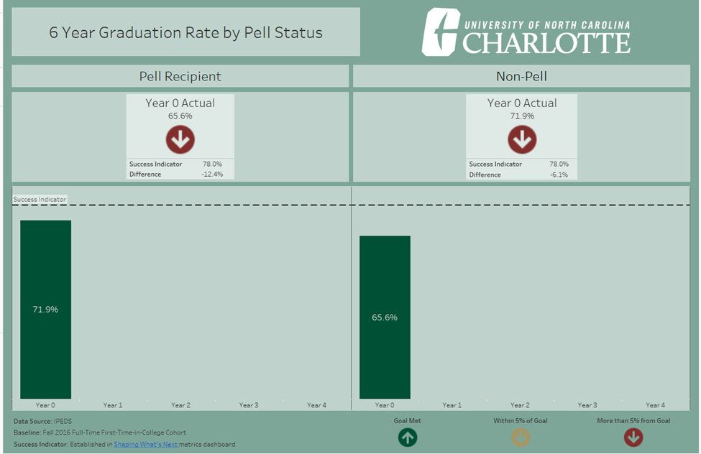
DASHBOARD + DATA CARDS
The primary data presentation will be the dashboard that mirrors SWN
Secondary data presentations will be website visualization cards accessible by clicking through the dashboards
People-related data will be disaggregated by population groups appropriate to the dashboard item
The success indicator line (- -) reflects our goal and the bars--our progress
Breakdown views: A viewer can toggle the tab for disaggregate data
A similar dashboard image will be in the pdf. version
Above is a disaggregate breakdown by Pell Status
Notes:
These are images of the public facing data.

Slide 7
LOOKING AHEAD: IE ACTION PLAN
UPON COMPLETION YOUR ACTION PLAN WILL CONSIST OF THE FOLLOWING:
Introduction: A brief overview of the university’s Inclusive Excellence plan about the college or division’s mission and a short description of the process used to develop YOUR unit-level plan (500 words or less).
Strategic Priorities, Objectives, and Actions for the college or division. The priorities and objectives will be taken directly from Building on Common Ground: The Inclusive Excellence Strategic Plan, 2023-2033. The priorities and objectives are already provided, but YOU will create the actions for each objective.
Communication Plan: A brief overview of how you will communicate your IE Action plan, progress, and impacts to stakeholders, community partners, and others. Please include information on how people can monitor progress and participate in the success of the IE plan (i.e., website, summary report, presentation).
Notes:
Metrics for the actions do not have to be reported. However, we encourage the use of measurement to note progress.

Slide 8
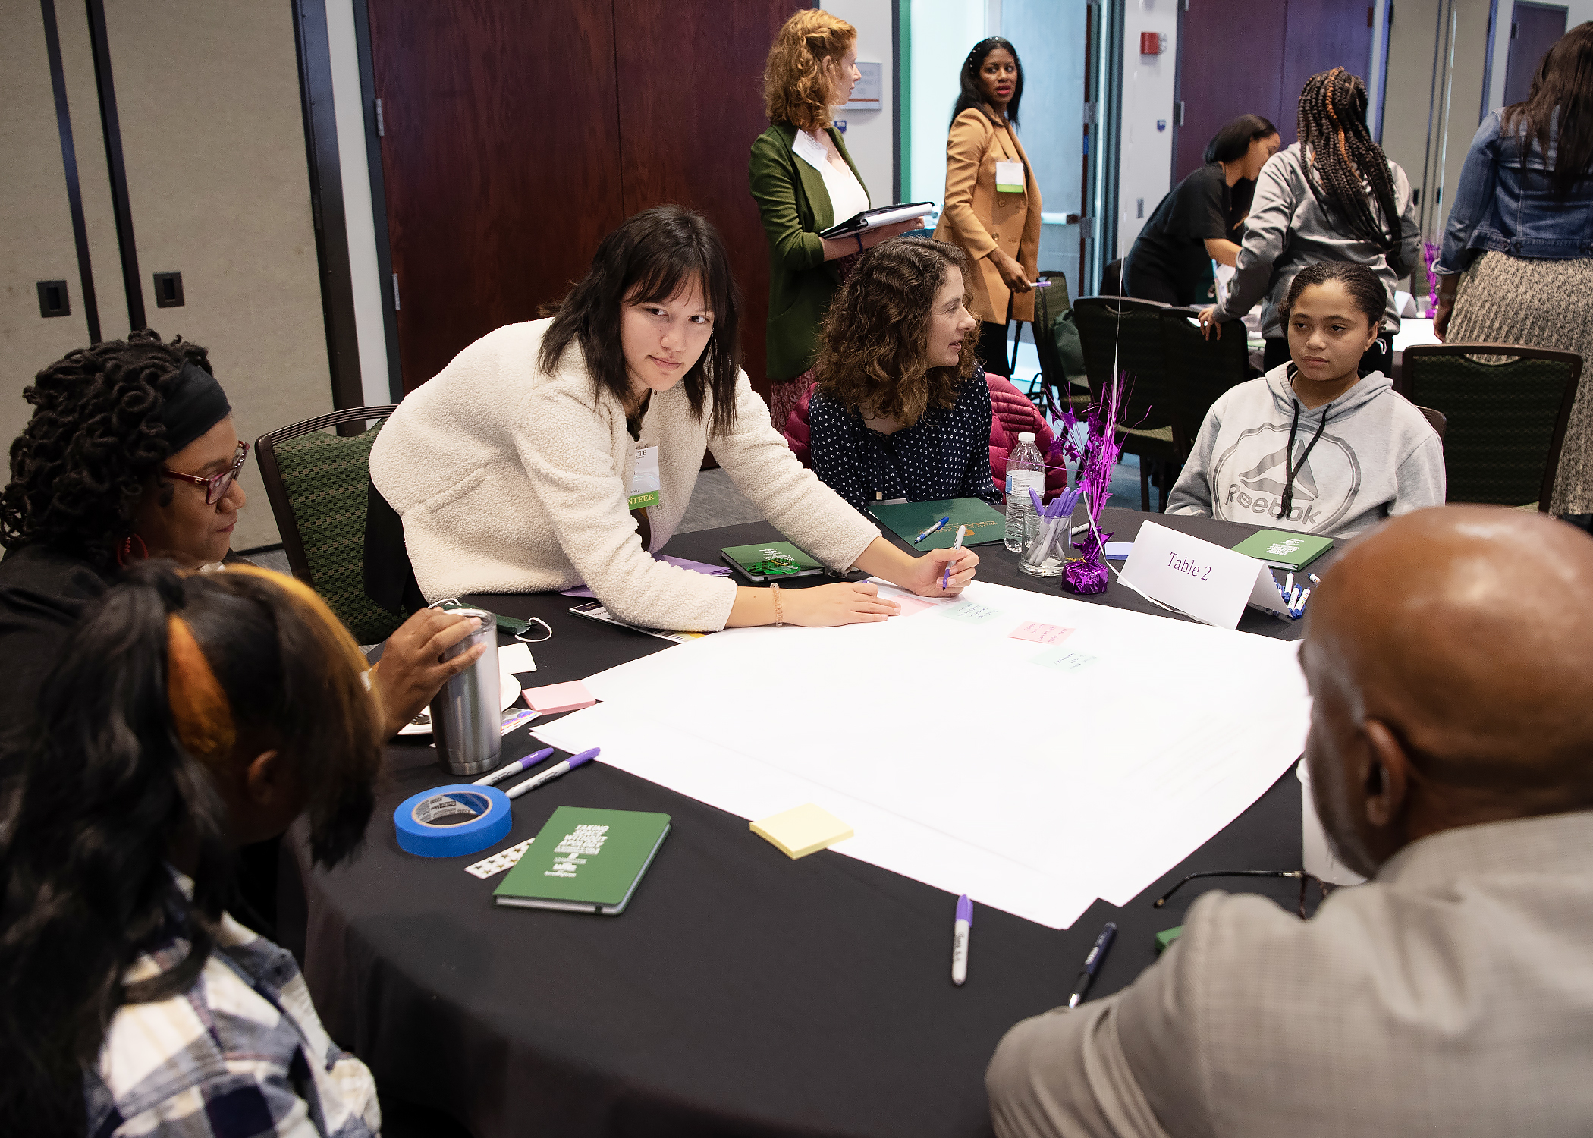
YOUR UNIT-LEVEL ACTIONS
ACTIONS SHOULD ADDRESS THE FOLLOWING
What steps will your college take to address the listed objective?
How do you know if the intent of your action(s) matches the targeted impact?
Is this action achievable in the allotted period?
Who is responsible and what resource(s) will be used?
Notes:
This is where we ask that you think through how you will measure your actions. You will not be asked to submit your metrics to us. Your metrics are for your own internal understanding of intent versus impact.

Slide 9
STRATEGIC PLAN MULTI-PHASE ROLLOUT
[DEC 2023-JAN 2024]
[JAN 2024-MAR 2024]
[MAR 2024-NOV 2024]
INFORMATION SESSIONS
Early plan access to ADIE, Deans and Cabinet (once approved)
PLAN WORKSHOPS
Monthly college and division-level workshops
AFTERWORK
Monthly IEAP workshops
Information sessions with each of the colleges and divisions
Chairs and program directors
Faculty and staff governance
SGA and GPSG information
Draft submissions and feedback
Plan development resources provided
Draft submissions and feedback
Semester check-ins
Yearly progress report:
What have you achieved in the past academic year?
PHASE I
PHASE II
PHASE IV
PHASE III
Chancellor Review and Approval
Final draft copy dissemination to key leaders
Presentation to Cabinet
Campus letter
Securing dates
Prep Workshops
PRIOR TO LAUNCH
Campus Letter
Emails from key campus leaders
Additional internal communications as participation reminders
Copies of the plan made available
Date reminders
ANNOUNCEMENT

Slide 10
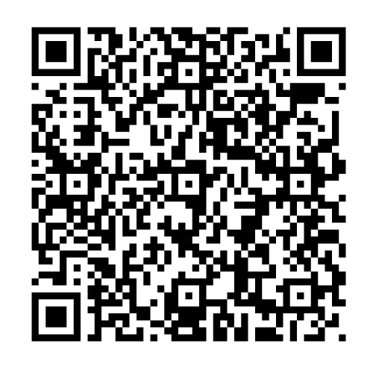
UPCOMING IMPORTANT DATES
INFORMATION SESSIONS
February 1- March 21st
REGISTRATION FORM IS OPEN!
COLLEGE WORKSHOPS
March 12, 1-2:30 p.m.
April 8, 1-2:30 p.m. (virtual)
DIVISION WORKSHOPS
March 28th, 9-10:30 a.m.
April 24th 9:30-11 a.m. (virtual)
DATA WORKSHOPS
March 20, 10-11:30 a.m.
April 4, 1-2:30 p.m. (virtual)
April 16, 10-11:30 a.m.
April 29, 1-2:30 p.m. (virtual)

Slide 11
REVIEW AND REMINDERS
GET FAMILIAR, GET INVOLVED, AND GET GOING
Read and learn the plan
Support your identified team leader in plan development
Use the available resources
Review your plan with Dean, ODI, and the IESP Plan Review Team for feedback
Work with your teams to revise and finalize accordingly
Submit your plan
Broadcast your plan to your wider college or division
Routinely monitor your progress and share your wins

Slide 12
369 CONE UNIVERSITY CENTER
9025 UNIVERSITY RD
CHARLOTTE, NC 28223
704.687.5354
DEI-OFFICE@CHARLOTTE.EDU
DIVERSITY.CHARLOTTE.EDU

