Slide 1
UNC Charlotte Faculty Council
Welcome!
Strategic Planning Session
May 13, 2021
1:00 – 3:00 p.m.

Slide 2
Agenda Review

Slide 3
Thank you for your service
Policy-Making Responsibilities and Authority
setting minimal general degree requirements for the University,
setting minimal University admission standards,
establishing academic plans and curricula and developing and reviewing proposed new programs, including auxiliary academic programs (e.g., continuing education);
establishing grading systems and setting academic policies concerning withdrawal, suspension, and retention;
establishing policies and standards for the granting of academic credit;
establishing policies for the granting of degrees, academic and honorary, and acting to award such degrees;.

Slide 4
7. establishing policy, within the limitations of The Code, and the tenure document, concerning promotion, appointment, reappointment, tenure, and post-tenure review of faculty (It is recognized that the tenure document is, and will continue to be, subject to judicial interpretation and to interpretation by the administration after hearing the advice of appropriate faculty bodies as designated by the Faculty Council);
8. establishing policies governing academic counseling of students;
9. establishing policy for the allocation of those UNC Charlotte research funds which are open to the solicitations of the general faculty; and
10. establishing policies and procedures for the faculty review of University administrators

Slide 5
Consultation Responsibilities
1. the academic calendar,
2. salary increases,
3. academic leave,
4. academic workloads,
5. allocation of academic positions,
6. appointment of administrators,
7. library user services and collection department,
8. grants and contracts,
9. academic computer use,
10. course scheduling,
11. allocation and use of existing facilities,
12. transportation and parking,
13. program and design of new facilities,
14. changes in the formal structure of colleges, departments, or other units in the division of Academic Affairs.
Notes:
In the chat: Is there anything you think is missing from this list?

Slide 6
Let’s hear from
SGA – 21/22 priorities
Dick Beekman, Student Body President

Slide 7
Provost’s FC Workplan
Procedures for Resolving Faculty Grievances (carryover from 2020-2021). Following our conversations over the past two years regarding the Grievance Procedures, the policy and procedures have been revised to: 1) eliminate the University Mediation Coordinator (UMC) and replace with a Faculty Grievance Manager, and 2) investigate discrimination complaints prior to Grievance Committee review. The current drafts have been reviewed by the Grievance Committee and FEC but have not been formally considered by the Faculty Council.
Academic Policy Equity Review: Students (carryover from 2020-2021). As a continuation of an equity audit of our policies and practices, I ask that the Student Equity Audit Working Group complete their policy revisions and creation of an audit tool for departments in collaboration with FAPSC, the FEC, and the Faculty Council. I also ask that this work continue with a review of graduate student policies and procedures in coordination with the Graduate Council and Graduate School. Assistant Provost Leslie Zenk continues to lead this effort in coordination with the Office of Undergraduate Education and the Graduate School.

Slide 8
University Policy 101.3: Relationships between Students and Faculty Members or Other University Employees.
Tenure Policies, Regulations and Procedures (carryover from 2020-2021). The Tenure policy is in the process of being revised to incorporate: 1) proposed changes from the Faculty Council regarding the review procedures for Special Faculty Appointments as well as 2) updates to align with forthcoming changes to UNC System Office policy including the removal of appeals at the Board of Governors level. I request review by the Faculty Employment Status Committee (FESC), FEC and Faculty Council before the final changes are approved by the Board of Trustees.
Adding a violation to the Code of Student Academic Integrity. The Office of Student Conduct and Academic Integrity has seen an increase in the number of faculty members submitting academic integrity violations for violations of syllabus policies. Currently, since there is not a violation of this type to charge students in our code, faculty are instructed to handle these syllabus policy violations themselves with the student. Some of our UNC institutions (NC State and UNC-Chapel Hill, for example) have a specific violation articulated in their code to allow students to be found in violation of the code for failing to adhere to a policy articulated in the syllabus. .

Slide 9
Student Evaluation of Teaching (SET) Task Force (carryover from 2020-2021). In February 2021 I charged the Student Evaluation of Teaching Task Force with: a) reviewing the content of the questions used for course evaluations as well as the introductions given to students, b) drawing on existing research to develop a better curated list of core evaluation questions that avoid bias and are focused on the educational process rather than instructor personality and other qualities, and c) developing a list of best practices to mitigate bias in question development for departments and colleges who wish to add additional, unique questions. I ask that the work of this task force be completed during the 2021-2022 academic year.
H Grade. We have had the “H” grade (Honors) available as an option since 1969, however is not used by the Honors College or the Graduate School; in the 2019-2020 academic year, the H grade was only assigned 26 times, only 5 times for honors courses. During the 2020-2021 academic year the H grade was redefined to designate “high pass” for undergraduate students who opted for P/N grading. I ask that FAPSC consider the relevance of the H grade, whether it needs to continue to exist, or whether it should be redefined.

Slide 10
Course Numbering and Status. During the 2020-2021 academic year there were many situations in which we were required to be able to determine the type of course based on the course number as defined in the Course Numbering and Status policy. As such, it became clear that there are some types of experiences that are not well-defined under this policy. As such, I ask that FAPSC review our suggested revisions for consideration to make the numbering policy more clear for our thesis and dissertation courses as well as our clinical and student teaching experiences.
Student Request: The SGA Academic Affairs Vice President has requested that the faculty consider the award of Chancellor’s and Dean’s list distinctions in the summer term.
Seven-Year Policy Review. Finally, there are five policies that are due for their seven-year review (two that are a carry-over from last year). I am requesting that FAPSC or the appropriate standing committee review each of these policies for relevance, accuracy, or gaps. Any changes recommended need to be considered by the Faculty Council. If there are no changes, please notify Matt Wyse, Faculty Governance Assistant, that the review has taken place and is complete.

Slide 11
Break out rooms
Introduce yourself
Strengths, Weaknesses, Threats, Opportunities
Select a member to record feedback in form
30 minutes
Provide feedback on form
https://forms.gle/bvngHgKqhDbTSkY26

Slide 12
Faculty Compensation
Susan Harden
Faculty Council Strategic Planning Session Thursday, May 13 1-3 p.m.

Slide 13
Thesis
UNC Charlotte faculty are high-performing and fundamental to the historical success of institutional performance measures.
Increases in faculty compensation do not reflect faculty performance over the last ten years.
Faculty are stretched. (Some: beyond burnout)
If the next ten years mirror the last ten years, significant and long lasting harm will be sustained by the faculty at UNC Charlotte.
We must look clearly at the data.
Possible Proposal: Seeking a long-term plan from UNC Charlotte leaders to address faculty compensation

Slide 14
UNC System Strategic Plan and Performance Framework
Higher Expectations
In 2017, UNC Charlotte signed a Performance Agreement
Measures: Low income completions; 5 year graduation rates, UG Degree Efficiency, Research Productivity; etc.
“UNC Charlotte stands out as the single institution, as of this writing, to take on seven stretch goals.
Promises made / promises kept: We Deliver the Outcomes

Slide 15
How Did UNC Charlotte Perform? Did we stretch? Note During Pandemic.

Slide 16
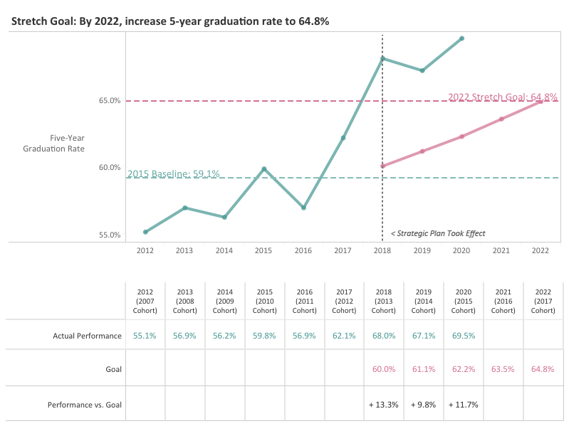

Slide 17
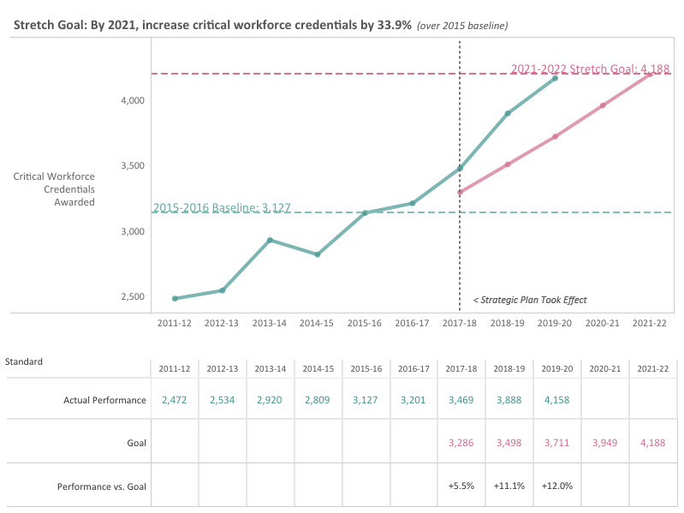

Slide 18
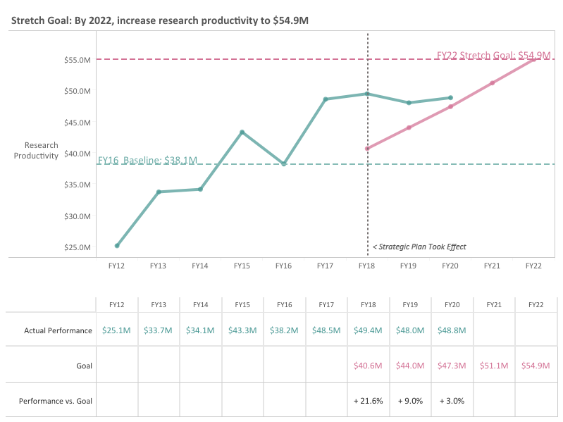

Slide 19
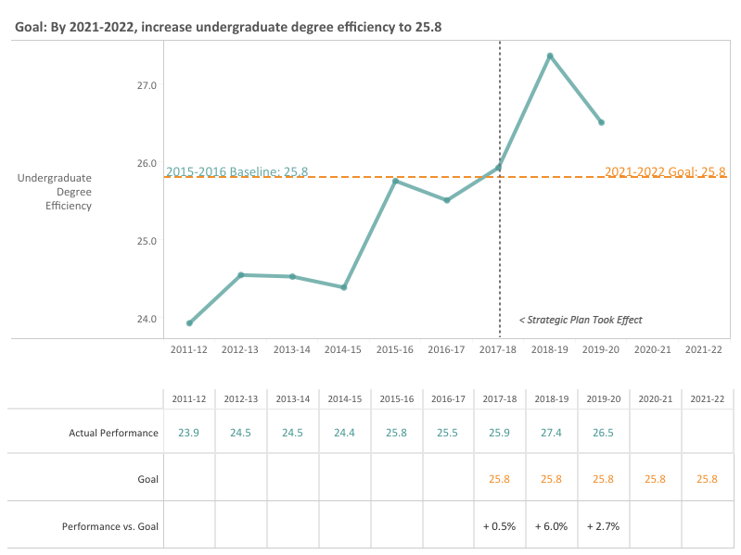

Slide 20
Organizational Factors that Contribute to Burnout (use pandemic lens to consider)
Unsustainable workload (homeschooling, caregiving)
Perceived lack of control (pandemic)
Insufficient rewards for effort (pay)
Lack of a supportive community (pre-tenure, adjunct, lecturer)
Lack of fairness (raises in other fields; inflation; administrators rewarded for the work of the faculty)
Mismatched values and skills
Moss, Jennifer (February 10,2021). Beyond burned out. Harvard Business Review.

Slide 22
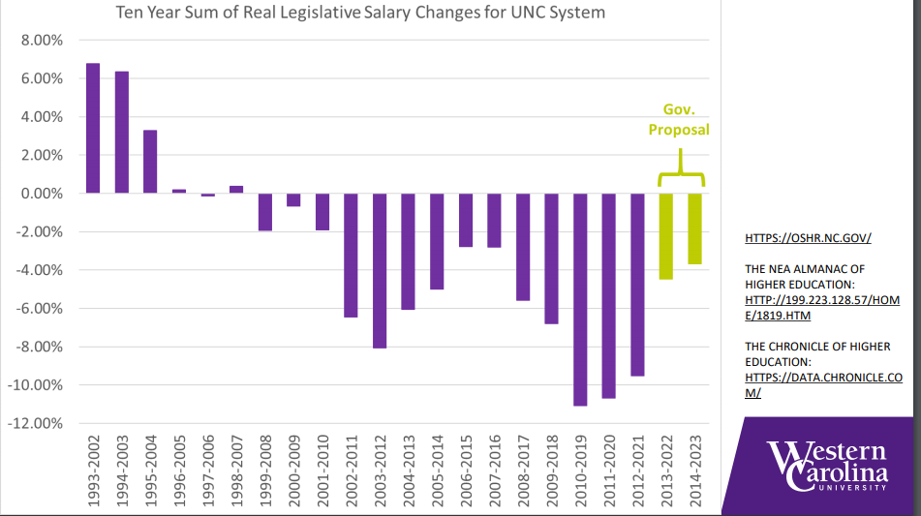

Slide 23
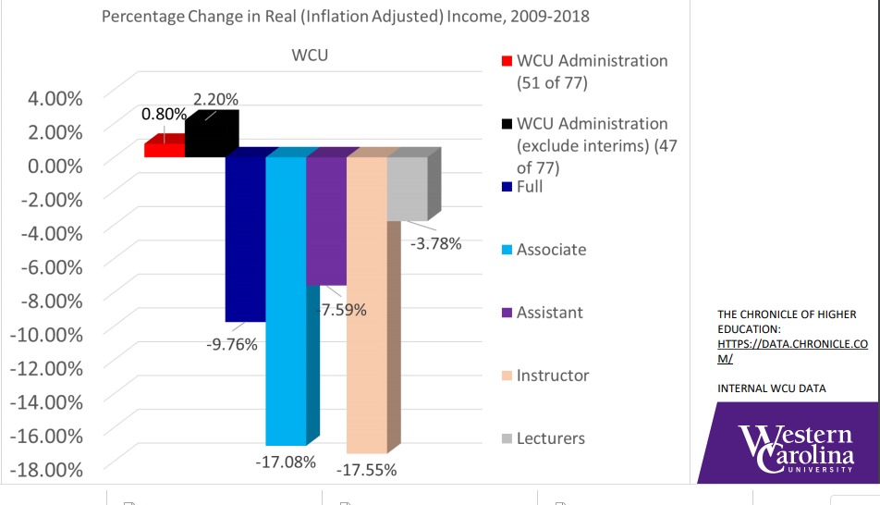

Slide 24
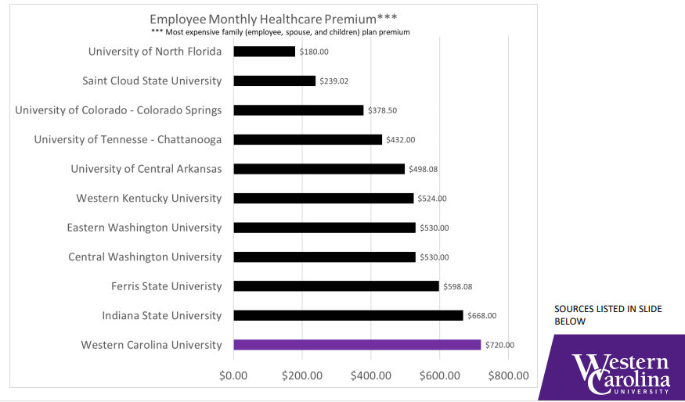

Slide 25
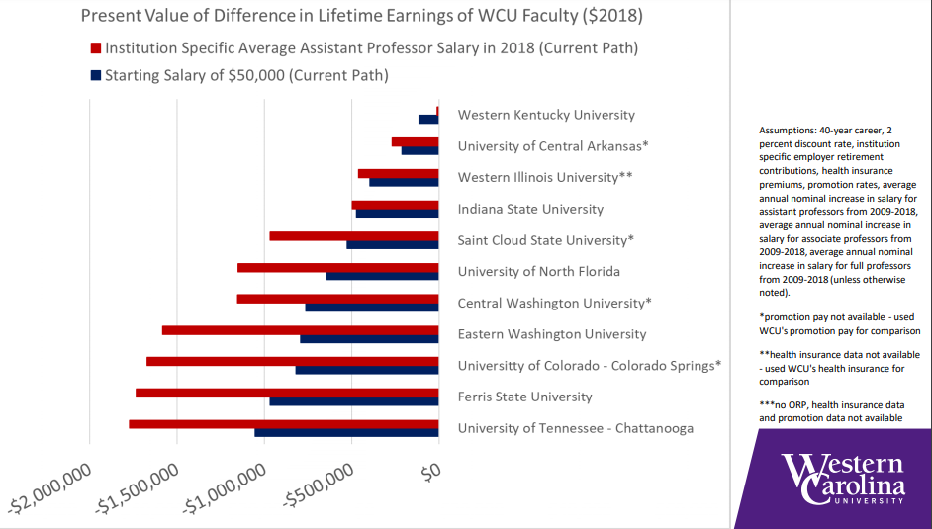

Slide 26
Cost of Living in Charlotte Area
Average home price approximately $300,000, up 11% this year

Slide 27
Faculty Council Compensation Study Committee Ad hoc Committee Co-chaired by Craig Depken (FESC) Rob McGregor (FWC) Looking for volunteers for committee

