Slide 1
State of Information Technology
Presentation for Faculty Council
November 14, 2013
Mike Carlin
Vice Chancellor for IT and CIO

Slide 2
Completed Projects July 2013 to Present
HR Data Mart Enhancement
Decommission Old Enterprise Storage
Graduate Academic Petition
Grade Change Process
Emergency Alerts System
Treasury Services Financial Statements Development
49er Mart Journal Voucher Entry for Internal Vendors

Slide 3
Completed Projects July 2013 to Present
Payment Card Industry (PCI) Migration to New Network
Moodle 2.0 Upgrade Migration to New Servers
VMware Infrastructure Expansion
Deck J RUP 4
Centralized Apple Device Management
DNS/DHCP Replacement

Slide 4
Completed Projects July 2013 to Present
Benefit Eligibility & Deduction Vendor Change
Banner Upgrades
WiFi Expansion

Slide 5
Quick Facts
Total Tickets Submitted and Total Resolved by ITS
July 2013 to Present

Slide 6
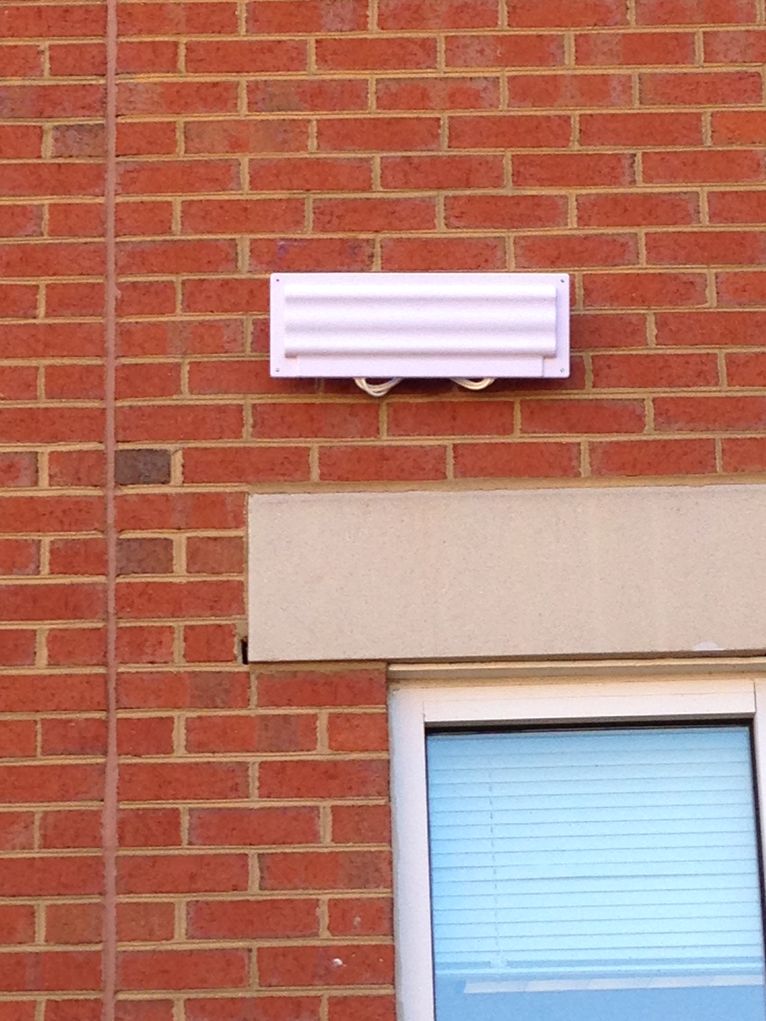
Highlighted Projects
Campus Wireless
Increased Wireless Access Points (WAP)
949 Existing WAPs
353 WAPs Upgraded
601 New Installs
Total 1,550 WAPs Campus-Wide
Completed in 6 Months

Slide 7
Highlighted Projects
Year

Slide 8
Areas of Focus
Consistent and Reliable Delivery of All Services
Continued Improvement of Customer Service
Building Trust and Confidence With Our Customers
Strengthen Disaster Recovery Capabilities
Enhance System Redundancy at MCNC (Research Triangle) Data Center
Extend Non-Banner Service Redundancy

Slide 9
Areas of Focus
Continued Virtualization of Physical Servers
Improves Disaster Recovery
Greater Efficiency & Fewer Wasted Computing Resources
Migrate and Upgrade Aging Systems
Dozens of Systems Running Old and Soon to Be Unsupported Operating Systems
Many Physical Servers Out of Warranty

Slide 10
Areas of Focus
Training and Awareness
Improve Documentation and Support for Services and Applications
Enhance Communications and Transparency to the Campus Community
IT Master Plan
Total of 9 Sessions Over the Last Two Months
Completing Last Three Work Sessions This Week
Developed Draft Initiatives From Each Session
Draft Report in Early Spring

Slide 11
ITMP Schedule

Slide 12
Areas of Focus
Continued Improvements to Security
Assess Effectiveness of Current Protections
Ensure Appropriate Balance Between Security and Ease of Use
Provide Greater Transparency to Campus Community

Slide 13
Current ITS Sponsored Projects
Security and Compliance
UNC Charlotte’s Adoption of ISO 27002
Step 1 Policy
Step 2 Standard
Step 3 Guideline(s)
Step 4 Form(s)
Beginning With Data Policy and Data Use Guidelines
Clear and Concise Definitions
Easily Understood Data Levels (0 to 3)
Audits

Slide 14
Current ITS Sponsored Projects
Identity Management and Single Sign On (SSO)
Shibboleth and InCommon Federation
Develop and Identify Campus Rules and Convert into Actual Workflows with IDM Tool
Benefits
Complete End to End Account Life Cycle Management
Guest & Sponsored Accounts
Shared Resource Access Between Institutions
Federated Authentication with Member Institutions

Slide 15
Transformative Project
Virtual Lab Desktop Pilot Phase II Spring 2014
Current Participants
College of Health and Human Services
College of Business
College of Computing and Informatics
Benefits
Provides Windows Lab Image Via Web Browser
Any Time Any Where Access – No Longer Bound to the Lab
Utilizes New Enhanced Campus WiFi
Works on Tablets, iPads, Laptops
Turn Any Classroom Into A Computer Lab

Slide 16
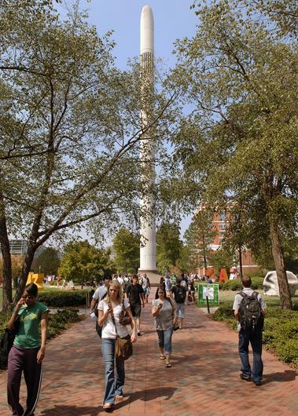
Questions?

