Slide 1
Faculty Council Report
Charlotte Board of Trustees
April 27, 2023
Susan B. Harden, Faculty Council President
Happy End of Semester
Happy End of Faculty Council President Term

Slide 2
Key Points:
We are grateful for your advocacy and we need it now, more than ever.
Charlotte Faculty and Staff are high performing. We need to reward them.
Housing affordability, cost of living including childcare, and salary compression remain top long-term concerns.
It’s been a challenging month for the Faculty with stress from potential legislation regarding eliminating tenure and other political / policy changes.

Slide 3
Who are the UNC Charlotte Faculty? – My Last Message
Subject experts that love learning and discovery
We endured a long process, with multiple “high performance” hurdles to demonstrate our expertise (masters, doctorate, highly competitive hiring process, super rigorous process of tenure to demonstrate contributions) – think Navy Seals for the brain. All could find jobs in private industry.
We love the trinity of teaching, research, and service
80 percent faculty members with Ph.D.s in the U.S. trained at just 20 percent of universities – Most Ph.Ds work at an institution less prestigious than where they graduated (Nature, Sept. 2022)
Our higher education values are unique compared to the world: we believe that our children from every social station deserve to be instructed by the best in their fields – secret to American economic mobility and why people from all over the world want to send their children to American universities like UNC Charlotte.
UNC Charlotte Faculty are also caring and hardworking. Such good people.

Slide 4
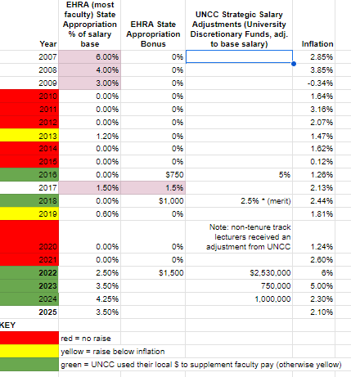
Salary – We asked for a long term plan and we are seeing progress
The Cost of Living and Inflation (Food and Housing) is some of the highest in the nation
We are moving in the right direction but we aren’t “getting ahead”
We continue to perform at high levels.

Slide 5
Deloitte UNC System ROI Study
LESS APPROPRIATION; HIGHER ROI

Slide 6
Faculty Need Your Advocacy
HB 715 Eliminates tenure for Faculty hired after July 1, 2024
Key Points:
Tenure helps to secure highly motivated, high performing people to workplaces with outdated public pay structures that cannot compete with the private sector compensation options (stocks, bonuses, etc).
Public higher education will never be able to compete – people will leave and the secret sauce that creates upward mobility for millions of young people will be lost.
People don’t understand tenure (understandably) – please ask me questions about it. I want to help address any questions or concerns.
Also concern about political influence in general (Chancellor hiring, Accreditation, Curriculum, DEI) – Lots of distress, overshadowing our good work and good news about salaries. This isn’t meant to demean others with different perspective, but it’s important to understand our faculty point of view.

Slide 7
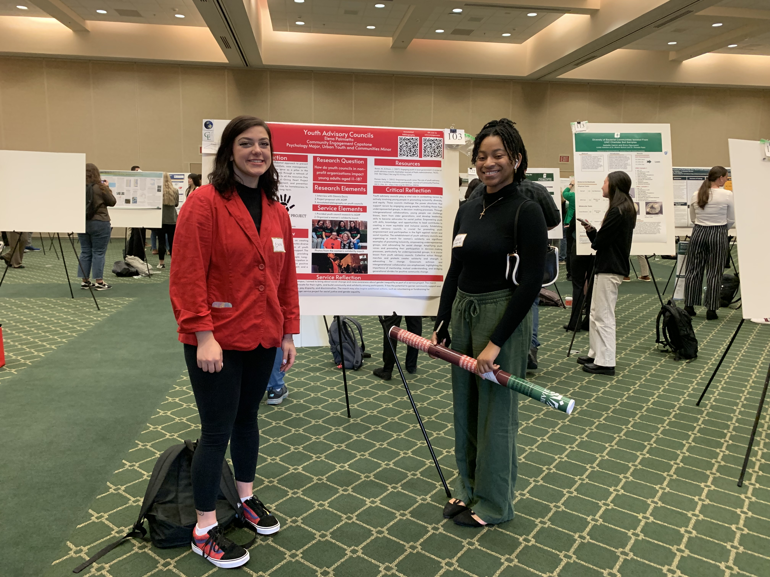
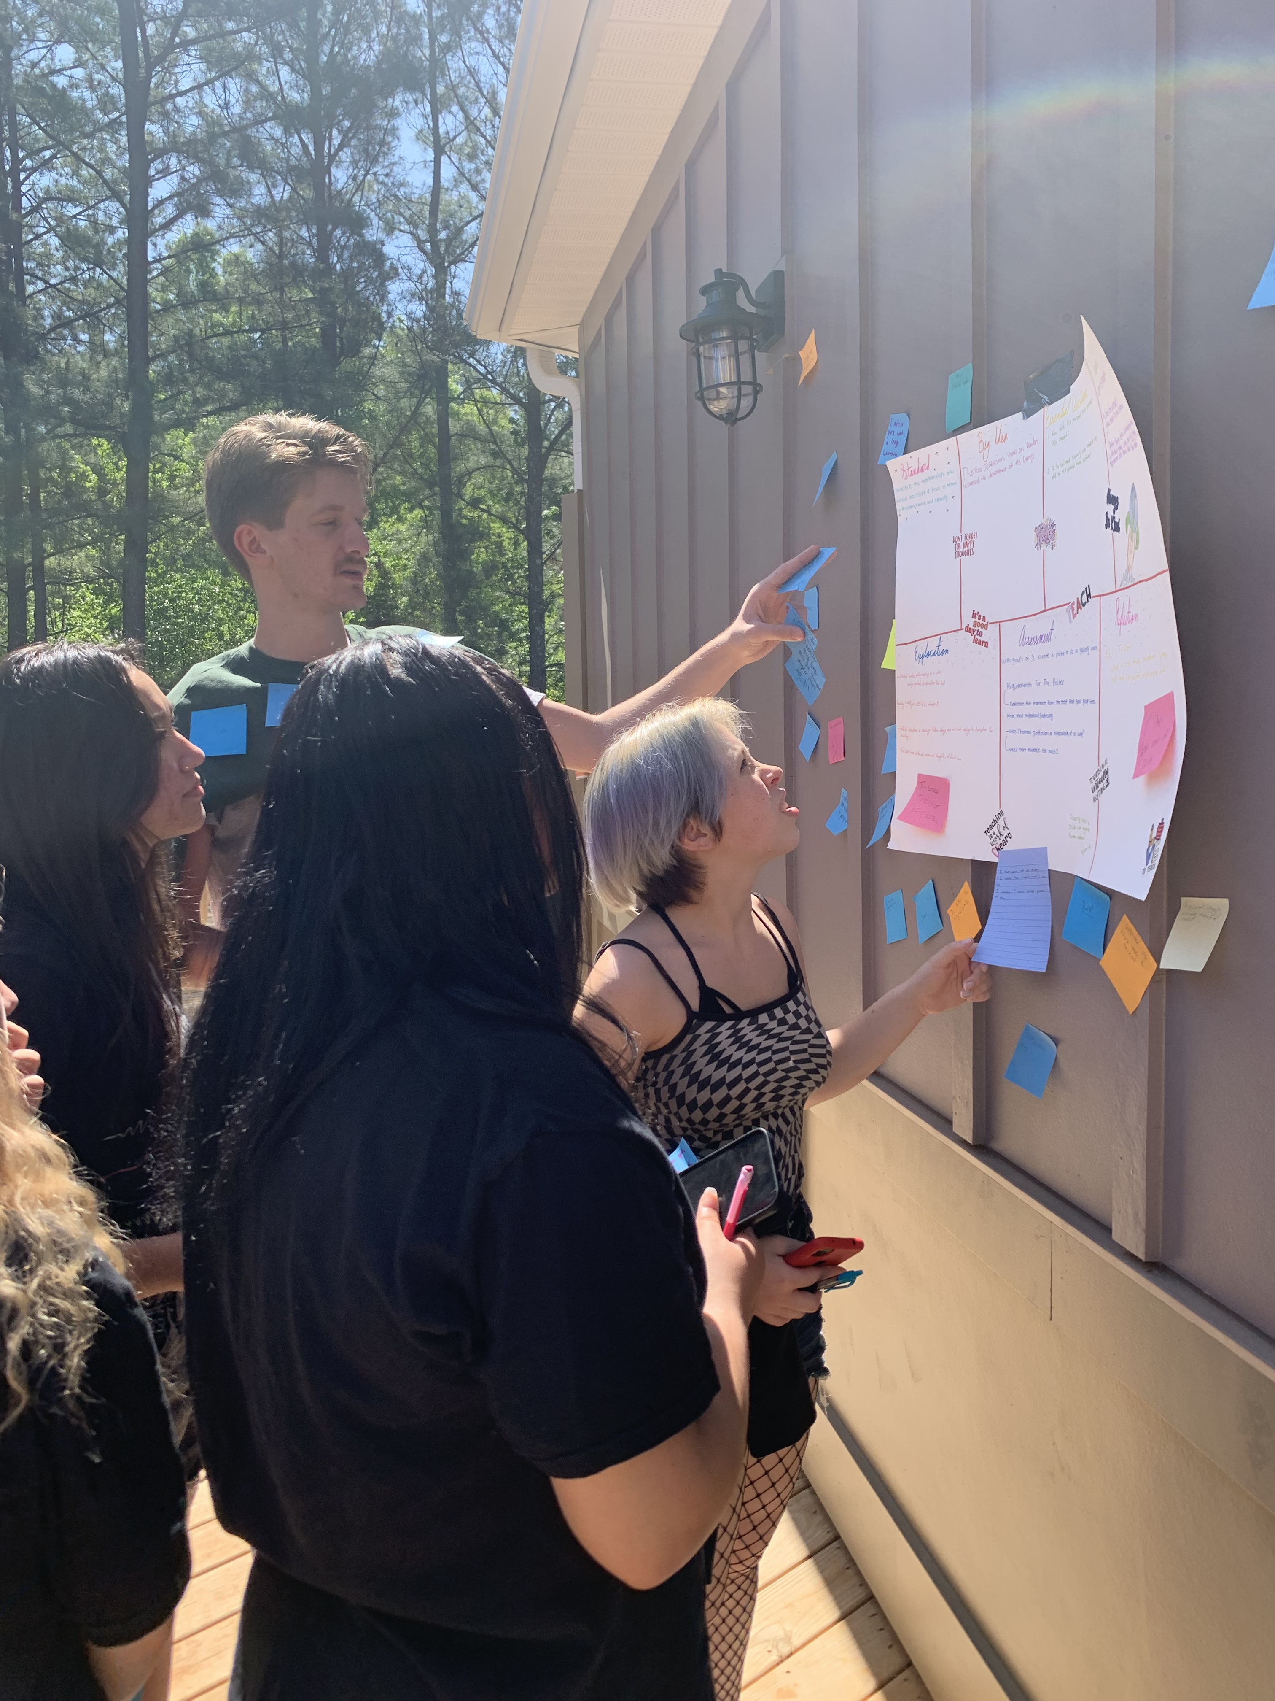
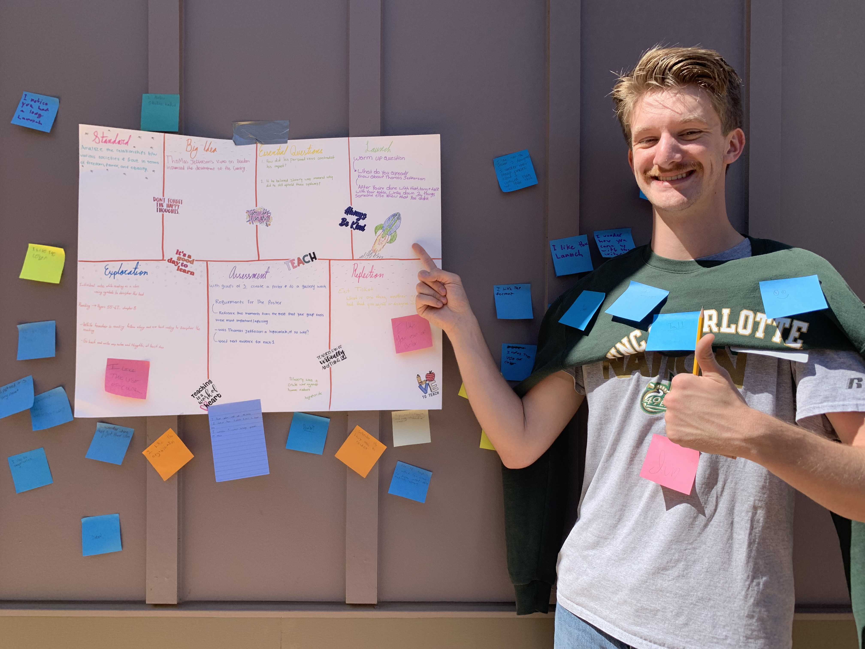
Thankful for your service – because of you I can do what I do

