Slide 1
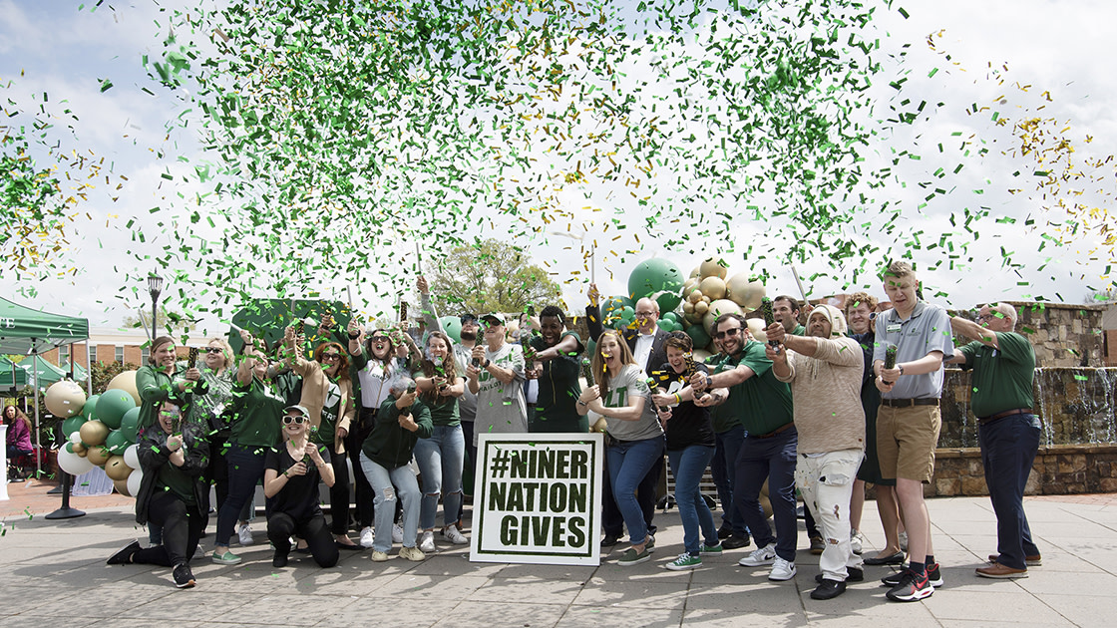

Slide 2
March 28 - 30, 2023
49-Hours to make a difference…
Generating necessary support for UNC Charlotte programs and priorities
Build UNC Charlotte pride
Foster a culture of philanthropy and provide philanthropy education
Show appreciation to donors and all alumni
Notes:
Faculty & Staff will extend through April 5th.

Slide 3
AUDIENCES
UNIVERSITY-WIDE CAMPAIGN
Alumni
Faculty & Staff
Students (focus on graduating seniors)
Parents
Friends
Areas of Representation
Academic Affairs
Alumni Association
Arts + Architecture
Athletics
BCOB
Business Affairs
CCI
CHHS
CLAS
COED
Engineering
Graduate School
Honors College
Levine Scholars
School of Professional Studies
Student Affairs
UCOL
Notes:
They say there is no ‘I’ in ‘team’, but there is in ‘NATiON.’ And every NiNER builds our NATiON. Together we're building a Nation. And Niners are a force to be reckoned with. It truly takes a Nation to raise support for students, we could not do it without you.
We have unit ambassadors in each of these units that will help spread the word about NNG, share updates throughout campaign, and send friendly reminders of what is happening that day!

Slide 4
2023 GOAL BREAKDOWN
5,800
TOTAL GIFTS
4,300
DONORS
$3,000,000
TOTAL DOLLARS
2,000
Alumni Donors
1,300
STUDENT GIFTS
$525,000
IN CHALLENGES
900
Faculty & Staff Donors
175 AMBASSADORS
50 STATES
Notes:
Our goal this year is to have 900 Faculty and Staff members make a gift towards a program, department, scholarship, or other area of interest that supports current and future Niners.

Slide 5
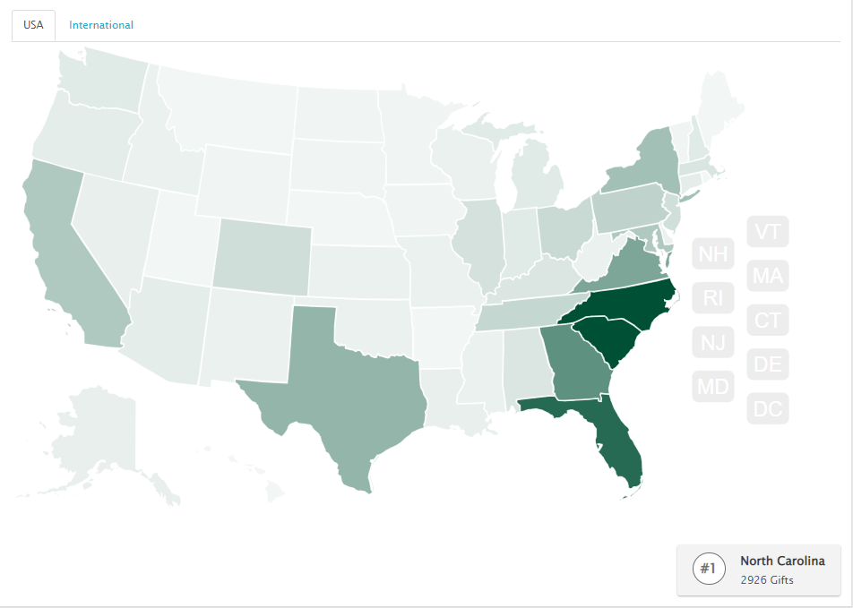
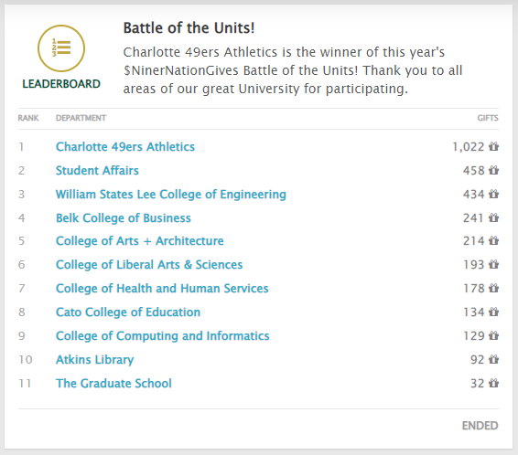
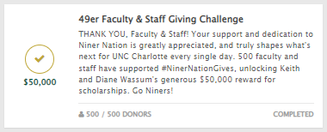
THE STAND OUTS
Notes:
You can help your unit or your board, get to the top of the leaderboard. I’ll tell you why that’s important in just a minute.
Pick an area of meaning to you and be an advocate or generally point your fellow niners to the main site and tell them to give where their heart leads them.

Slide 6
What you can do!

Slide 7
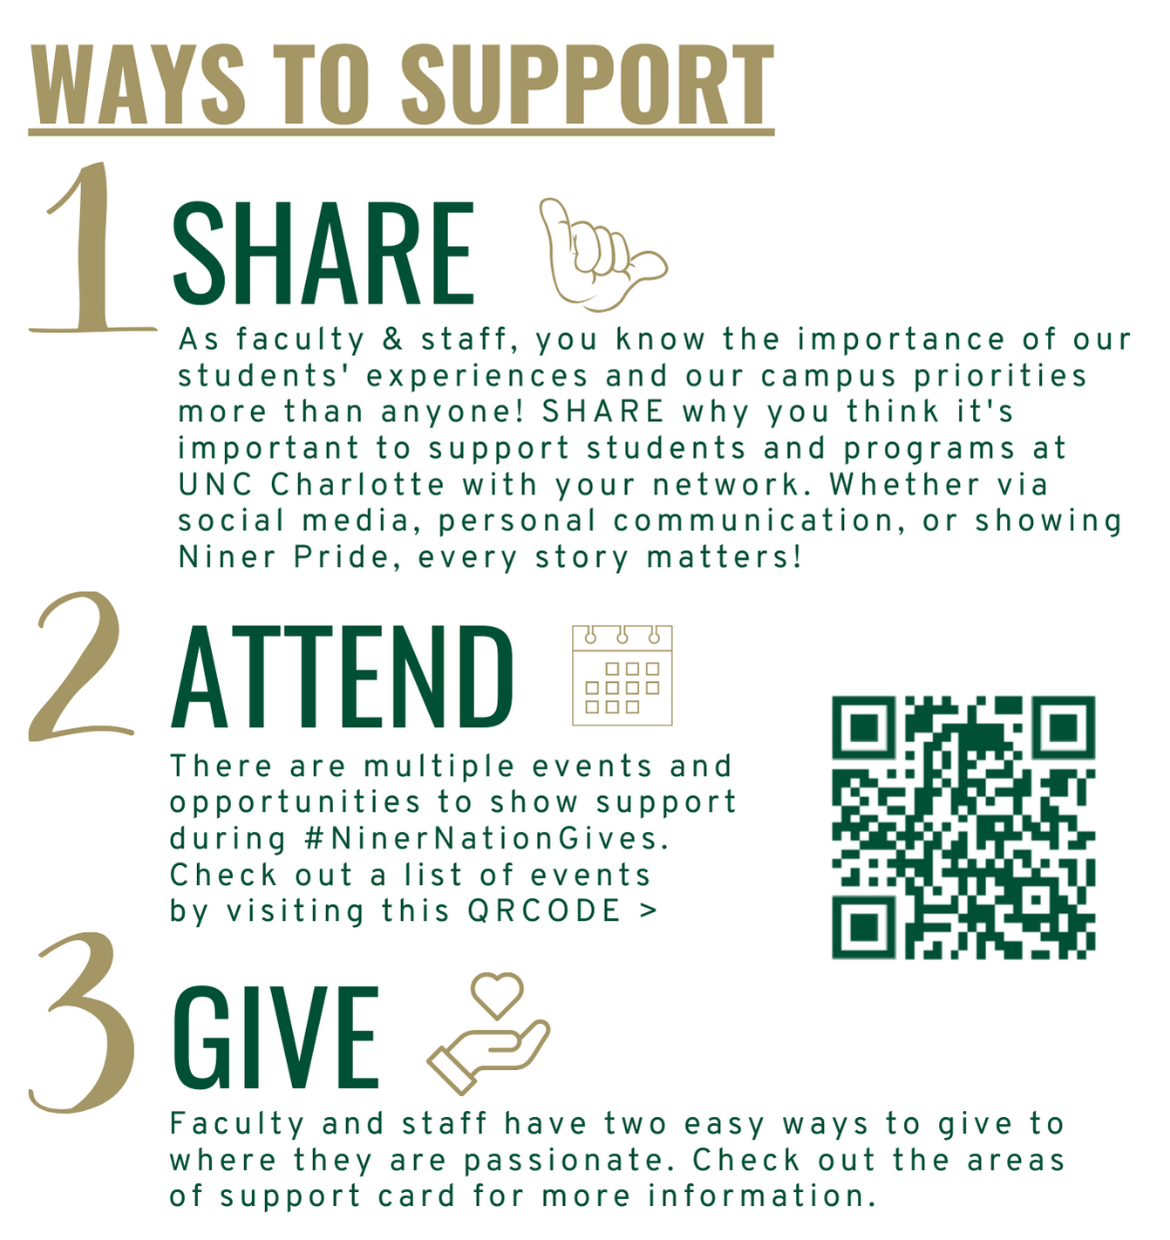
ENGAGEMENT
Engaging with Faculty/Staff
University wide communication - emails, Niner Insider, etc
Campus Mailer
Events
Designated college/unit ambassador to share timely updates with your area
Gift Officers and Development staff to update Deans and Leadership of significant gifts and milestones
Notes:
There are 3 ways to participate and give to wear you are passionate!
This is how communication will work within your area.

Slide 8
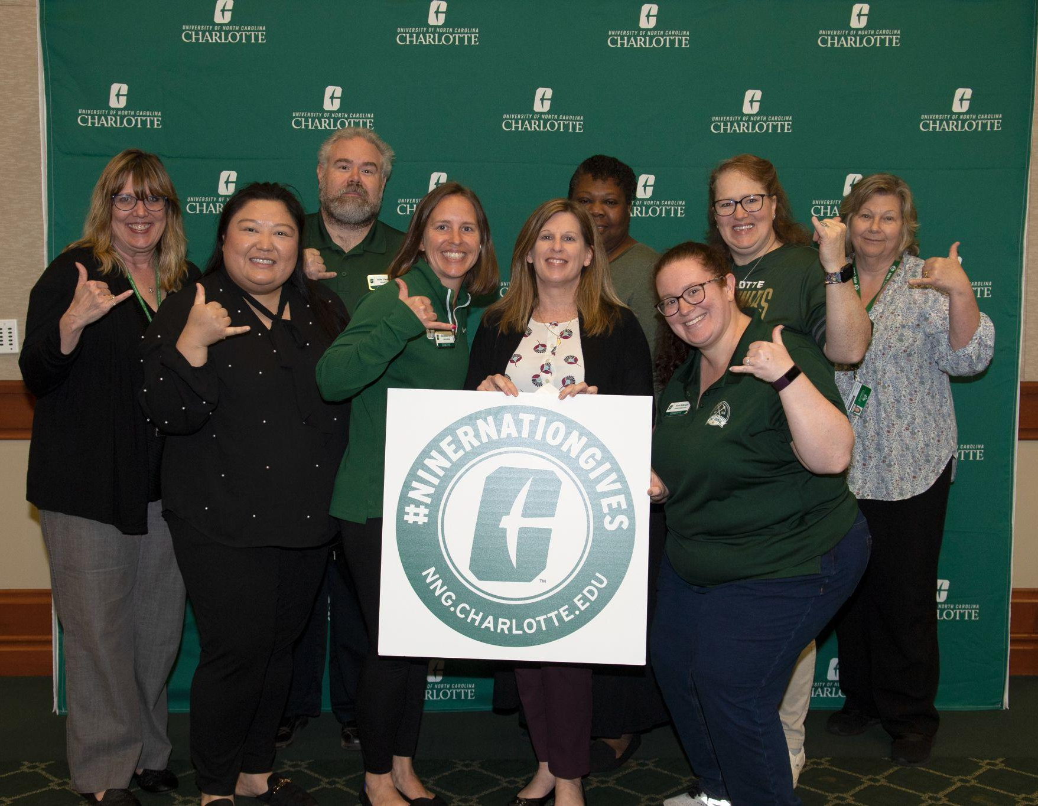
SAVE THE DATE
Faculty/Staff Kick-Off
DATE: Tuesday, March 28th
TIME: 11 a.m - 1 p.m.
LOCATION: PMSU Multipurpose
Notes:
CALLING ALL Faculty & Staff!

Slide 9
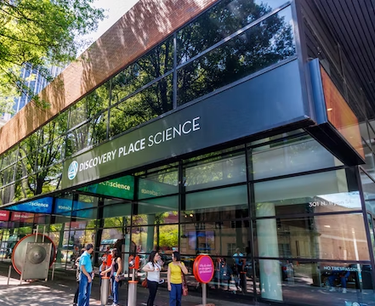
SAVE THE DATES
#NinerNationGives
Celebration at Discovery Place
DATE: Tuesday, March 28
TIME: 5:30 - 7:30 p.m.
LOCATION: Discovery Place Science, 301 N Tryon St, Charlotte, NC 28202
LINK TO RSVP: nng.charlotte.edu
Notes:
This is for all audiences!

Slide 10
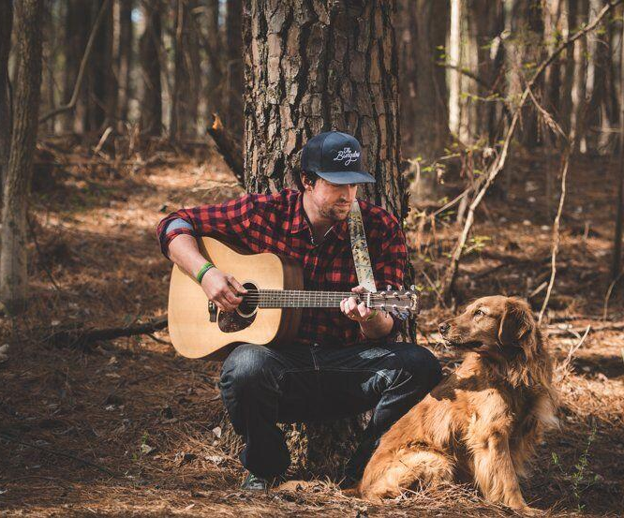
SAVE THE DATES
Benefit Concert featuring John Sullivan ’10
DATE: Wednesday, March 29
TIME: 6:30 - 9:00 p.m.
LOCATION: Hauser Alumni Pavilion
LINK TO RSVP: nng.charlotte.edu
(Image courtesy of https://www.lakenormanpublications.com)
Notes:
This is for all audiences!
$5 registration fee but can be used towards donation

Slide 11
Thank You!
#NINERNATIONGIVES CONTACTS
Penny Hawkins
Interim AVC Development
Penny.Hawkins@uncc.edu
Shayna Long
Sr. Director of Annual Giving
Shayna.Long@uncc.edu
Brittany Kicklighter
Director of Leadership Giving Brittany.Kicklighter@uncc.edu
Natalie Huie
Asst. Director of Annual Giving
Natalie.Huie@uncc.edu
Notes:
Questions?

