Slide 1

The ROI Project and Charlotte
Dr. Greg Weeks
Associate Dean for Academic Affairs, CHESS
Provost’s Representative to the UNC System for the ROI Project

Slide 2

Quick Background
Legislatively mandated process began in May/June 2022
--”Current Operations Appropriations Act of 2021”
ROI is defined entirely in financial terms
The final product consists of three dashboards
--Institutional context
--State ROI
--Student ROI
Very large number of data points

Slide 3
Charlotte is an Excellent Investment

Slide 4
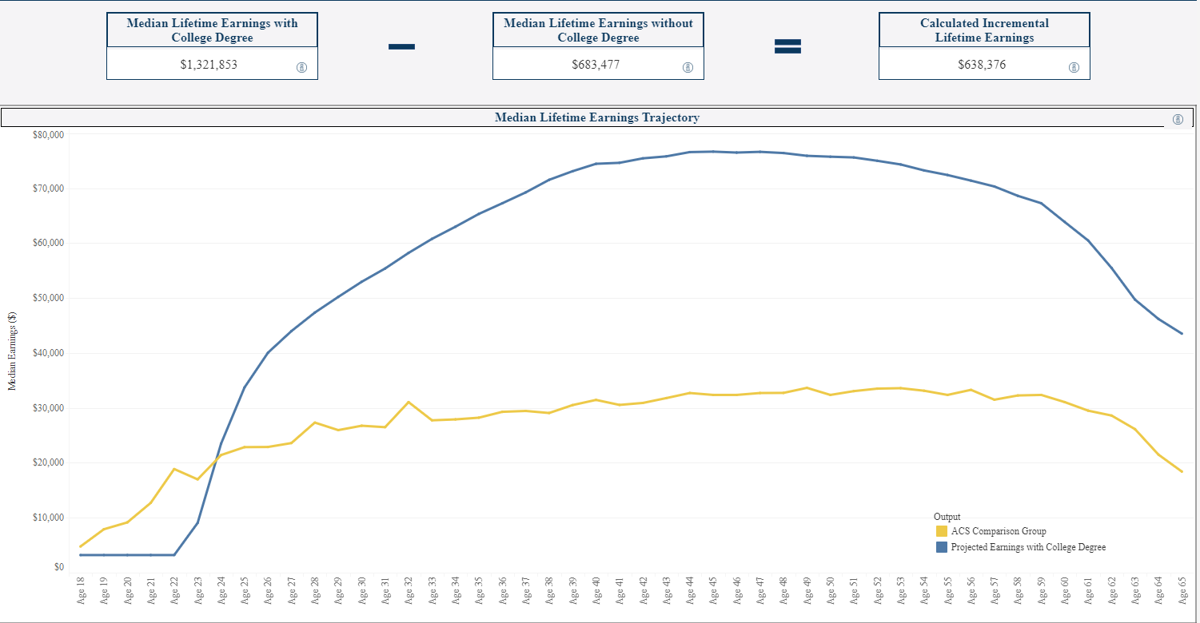
Charlotte Undergraduate Degree Lifetime Earnings

Slide 5
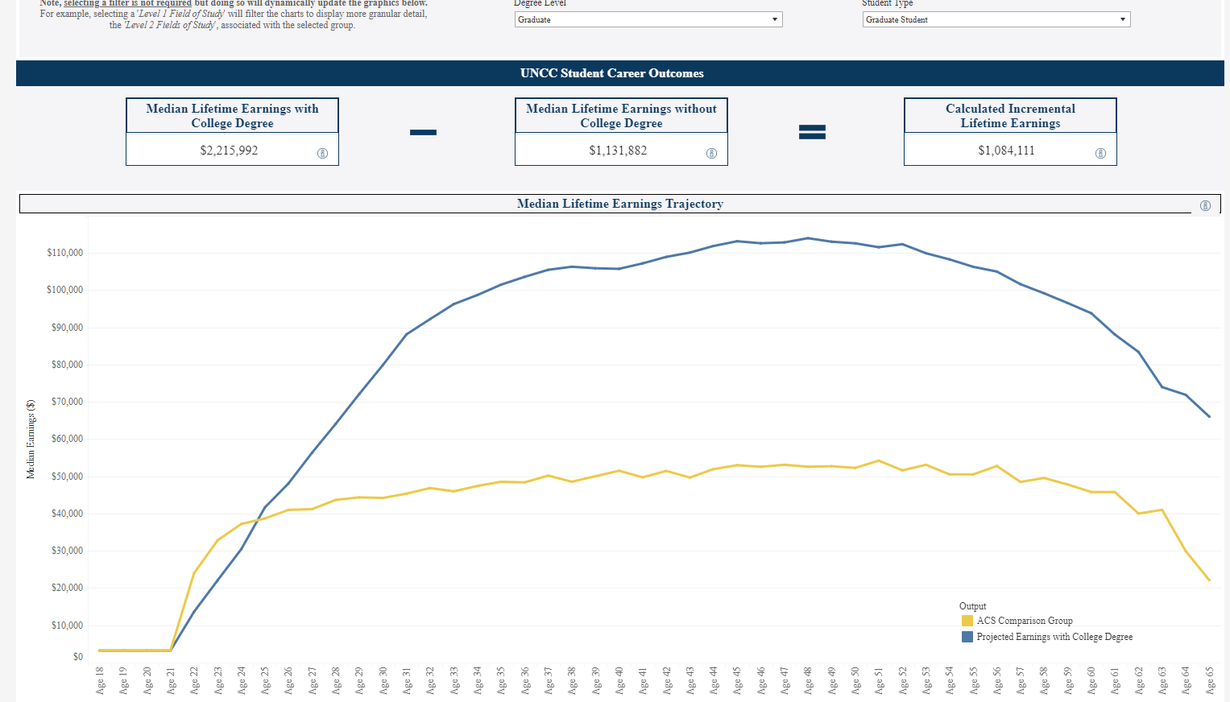
Charlotte Graduate Degree Lifetime Earnings

Slide 6
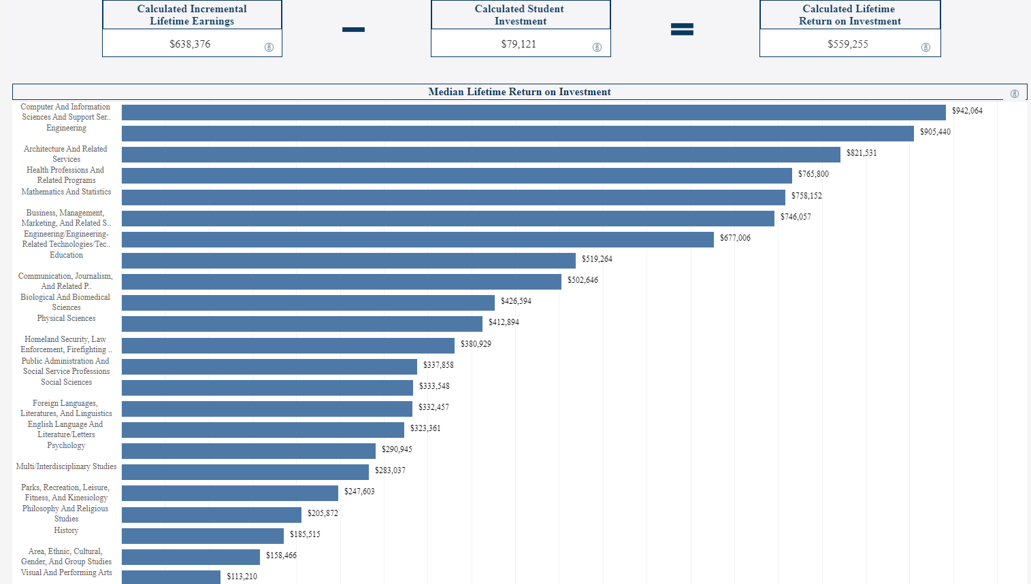
Student ROI Summary (Charlotte Undergraduate Degree)

Slide 7
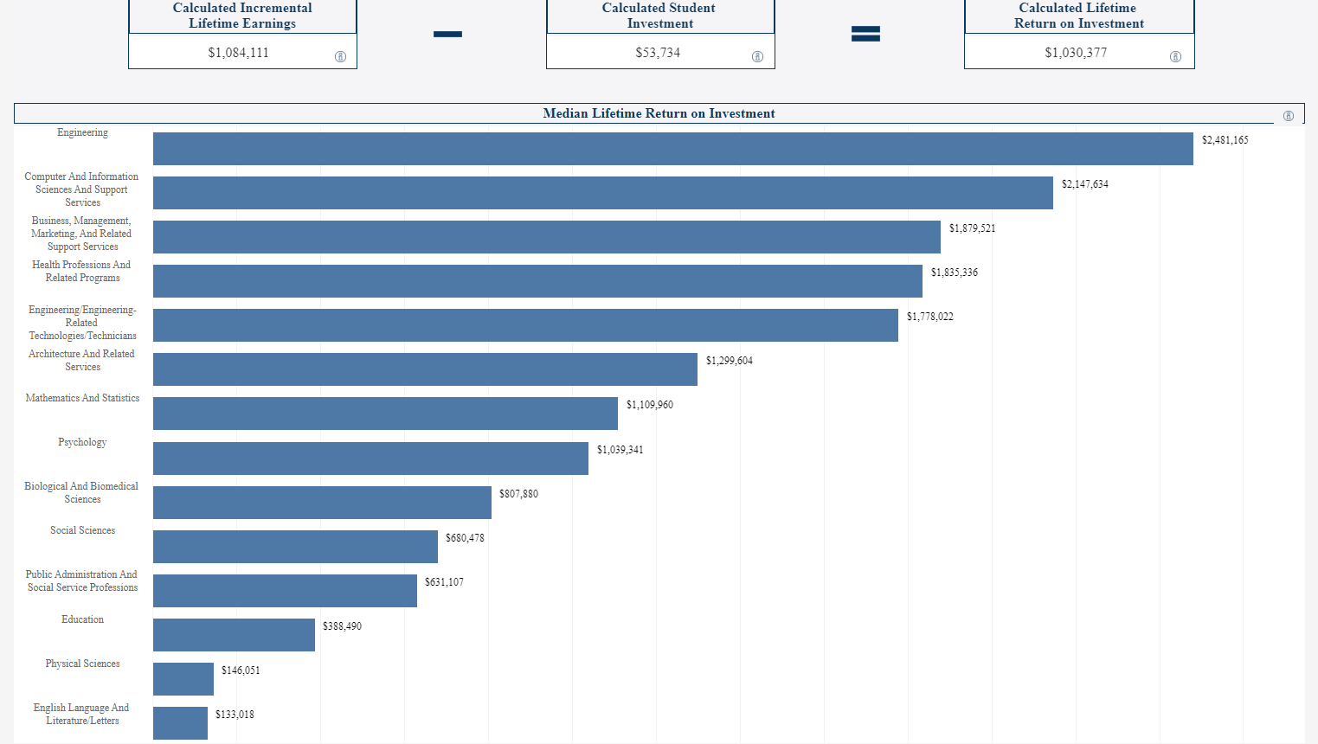
Student ROI Summary (Charlotte Graduate)
Student ROI Summary
(Charlotte Graduate Degree)

Slide 8
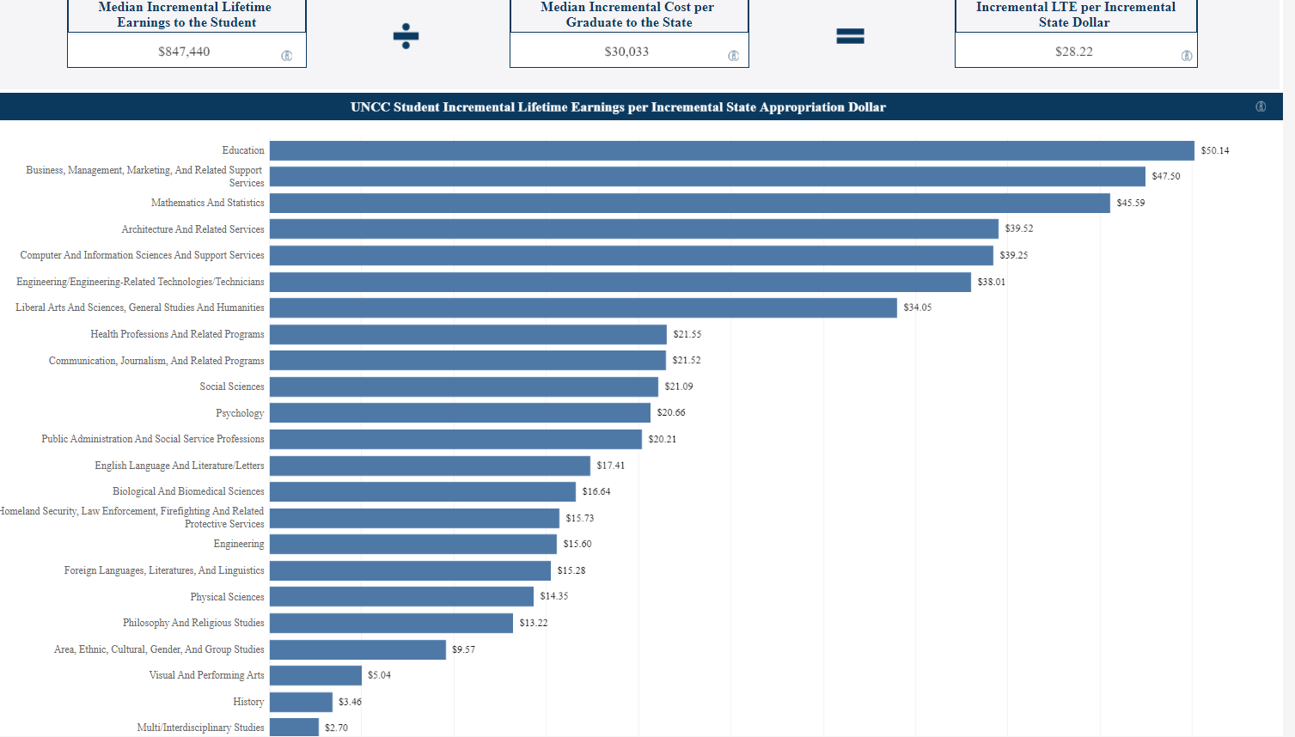
State ROI Summary (Charlotte)
State ROI Summary (for Charlotte)

Slide 9
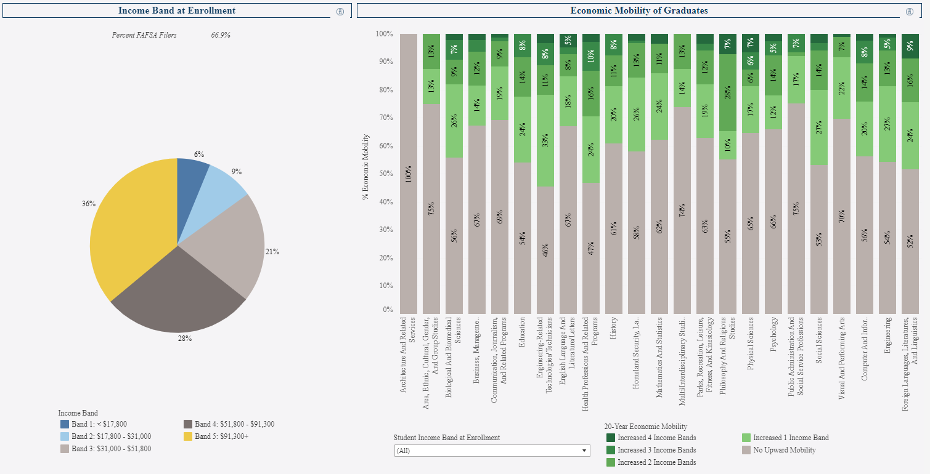
Economic Mobility (Charlotte Undergraduate Degree)

Slide 10
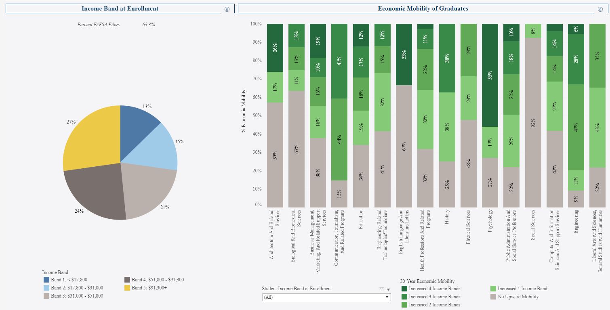
Economic Mobility (Charlotte Graduate Degree)

Slide 11
In sum, the dashboards hold countless great stories about the value to students of Charlotte programs.

