Slide 1
UNC CHARLOTTE / Strategic Enrollment Planning
Claire Kirby, Associate Provost for Enrollment Management
Dr. Pinku Mukherjee, Interim Associate Provost and Dean of the Graduate School

Slide 2
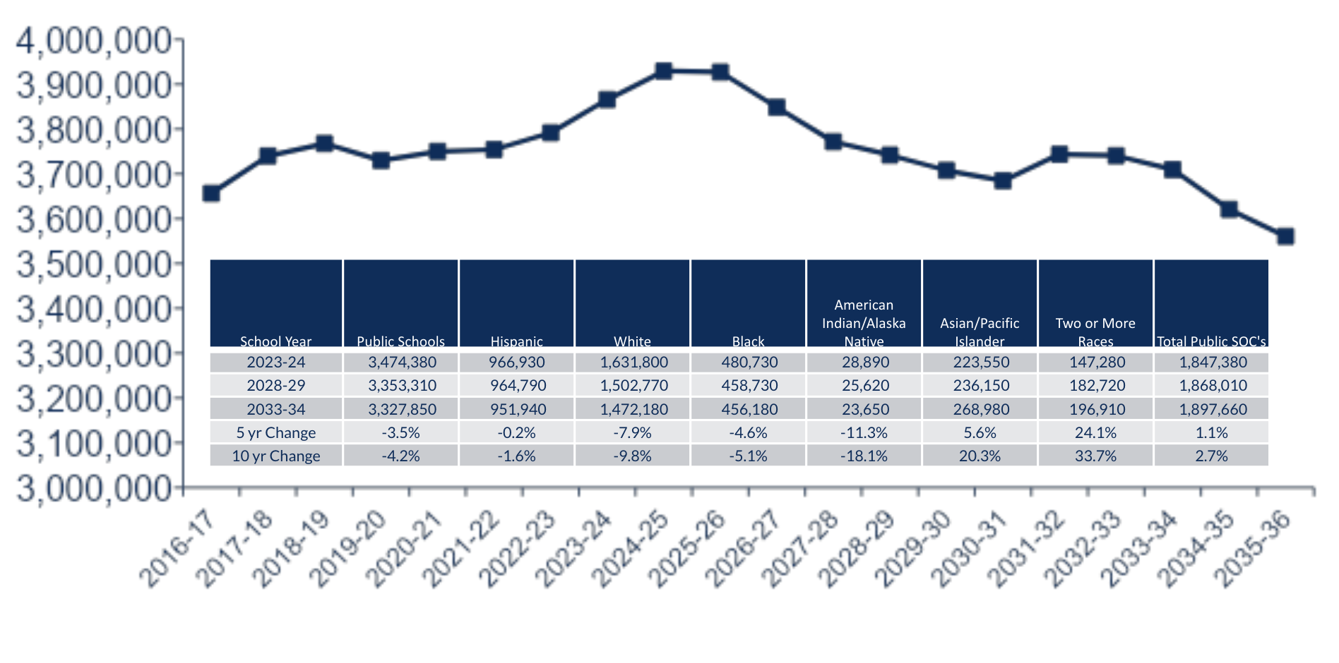
HIGHER EDUCATION ENROLLMENT LANDSCAPE
Projected change in high school graduates, United States 2017-2036
-12%
Decline in number of 18-year olds, 2025-2030
Source: Western Interstate Commission for Higher Education, Knocking at the College Door:
Projections of High School Graduates, 2020, www.knocking.wiche.edu
Notes:
Peak is 3.9M students in 2025 and then declines to 3.5M by 2037

Slide 3
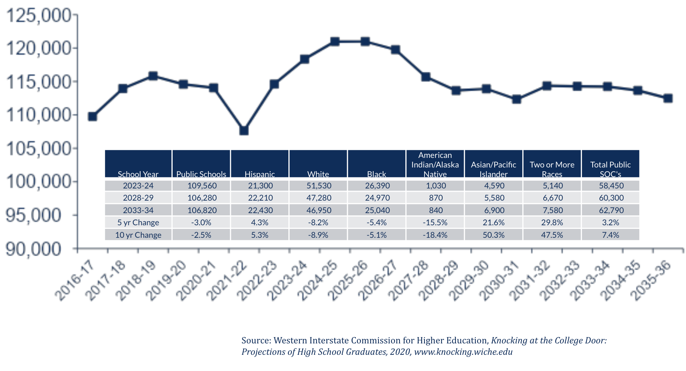
HIGHER EDUCATION ENROLLMENT LANDSCAPE
Projected change in high school graduates, North Carolina 2017-2036
-2%
Decline in number of HS graduates, 2023-2037
Source: Western Interstate Commission for Higher Education, Knocking at the College Door:
Projections of High School Graduates, 2020, www.knocking.wiche.edu
Notes:
Peak in 2026 at 120K graduates - declines to 112K in 2037
Key point is that we have an opportunity through 2026 but then we see dramatic shift
Demographic changes are more impactful - the makeup of the student population is changing

Slide 4
HIGHER EDUCATION ENROLLMENT LANDSCAPE
North Carolina Competition
 | In-state Counts | Percentage | Rank
2022-23 High School Seniors* | 114,610 |  | 10
Institutions of Higher Education** | 139 |  | 8
College Continuation*** | 78,206 | 68.2% | 21
Leave the State to Go to College*** | 11,545 | 10.1% | 41
Largest Institutions*** | In-state Freshman*** | Estimated Market Share^
North Carolina State University at Raleigh | 4135 | 6.20%
University of North Carolina at Chapel Hill | 3717 | 5.58%
University of North Carolina at Charlotte | 3658 | 5.49%
Appalachian State University | 3629 | 5.44%
East Carolina University | 3611 | 5.42%
Remaining Students | Remaining Institutions | Students Per Institution
47,911 | 134 | 358
10 years ago, our market share in NC was 3.4%
Sources:
*Western Interstate Commission for Higher Education, Knocking at the College Door: Projections of High School Graduates, 2020, www.knocking.wiche.edu
**National Center for Education Statistics, IPEDS, 2022
***National Center for Education Statistics. Freshman Migration Data for 2020-21

Slide 5
HIGHER EDUCATION ENROLLMENT LANDSCAPE
RECAP OF THE MACRO FORCES IMPACTING ENROLLMENT
The demographic cliff - shifts and declines in traditional direct from HS enrollment
The enrollment “demand cliff*” - college-going rate declining, value proposition, higher entry-level wages creating competition
Gen Z statistic from 2022 ECMC Group survey: 51% of Gen Z students are considering a four-year degree - a 20-pt drop since May 2020
Non-consumers are similar to college-bound peers in family income, racial/ethnic/gender diversity
Market share and competition
NC market share has increased significantly for FTIC, but declined for transfer students
Competition is intensifying for all student types - first-year, transfer, adults, graduate students
Source: “Managing the Demand Cliff”, Inside Higher Ed, October 16, 2023
Notes:
These are the forces we focus on when setting strategy.

Slide 6
HIGHER EDUCATION ENROLLMENT LANDSCAPE
OTHER ENROLLMENT TRENDS
Changes in visit activity - more visits post-admit
Test-optional admissions processes and applicant behavior - students are applying to more schools, skews selective
Race-conscious admissions
Recruitment efforts also newly hampered by privacy laws
Financial aid changes

Slide 7
GRADUATE ENROLLMENT LANDSCAPE
UNC CHARLOTTE ENROLLMENT TRENDS
Total Enrollment | Total International Enrollment | New International Enrollment | New Domestic Enrollment
3rd Highest in the UNC System | 3rd Highest in North Carolina | 45% Increase Compared to Fall 2019 | 7.5% Increase Compared to Fall 2019

Slide 8
GRADUATE ENROLLMENT LANDSCAPE-NORTH CAROLINA
INSTITUTIONS HOSTING INTERNATIONAL STUDENTS PER STATE
INSTITUTION | CITY | TOTAL
NC State | Raleigh | 5,195
Duke University & Medical Center | Durham | 5,039
UNC Charlotte | Charlotte | 2,633
UNC Chapel Hill | Chapel Hill | 2,501
Wake Forest University | Winston-Salem | 996
INSTITUTION | TOTAL ENROLLMENT | GRADUATE ENROLLMENT | % GRADUATE
UNC Chapel Hill | 32,234 | 11,553 | 36%
NC State | 37,323 | 10,000 | 27%
UNC Charlotte | 30,298 | 6,317 | 21%
ECU | 26,785 | 5,457 | 20%
UNC Greensboro | 17,743 | 3,587 | 20%

Slide 9
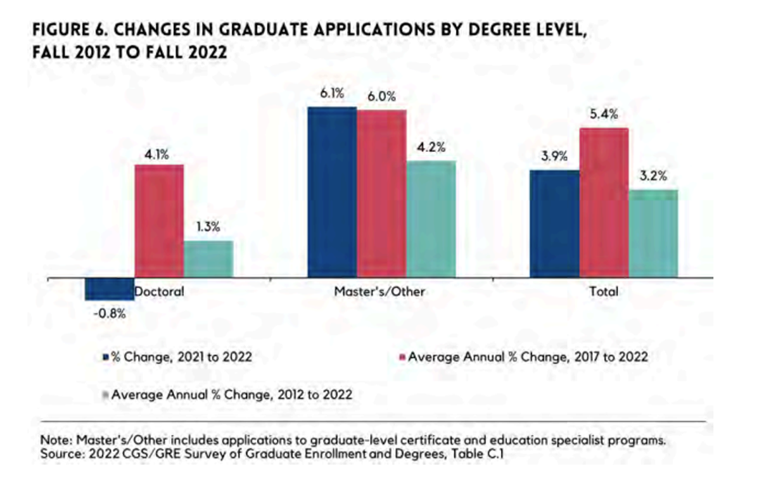
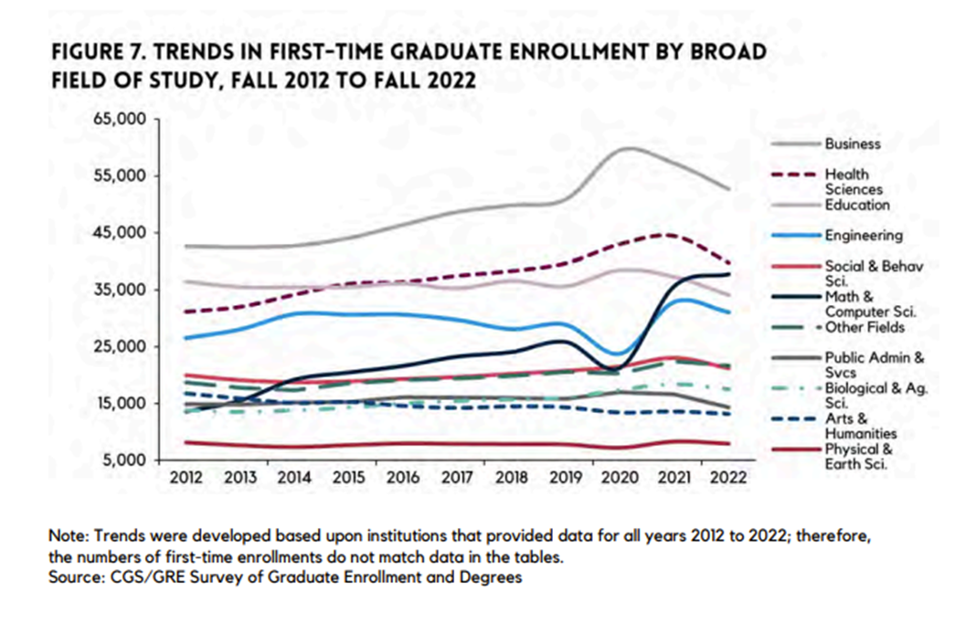
GRADUATE ENROLLMENT TRENDS 2012-2022

Slide 10
GRADUATE ENROLLMENT LANDSCAPE
FASTEST GROWING OCCUPATIONS IN NC REQUIRING AN ADVANCED DEGREE (CGS)
WORKFORCE DEMANDS IN NC Among the fastest growing occupation in North Carolina requiring an advanced degree:
Nurse Practitioners
Statisticians
Epidemiologists
Economists
Physician Assistants
Fall 2023 Grad Enrollment
66% In-State
57% of Master’s alumni work in NC*
In NC, jobs that require a master’s degree at an entry-level are projected to grow by **15% between 2021 and 2030, the fastest across all educational levels.
*Lightcast: Master’s Alumni 1998 through 2022
** NC Department of Commerce: 2021-2030 Long-Term Employment Projections and US Bureau of Labor Statistics
Notes:
Epid = Public Health
https://doc-0o-18-prod-01-apps-viewer.googleusercontent.com/viewer2/prod-01/pdf/hrp9013b3gdflr2g5on12rb7oejojg3s/9loikvi109hqgsjpbk1r539r6c2dvueo/1697730225000/3/107528881941702063032/APznzaY32rpPDQL_Dwk23a1dvqJ4wQ9gPY0pP_2P1bhYM2g2LlM-G1FV5g5YHLXCfzKNcQNbdg25I3LRIanB2qS5GieLQhnDHlXTlySjHFHXrT5I1NPqEX9G16B2rqDtBjKIKhFLpsrDgFYQl05JEAD5wdDQUZT8HYY4psDDC7oJqfnjFtdOsG-ZwAqPf8uRyDBEJrywVdS2gQgQaEQIPZPhXS_7sffNub5Z2AVtCo1n85XnPWDVwui66mDeBRn5G5X7bmTKf9Vs6oK9UCWlKc6kdGiJpJQXUmrvnh3UYDiVADjRlztWC3z5AVhtAb65KIrtxQPFEUCeHHV-E0JEv3LapV79NQm4pzuSAv5cXmlrzQUwfiNQHgk3oSQHw00kU_tI8psqUGbr-wEuvSC9j3KMY4HF8YF-C5j2tXxdOOho9B8dwggZWHo=?authuser=0&nonce=k1550grkv7uq2&user=107528881941702063032&hash=97gqgro1b6ereki1nlacpiunntggrpsn

Slide 11
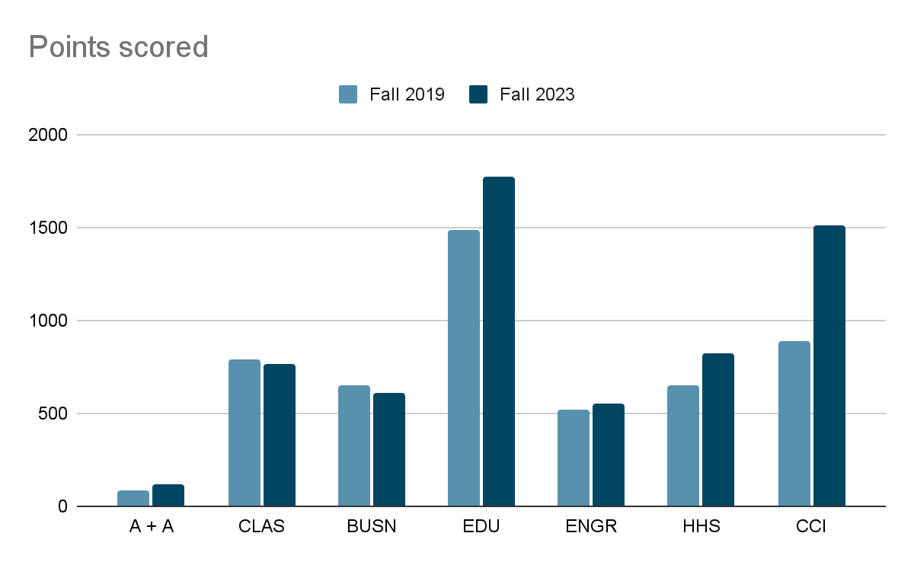
GRADUATE ENROLLMENT LANDSCAPE
CGS/GRE SURVEY OF GRADUATE ENROLLMENT AND DEGREES REPORT (2022 V 2021)
Decreases in first-time and total enrollment among underrepresented minorities.
Increases in international first-time enrollments (+10.2%) across all fields except engineering.
Decreases in domestic first-time enrollment (-4.7%) in all fields of study
Largest decreases:
Engineering (-16.1%)
Public Administration and Services (-13.4%)
Business (-11.3%)
Health sciences (-10.7%).

Slide 12
KEY ENROLLMENT STRATEGIES IN DEVELOPMENT
New Enrollment
Financial Aid Leveraging
Out-of-State and International
Transfer
Distance Education / Online
Enrollment Marketing
Retention
Advising
Transition Support
Course Scheduling
Peer Engagement
Student Employment and Financial Literacy
Graduate
High demand programs
Teacher Licensure

Slide 13
Discussion

