Slide 1
AIP Review and
First Day Complete Implementation

Slide 2
AIP - Adoptions and Insights Portal
AIP complements the University’s commitment to affordability, including the ability to:
Browse over 10 million textbooks, ebooks and courseware from all major publishers,
Search for free Open Education Resources (OER) to enhance or replace traditional course materials,
Easily adopt course materials with One Click Re-Adopt,
View a personalized Course List to easily search, research and submit your adoptions, and
Receive affordability recommendations as a complement or substitute to traditional course materials.
Log in at: https://aux.charlotte.edu/bookstore/textbooks/textbook-adoption
Need help? Visit aiphelp.charlotte.edu.

Slide 3
AIP - Adoptions and Insights Portal

Slide 5
An affordable textbook rental program that lowers the overall cost of course materials by 35 to 50%
Students are charged $20 per credit hour–no matter how many materials are adopted
Students can use leftover financial aid or scholarships to cover the cost of their Niner Course Pack (course material bundle)
Students save time on shopping around for the best price
Students can opt out of the program anytime prior to the University’s census date for fall or spring; or five days after the start of summer session

Slide 6
How does it work?
Submit your adoptions for fall 2023 through AIP by May 1, 2023.
Students receive an email from the bookstore before the fall semester asking them to verify their course materials and select pick up or shipping preference
If you have adopted digital textbooks or access codes, they will be available to students on the first day of class when you publish your course in Canvas under Course Materials.

Slide 7
Faculty Benefits
Students are prepared with their course materials (Niner Course Pack) on or before the first day of class.
Easy integration into Canvas means faculty can be assured that students have access to their digital materials
Faculty receive one-on-one 24/7 support from a Barnes & Noble College First Day Complete expert, if needed.

Slide 8
Get help:
For technical issues, please call Adoption Support at 877-713-6697 between the hours of 9 a.m. and 6 p.m., Monday - Friday or email aipsupport@bnservices.com. Visit the help webpage in AIP to chat with a representative.
If you have a question about the textbook adoption process, you can also call Barnes & Noble Charlotte at 704-687-7050.

Slide 9
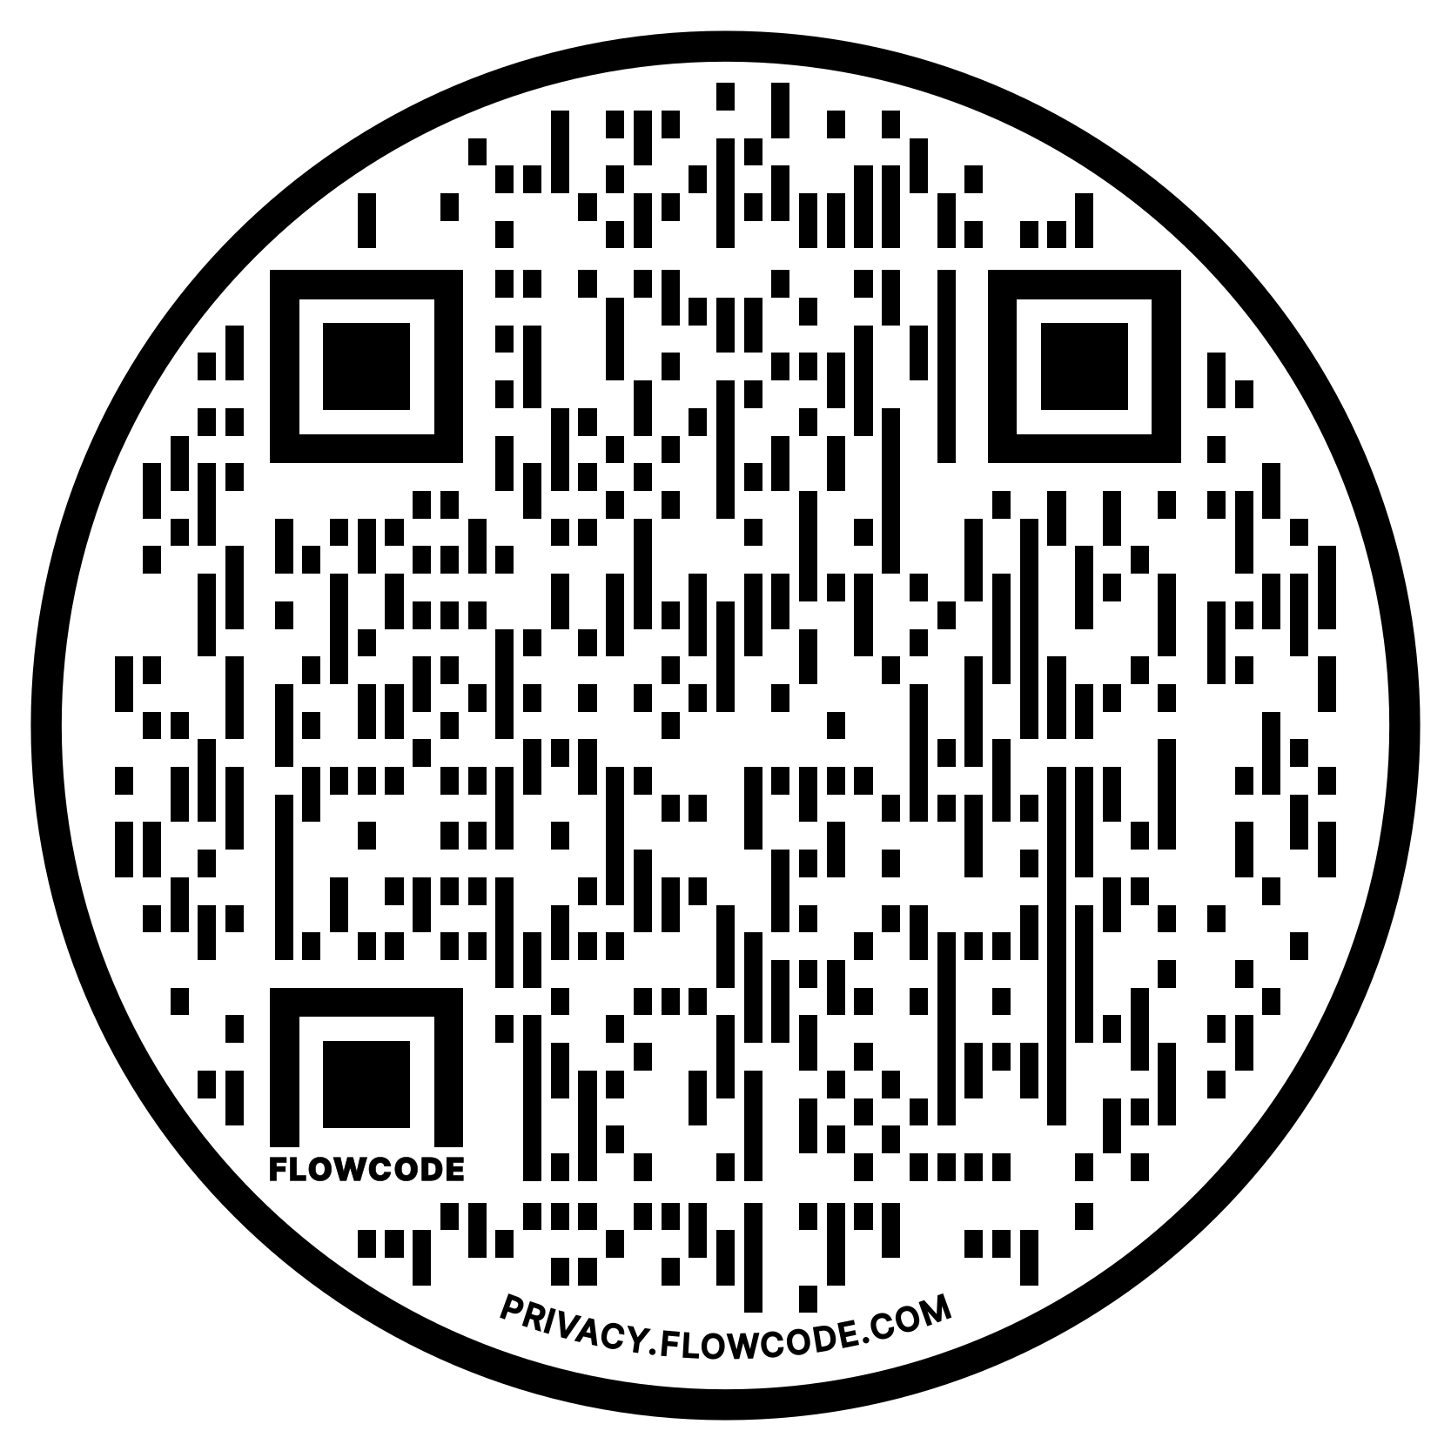
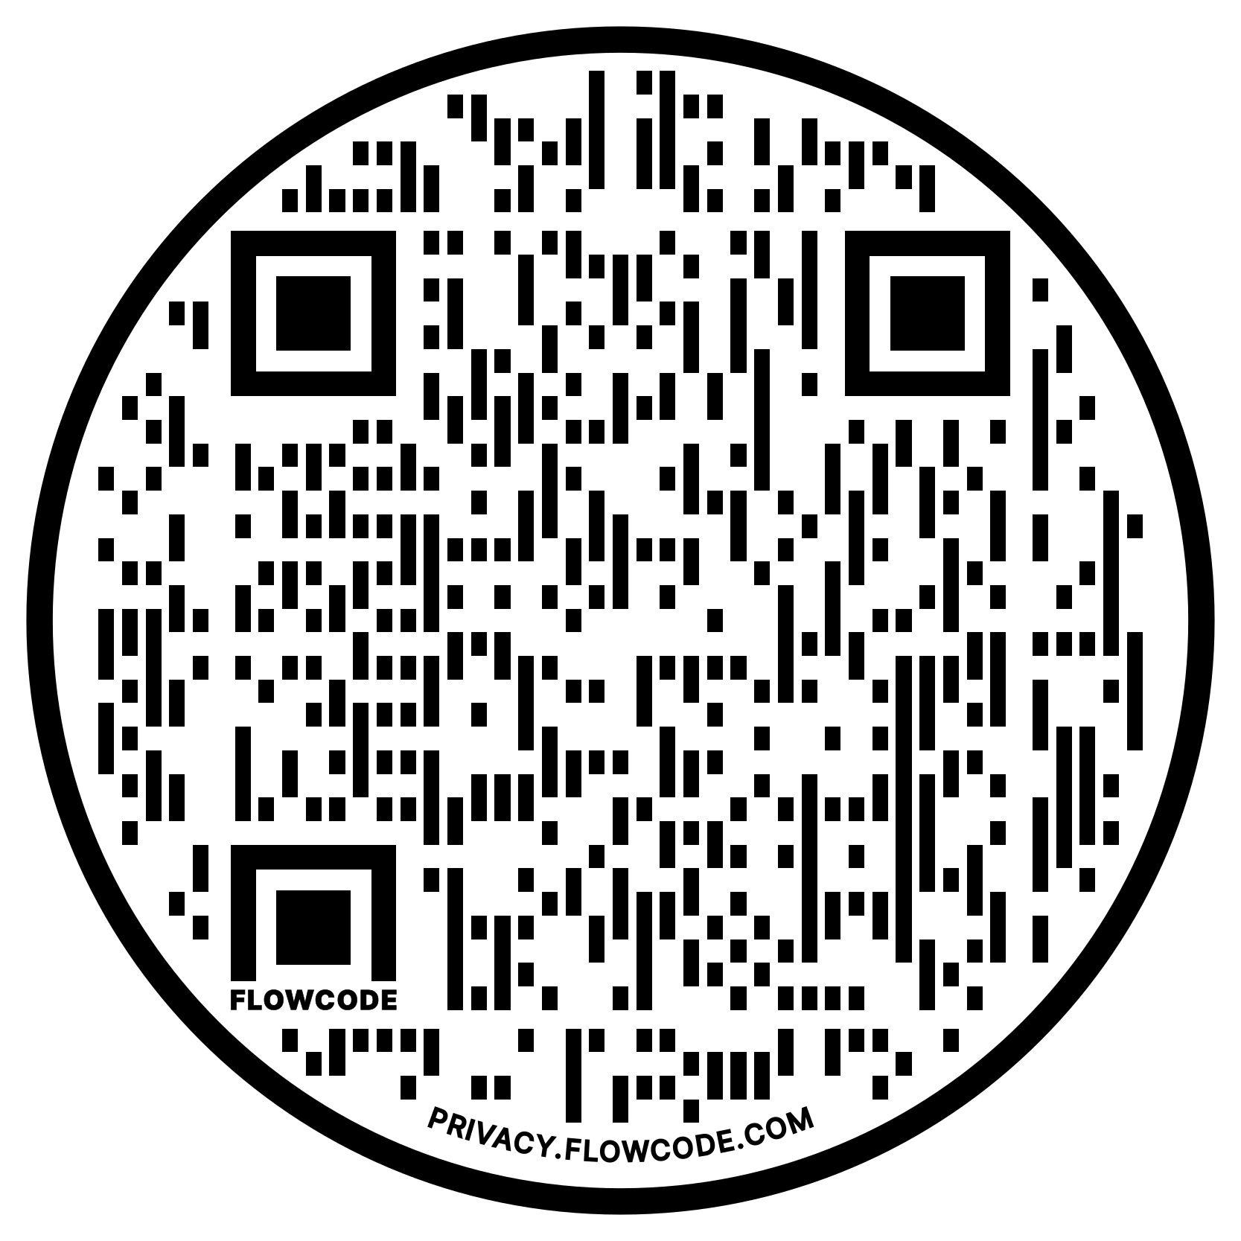
Virtual Information Sessions
FDC Virtual Information Session I
When: March 6, 2023, noon to 1 p.m.
Register
FDC Virtual Information Session II
When: March 22, 2023, 2 p.m. to 3 p.m.
Register

