Slide 1
Support for Childcare at UNC Charlotte
Faculty Welfare Committee
April 2023

Slide 2
How childcare addresses a need of the university:
Childcare is a major expense, drawing on salary
Childcare is a stressor
Childcare affects work schedules and availability
Childcare affects faculty welfare
Source: Child Care Resources Inc., Feb 2022 https://uploads.strikinglycdn.com/files/9394b72f-3812-4220-bf94-2c07710e8a8f/Star%20Chart-Mecklenbur-February2022.pdf?id=3872642

Slide 3
How other campuses are doing it
11 of the 16 UNC campuses offers some form of childcare support
Most have on-campus facilities
Working with educational/human development departments (9 of 11 campuses)
Bright Horizons on campus (UNCCH)
Other options:
Bright Horizons discounts or partnerships (NCSU)
UNCCH also includes discounts at other facilities

Slide 4
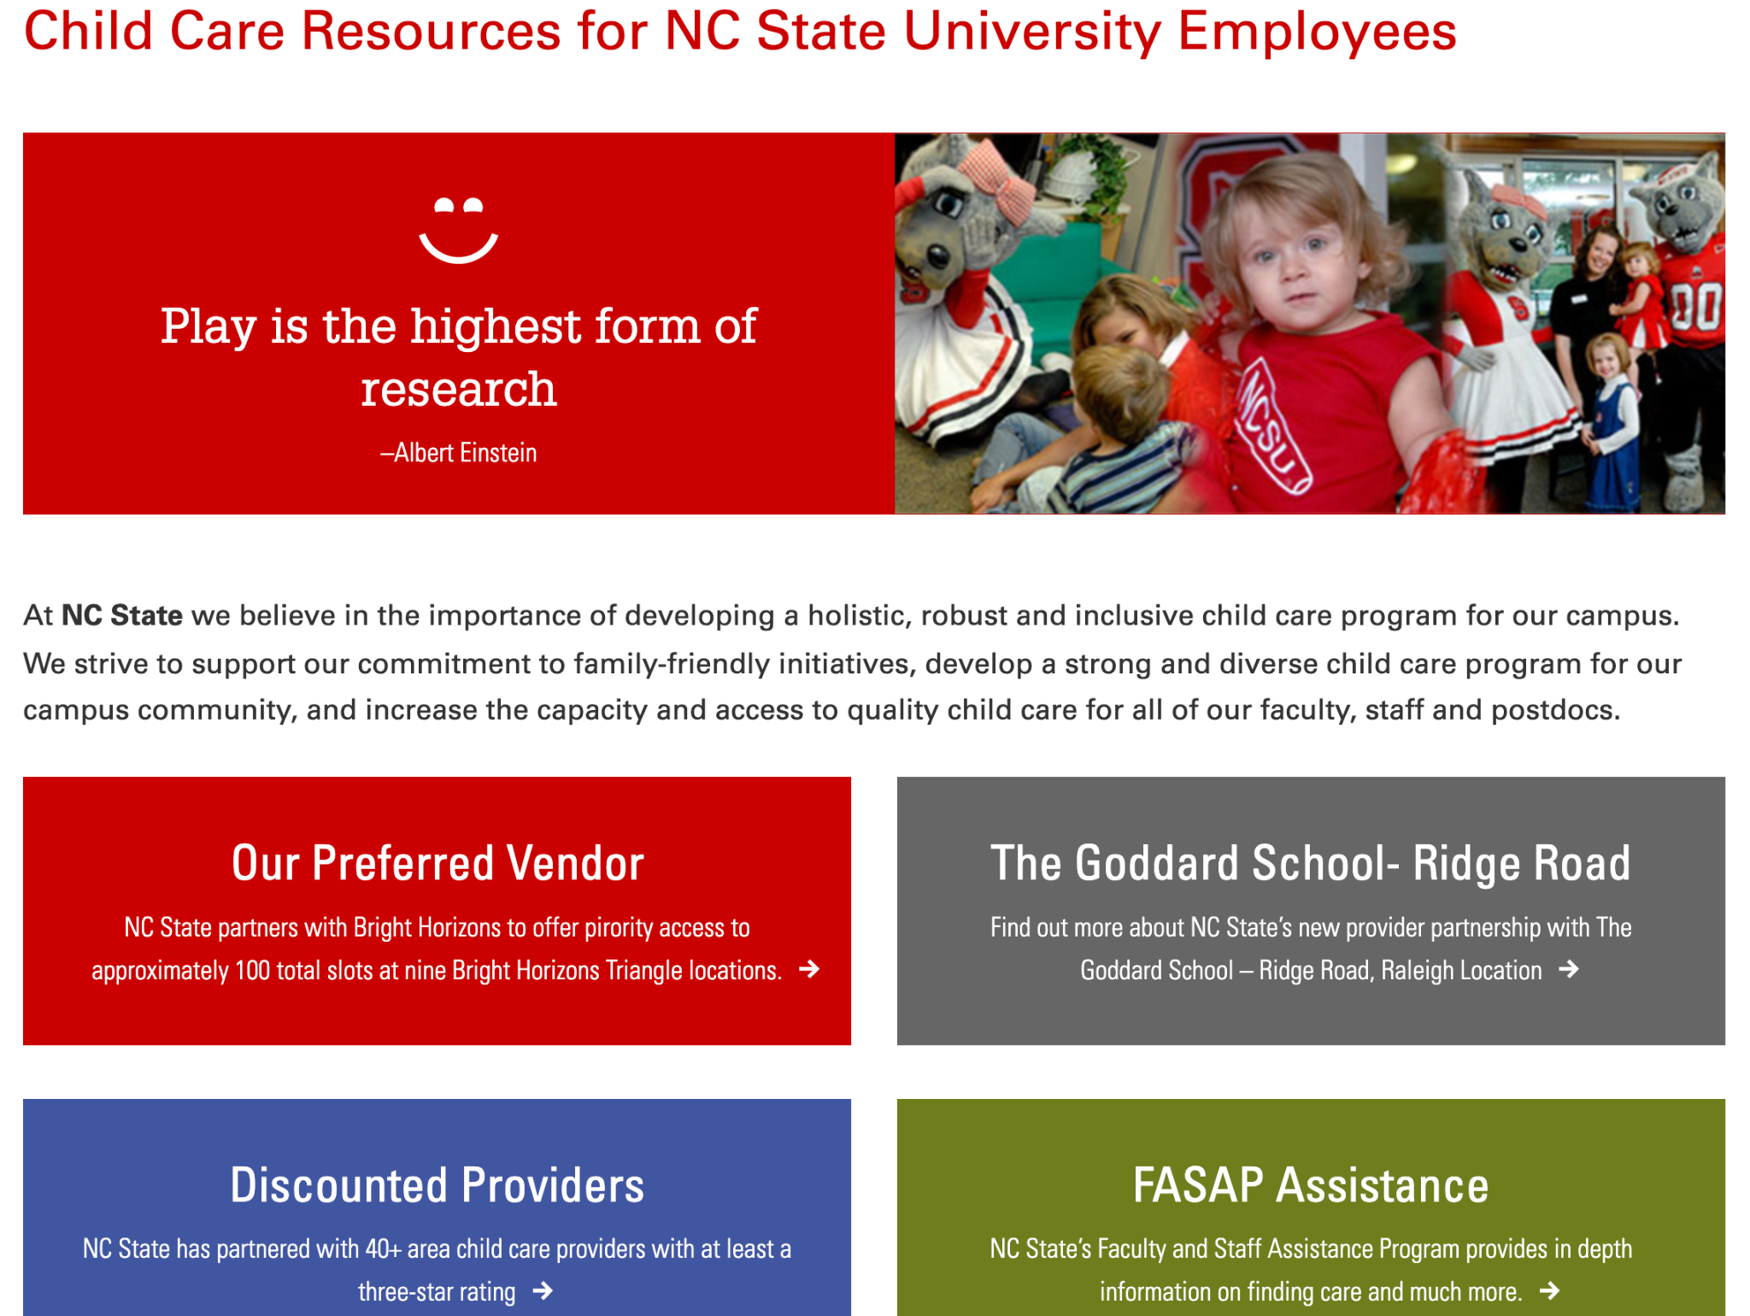
https://benefits.hr.ncsu.edu/childcare-resources/

Slide 5
Master planning should include planning for supporting faculty, staff, and students as we move towards a higher research profile
Next steps:
Collect information from other schools on relationships, resources, etc.
Survey of faculty for their needs and concerns (Fall 2023)
How much does childcare impact faculty wellbeing, including economics?
What else do faculty need to be successful researchers?

