Slide 1
Fall 2022 Enrollment
Post-Census Report
Faculty Council
September 15, 2022
Claire Kirby
Associate Provost for Enrollment Management
claire.kirby@uncc.edu

Slide 2
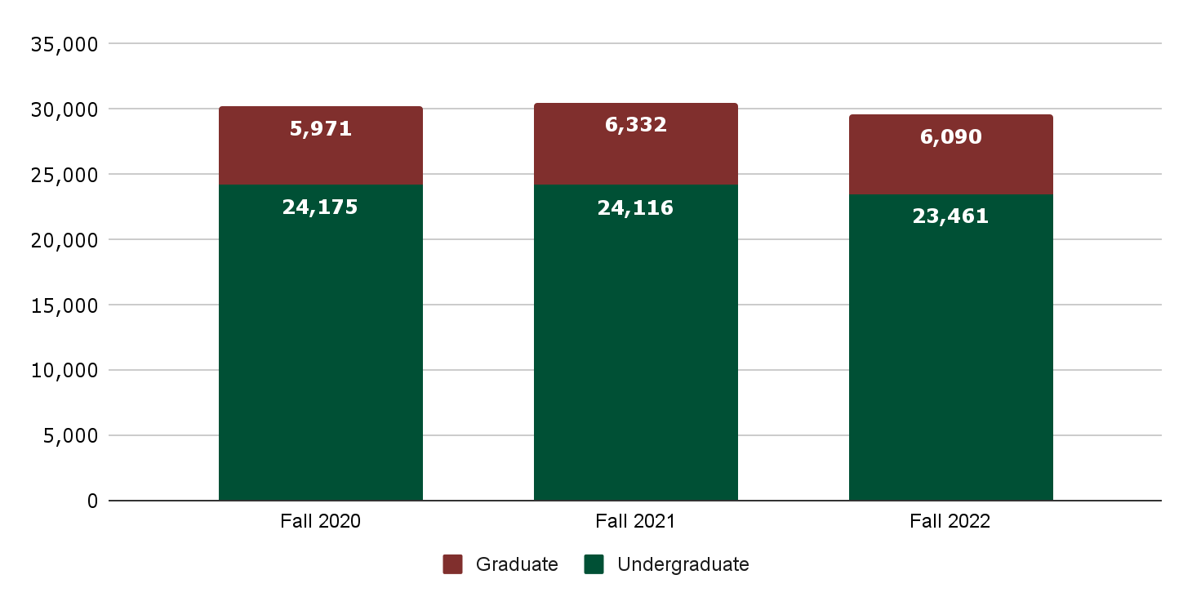
Fall 2020-Fall 2022 Total Headcount Enrollments
30,146
30,448
29,551

Slide 3
Fall 2020-Fall 2022 Headcount Categories
 | Fall 2020 | Fall 2021 | Fall 2022
First-Time-in-College | 3,999 | 4,256 | 4,157
New Transfer | 2,632 | 2,605 | 2,249
Continuing Undergrad | 16,730 | 16,535 | 16,387
Readmit Undergrad | 491 | 312 | 270
Non-degree Undergraduate | 323 | 408 | 398
Undergraduate Total | 24,175 | 24,116 | 23,461
New Doctoral-Research/Scholarship | 169 | 211 | 174
Continuing Doctoral-Research/Scholarship | 825 | 802 | 804
New Doctoral-Professional Practice | 52 | 50 | 53
Continuing Doctoral-Professional Practice | 56 | 64 | 89
New Master’s | 1,444 | 1,616 | 1,537
Continuing Master’s | 2,101 | 2,340 | 2,317
New Graduate Certificate | 597 | 494 | 478
Continuing Graduate Certificate | 479 | 543 | 436
Non-degree Graduate | 248 | 212 | 202
Graduate Total | 5,971 | 6,332 | 6,090
Grand Total | 30,146 | 30,448 | 29,551

Slide 4
Fall 2020-Fall 2022 Headcount Categories
 | Fall 2022 |  |  |  | Fall 2021
 | NC Resident | Non-Resident |  |  | NC Resident | Non-Resident
 |  | US | Intl |  |  | US | Intl
First-Time-in-College | 3,680 | 428 | 49 |  | 3,837 | 377 | 42
New Transfer | 1,945 | 253 | 51 |  | 2,252 | 314 | 39
Continuing Undergrad | 15,147 | 983 | 257 |  | 15,384 | 874 | 277
Readmit Undergrad | 250 | 16 | 4 |  | 290 | 17 | 5
Non-degree Undergraduate | 359 | 16 | 23 |  | 360 | 27 | 21
Undergraduate Total | 21,381 | 1,696 | 384 |  | 22,123 | 1,609 | 384
New Doctoral-Research/Scholarship | 80 | 29 | 65 |  | 126 | 29 | 56
Continuing Doctoral-Research/Scholarship | 458 | 51 | 295 |  | 429 | 49 | 324
New Doctoral-Professional Practice | 43 | 8 | 2 |  | 33 | 17 | 0
Continuing Doctoral-Professional Practice | 81 | 8 | 0 |  | 56 | 8 | 0
New Master’s | 914 | 132 | 491 |  | 1,043 | 170 | 403
Continuing Master’s | 1,716 | 146 | 455 |  | 1,891 | 127 | 322
New Graduate Certificate | 428 | 44 | 6 |  | 437 | 51 | 6
Continuing Graduate Certificate | 420 | 15 | 1 |  | 530 | 12 | 1
Non-degree Graduate | 187 | 13 | 2 |  | 199 | 11 | 2
Graduate Total | 4,327 | 446 | 1,317 |  | 4,744 | 474 | 1,114
Grand Total | 25,708 | 2,142 | 1,701 |  | 26,867 | 2,083 | 1,498

Slide 5
First-Time-in-College: IPEDS Race/Ethnicity
 | Fall 2020 | Fall 2021 | Fall 2022 |  | Fall 2020 | Fall 2021 | Fall 2022
Non-resident alien | 58 | 71 | 80 |  | 1% | 2% | 2%
Unknown | 75 | 99 | 78 |  | 2% | 2% | 2%
Hispanic | 524 | 562 | 597 |  | 13% | 13% | 14%
American Indian | 11 | 14 | 15 |  | 0% | 0% | 0%
Asian | 391 | 483 | 455 |  | 10% | 11% | 11%
African American | 563 | 669 | 679 |  | 14% | 16% | 16%
Pacific Islander | 2 | 1 | 1 |  | 0% | 0% | 0%
White | 2,171 | 2,153 | 2,028 |  | 54% | 51% | 49%
Two or more races | 204 | 204 | 224 |  | 5% | 5% | 5%
 | 3,999 | 4,256 | 4,157 |  | 100% | 100% | 100%
% URM |  |  |  |  | 32.6% | 34% | 36.4%

Slide 6
New Transfer: IPEDS Race/Ethnicity
 | Fall 2020 | Fall 2021 | Fall 2022 |  | Fall 2020 | Fall 2021 | Fall 2022
Non-resident alien | 70 | 47 | 60 |  | 3% | 2% | 3%
Unknown | 44 | 48 | 65 |  | 2% | 2% | 3%
Hispanic | 354 | 420 | 329 |  | 13% | 16% | 15%
American Indian | 6 | 4 | 4 |  | 0% | 0% | 0%
Asian | 180 | 203 | 172 |  | 7% | 8% | 8%
African American | 494 | 437 | 398 |  | 19% | 17% | 18%
Pacific Islander | 2 | 1 | 1 |  | 0% | 0% | 0%
White | 1,359 | 1,298 | 1,110 |  | 52% | 50% | 49%
Two or more races | 123 | 147 | 110 |  | 5% | 6% | 5%
 | 2,632 | 2,605 | 2,249 |  | 100% | 100% | 100%
% URM |  |  |  |  | 37% | 39% | 38%

Slide 7
New Undergraduates by Sex
 | Fall 2020 | Fall 2021 | Fall 2022 |  | Fall 2020 | Fall 2021 | Fall 2022
First-Time-in-College
Female | 1,895 | 2,193 | 2,138 |  | 47% | 52% | 51%
Male | 2,104 | 2,063 | 2,019 |  | 53% | 48% | 49%
 | 3,999 | 4,256 | 4,157 |  | 100% | 100% | 100%
New Transfers
Female | 1,380 | 1,299 | 1,121 |  | 50% | 50% | 50%
Male | 1,360 | 1,306 | 1,128 |  | 50% | 50% | 50%
 | 2,740 | 2,605 | 2,249 |  | 100% | 100% | 100%

Slide 8
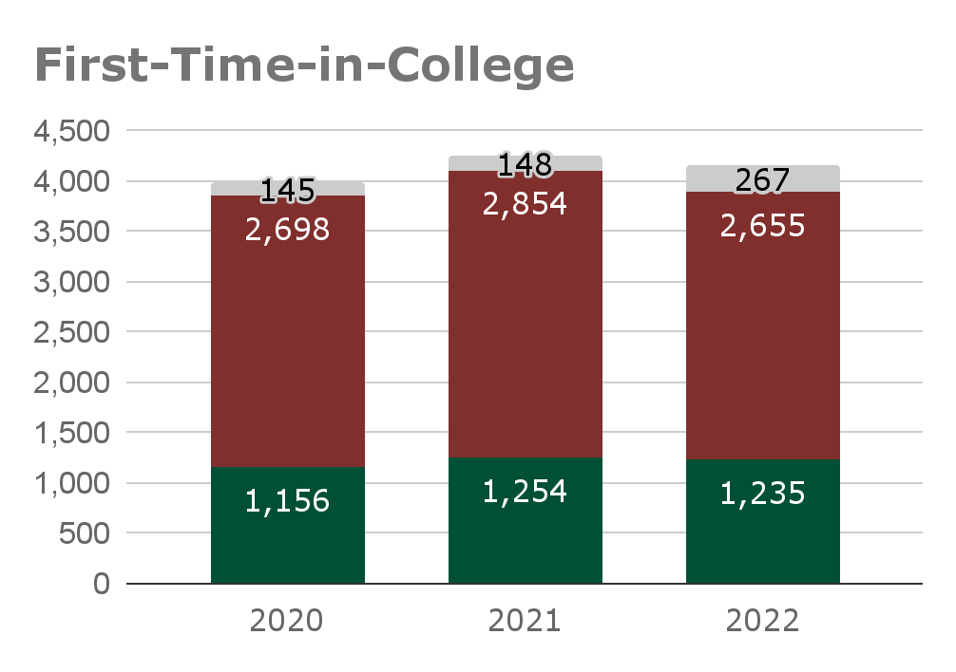
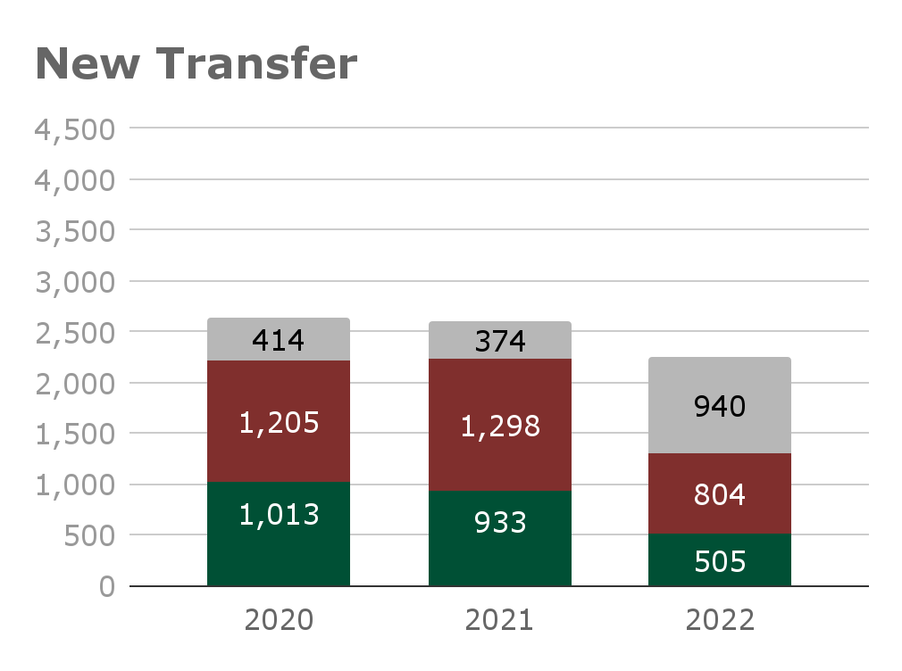
New Undergraduates: First Generation
30%
30.5%
32%
45%
42%
39%
First-generation = both/only reported parents education level less than 4-year degree; % excludes unknown
Notes:
Significant increase in non-reporting related to change in application platform so Admissions is working on ways to improve.

Slide 9
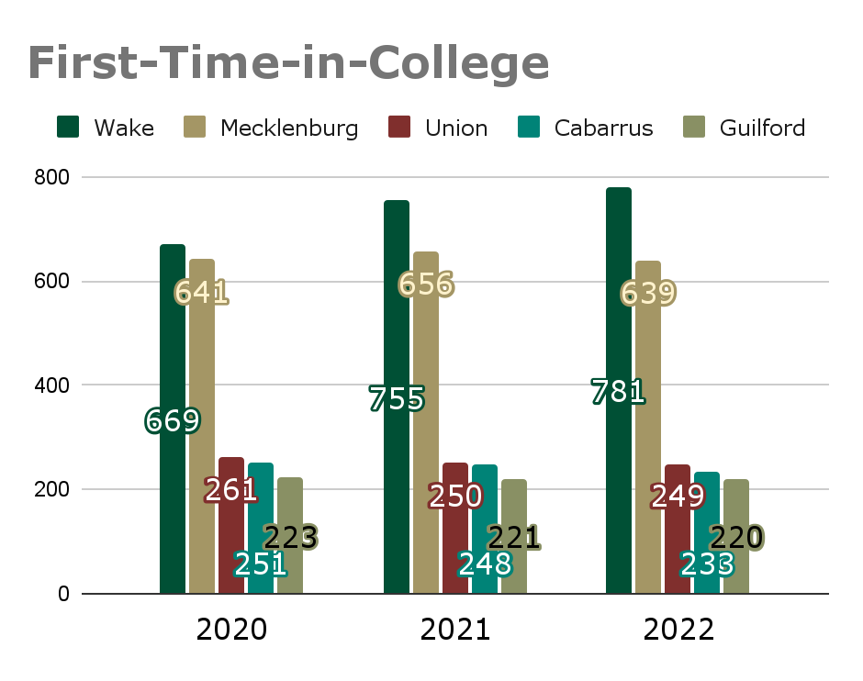
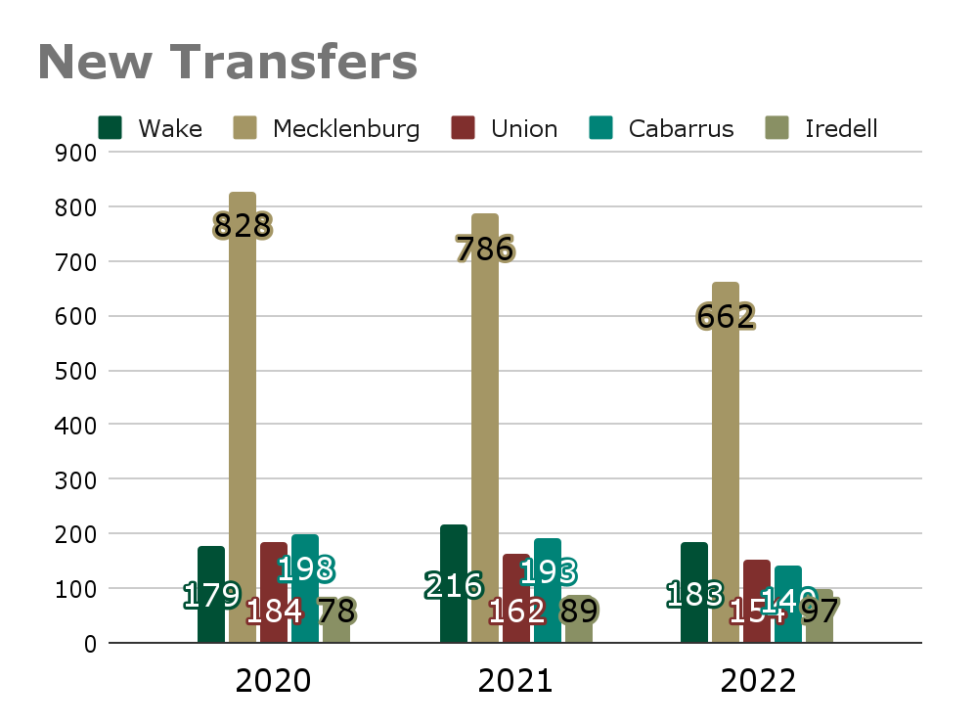
New Undergraduates: Geographic Origin
51% of New FTIC students are from 5 counties
55% of New Transfers students are from 4 of the same 5 counties
Notes:
CPCC: 614 students enrolled, down 128
RCCC: 62 students enrolled, down 22
Wake Tech: 129 students enrolled, down 54

Slide 10
UNC System Applications Estimates: First-Time (Institutions with >10K First-Time applications)
 | First-Time (Freshmen)
 | Fall 2021 |  |  | Fall 2022
Institution | Applied | Accepted | Rate | Applied | Accepted | Rate
UNC-CH | 50,804 | 10,347 | 20% | 57,221 | 9,640 | 17%
NCSU | 32,996 | 15,620 | 47% | 35,564 | 16,773 | 47%
ECU | 21,900 | 20,569 | 94% | 21,382 | 19,757 | 92%
NCA&T | 21,531 | 12,375 | 57% | 25,763 | 14,526 | 56%
ASU | 21,121 | 17,972 | 85% | 23,651 | 18,538 | 83%
Charlotte | 20,363 | 16,208 | 80% | 21,354 | 17,011 | 80%
UNCW | 15,778 | 10,745 | 68% | 16,859 | 11,609 | 69%
WCU | 12,306 | 9,772 | 79% | 17,918 | 15,205 | 85%
UNCG | 10,695 | 9,737 | 91% | 11,516 | 10,598 | 92%
System Total | 240,108 | 149,435 | 62% | 263,622 | 159,314 | 60%
Source: UNCDM

Slide 11
Yield concerns among FTIC
Yield = % of students offered admission who choose to enroll
First-gen students melted at a higher rate
African American students melted at a higher rate, both males and females
Later dates - application, admit, IE - melted at higher rates
UCOL, highest melt of 21%, highest among HPEX
CHHS - 17% melt overall, 67 Pre-Nursing Freshmen
Triad, Cumberland County and Durham County melted at higher rates
Fayetteville State’s NC Promise likely impacted Cumberland County and surrounding area

Slide 12
UNC System Applications Estimates: Transfer (Institutions with >10K First-Time applications)
 | Transfer
 | Fall 2021 |  |  | Fall 2022
Institution | Applied | Accepted | Rate | Applied | Accepted | Rate
UNC-CH | 3,458 | 1,806 | 52% | 3,899 | 1,682 | 43%
NCSU | 4,168 | 1,932 | 46% | 4,511 | 1,852 | 41%
ECU | 3,159 | 2,861 | 91% | 3,138 | 2,619 | 83%
NCA&T | 1,883 | 1,483 | 79% | 1,670 | 1,359 | 81%
ASU | 2,879 | 2,513 | 87% | 3,172 | 2,814 | 89%
Charlotte | 4,384 | 4,003 | 91% | 4,320 | 3,881 | 90%
UNCW | 3,507 | 3,168 | 90% | 3,046 | 2,753 | 90%
WCU | 2,307 | 1,750 | 76% | 2,800 | 2,123 | 76%
UNCG | 2,857 | 2,645 | 93% | 2,583 | 2,441 | 95%
System Total | 34,727 | 27,555 | 79% | 35,754 | 27,169 | 76%
Source: UNCDM
There were significant increases in transfer applications at three institutions.

Slide 13
Yield concerns among new transfers
Down 360 total students, CPCC down 120+
Yield declined from 65% to 59%
Sharpest decline among females
Transfers from 4-year institutions -- 57% yield
Transfers from 2-year institutions -- yield fell from 69% to 54%
Transfers with 2-year degree yield at high rate of >70%
Applications were down significantly among this group; feeder institutions were down 20% in enrollment through pandemic
Significant decline among non-trad
Students age 25+ had a 25% melt rate after IE
Second degrees were down in apps, resulted in 20 fewer students
Contributing factors to decision, in order:
Financial concerns, another institution, taking time off, housing concerns, class availability, academic concerns

Slide 14
Deferred enrollment plans
Some students choose to defer their enrollment to the spring term.
53 First-Year chose to defer to spring 2023
Visa process delays, family emergencies/medical reasons, military obligations, lack of housing, financial concerns
49 Transfer students chose to defer
course availability, lack of housing, financial concerns, late decision
Admissions is offering all non-enrolling students a spring start.

Slide 15
New Undergraduate Highlights
 | Fall 2020 | Fall 2021 | Fall 2022
GPA-FTIC | 3.9 | 3.95 | 3.95
Rural (Tier 1 & 2) | 23% | 23% | 21%
STEM - FTIC | 34% | 35% | 36%
STEM – TR | 26% | 27% | 28%
Yield - FTIC | 25.1% | 26.3% | 24.4%
URM – NEW UG | 34% | 36% | 37%
Non-Resident (% of FTIC) | 344 (9%) | 430 (10%) | 477 (11%)
Pell Eligible FTIC* | 1247 (31%) | 1321 (31%) | 1326 (32%)
Honors College welcomed 192 new students in UHP (148), BHP (35) and AAHP (9)
353 scholarships awarded to FTIC totaling more than $1.3M
5.7% increase in FTIC receiving scholarships
NC Residents Yield is 28%, above average
Increased FTIC enrollment in BU and IT
Top OOS: SC, NY, NJ, VA, MD, OH up more than 4%; OH up 320% over 2021
Notes:
*Re: Pell numbers - the Fall 20 and 21 numbers were the current numbers as of census date. Pell numbers increase throughout the year and we ended up with more than 1400 Pell eligible FTIC in fall 2021, or 35% of students. For fall 2020, we ended up with 1335 Pell eligible FTIC, or 33%.

Slide 16
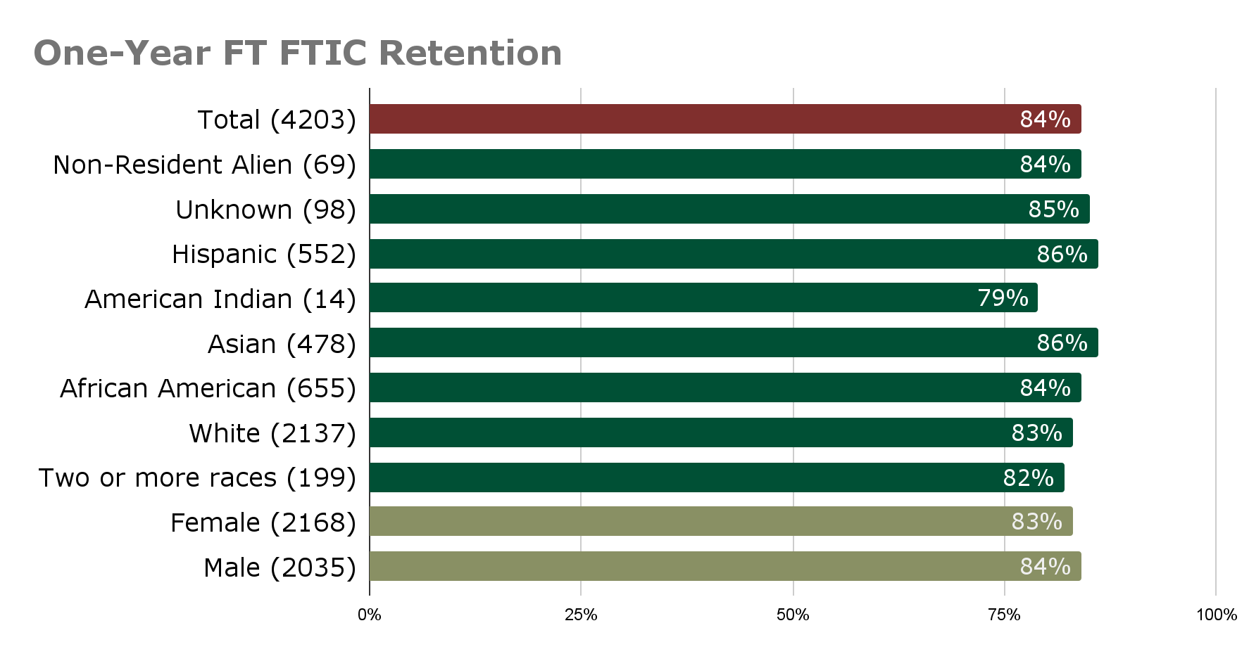
One-Year Retention: Fall 2020 FT FTIC
*Fall 20 FTIC retention was 85%

Slide 17
Continuing undergraduate enrollment
Approx 2.8% drop in undergraduate SCHs
Late push for enrollment resulted in increased retention
366 registered last August; this August--442
Advisors made progress with over 100 students in the week prior to FDOC
Last year’s FTIC were retained at a slightly lower rate - 84% compared to 85%.
Additional declines among soph, juniors and seniors.
Contributing factors to decision to not return per survey, in order:
Transferring, mental health, academic concerns, financial concerns, class availability

Slide 18
More students graduating in less time!
Graduation rates continue to increase. Both four-year and six-year rates are the highest ever and well above national averages.
Four-year graduation rate: 50%
Six-year graduation rate: 70%
AND three-year graduation rate was ~ 9%

Slide 19
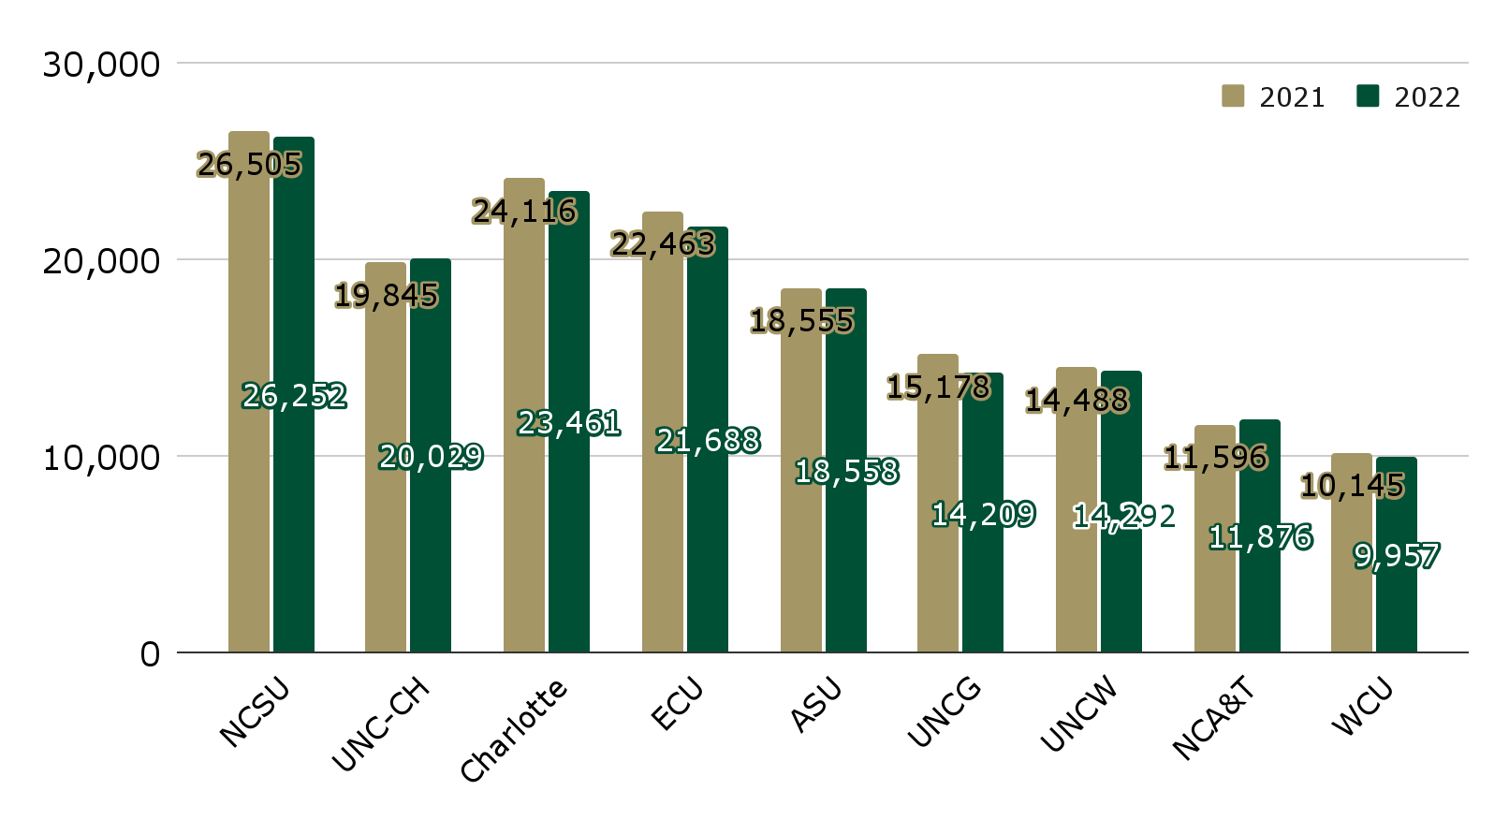
UNC System Estimates: Undergraduate (Institutions with >10K total enrollment)

Slide 20
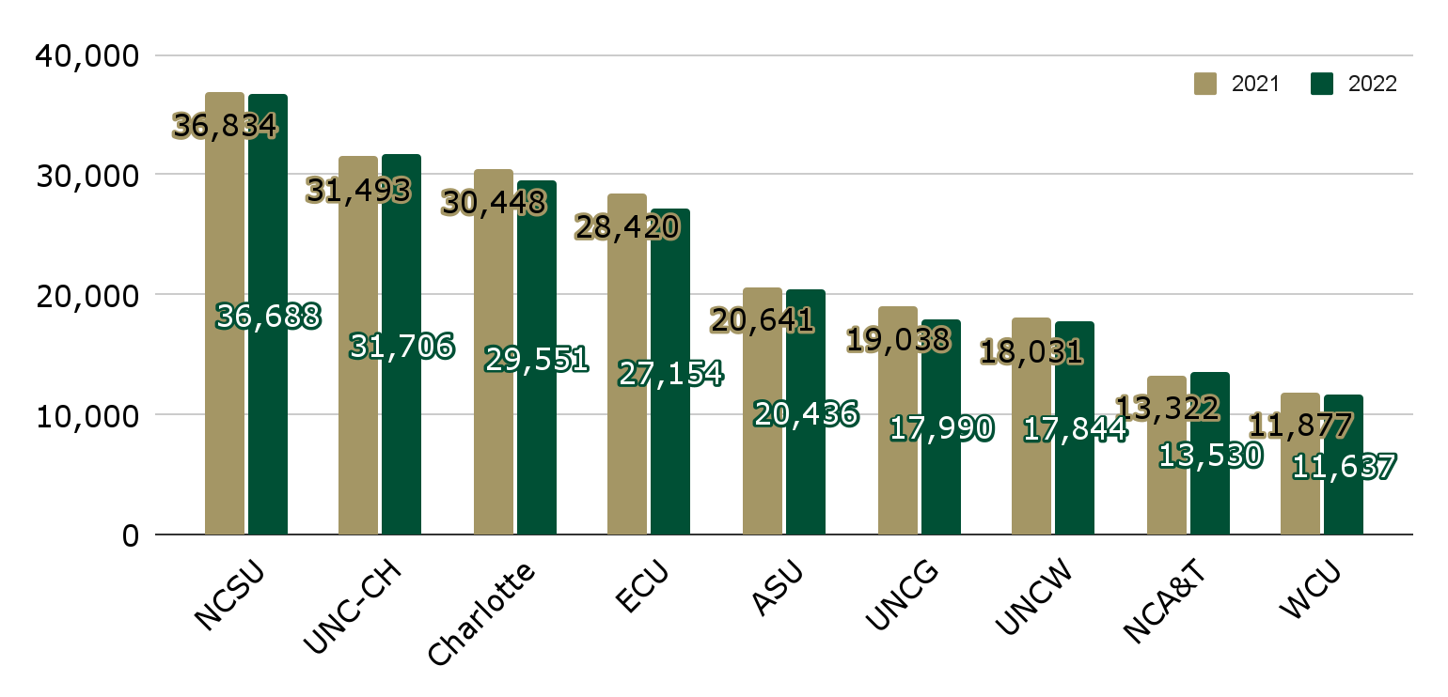
UNC System Estimates: Total Headcount (Institutions with >10K total enrollment)

Slide 21
Impact of a decline in enrollment
Financial implications are still being determined and there are several factors that impact funding. While some early estimates have been talked about, it’s important to remember that the funding considerations include enrollment as well as other performance measures where we’ve done really well! More information will be provided as it is available.

Slide 22
How can faculty support enrollment?
Enrollment is everyone’s business.
Examine and adjust seat capacities in critical courses.
Encourage students to take 15 hours.
Utilize summer and second half term to increase opportunities for students to progress.
***Please volunteer to support recruitment activities! Prospective students/families want to hear about academic programs - our majors, resources, and outcomes - and they want to hear from our faculty.

Slide 23
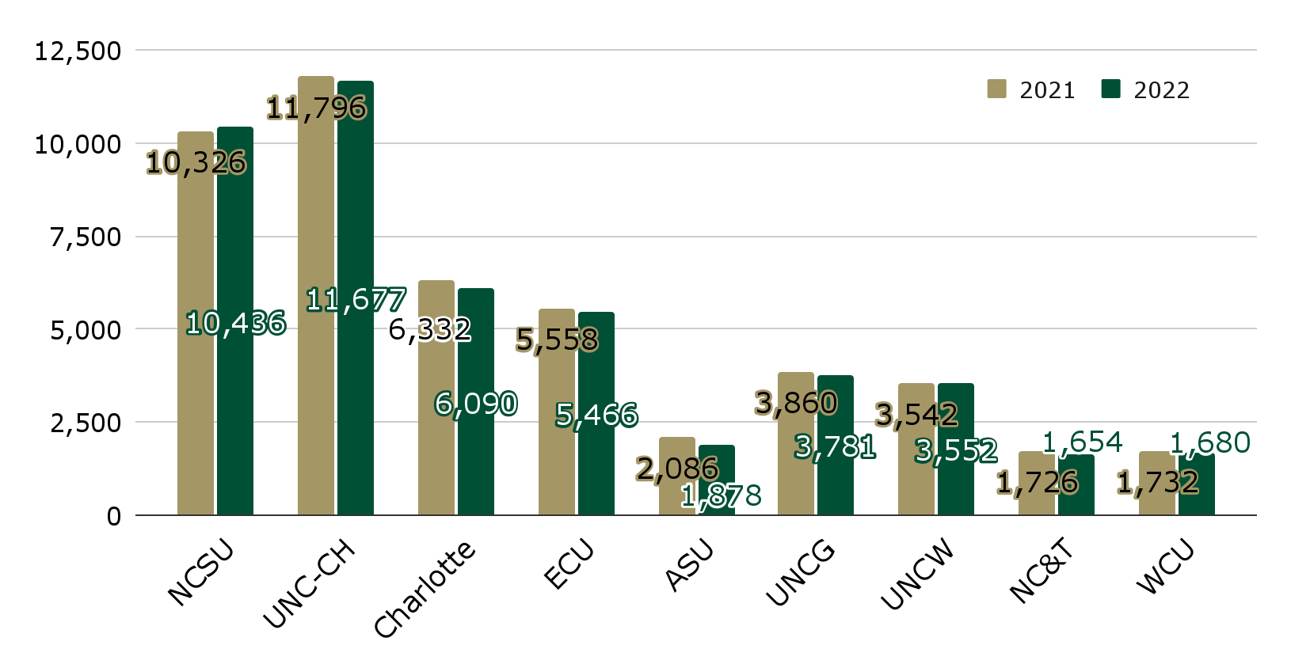
UNC System Estimates: Graduate (Institutions with >10K total enrollment)

Slide 24
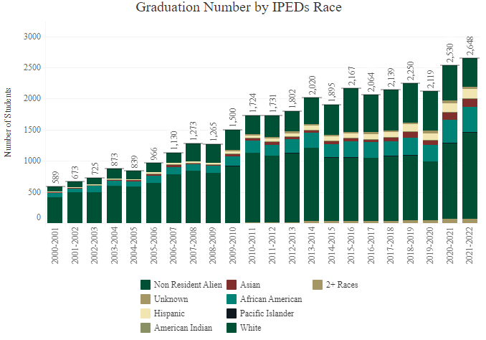
Graduate Degrees Awarded

Slide 25
Graduate Enrollment Snapshot
 | 2022 | 2021
Graduate Enrollment | 6,090 | 6,332
% of University Enrollment | 21% | 21%
Student Credit Hours | 45,605 (+352) | 45,253
Total New | 2,441 | 2,577 (2,201 in “19)
Total Continuing | 3,649 | 3,755 (3,344 in “19)
Doctoral-Research | 978 | 1,013
Doctoral-Professional | 142 | 114
Master’s | 3,854 | 3,956
Certificates | 842 | 959
Post-Master’s Certificates | 72 | 78
Post-bacs | 202 | 212
Female | 3,677 (60%) | 3,839 (61%)
Male | 2,413 (40%) | 2,493 (39%)
Underrepresented Groups | 1,853 (30%) | 1,857 (29%)

Slide 26
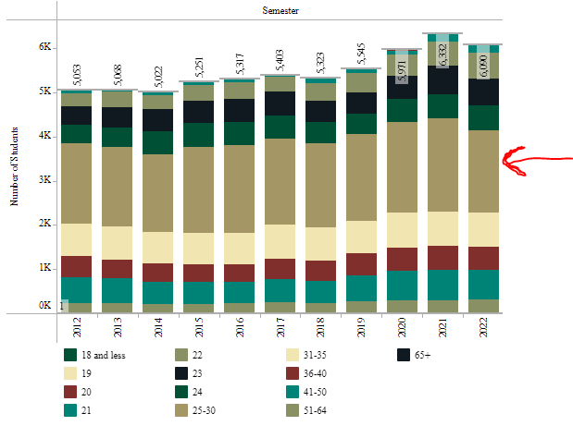
Fall Enrollment by Age
25-30 Year Olds: Lowest Since 2014
2022: 1,876
2021: 2,103
2020: 2.041
2019: 1,965
2014: 1,761

Slide 27
Graduate Program Highlights
Most significant growth:
New (+88) and continuing international (+133) master’s enrollments
Noteworthy increases:
M.S. Computer Science (+79), M.S. in Construction and Facilities Mgmt (+35), Master of Social Work (+31), M.S. in Data Science and Business Analytics (+25)
Graduate programs with enrollment over 200:
Teaching Certificate (585), Business Administration (469), Computer Science (549), Social Work (251)

Slide 28
How can faculty support graduate enrollment?
Enrollment is everyone’s business~
Determine program capacity
Create and deploy a recruitment and retention plan
Engage graduate faculty and students in enrollment efforts
Participate in information sessions, recruitment/conference fairs
Build enrollment and research pipelines with faculty at other schools
Connect with prospective students and applicants
Partner with Graduate Admissions~ We are here to help!

